Slide 1
10/01/21
Regents Chem
Atomic Theory
Dalton, Thompson, Rutherford

Slide 2
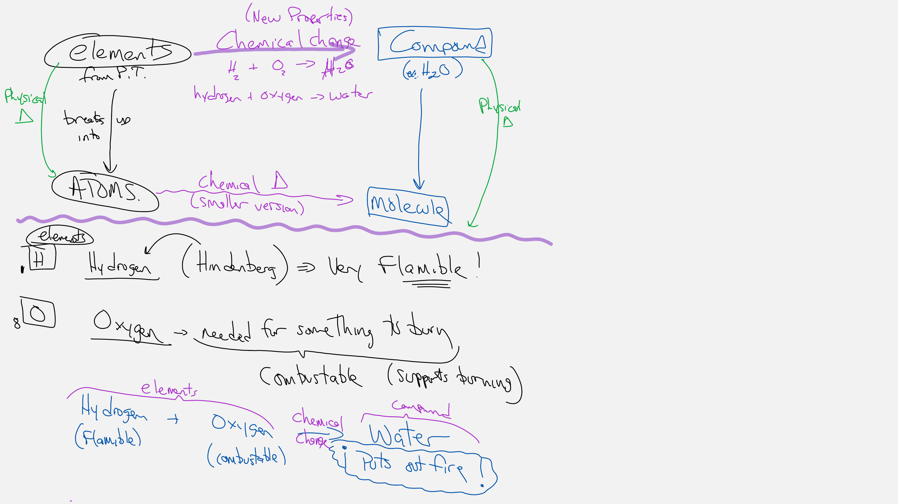

Slide 3
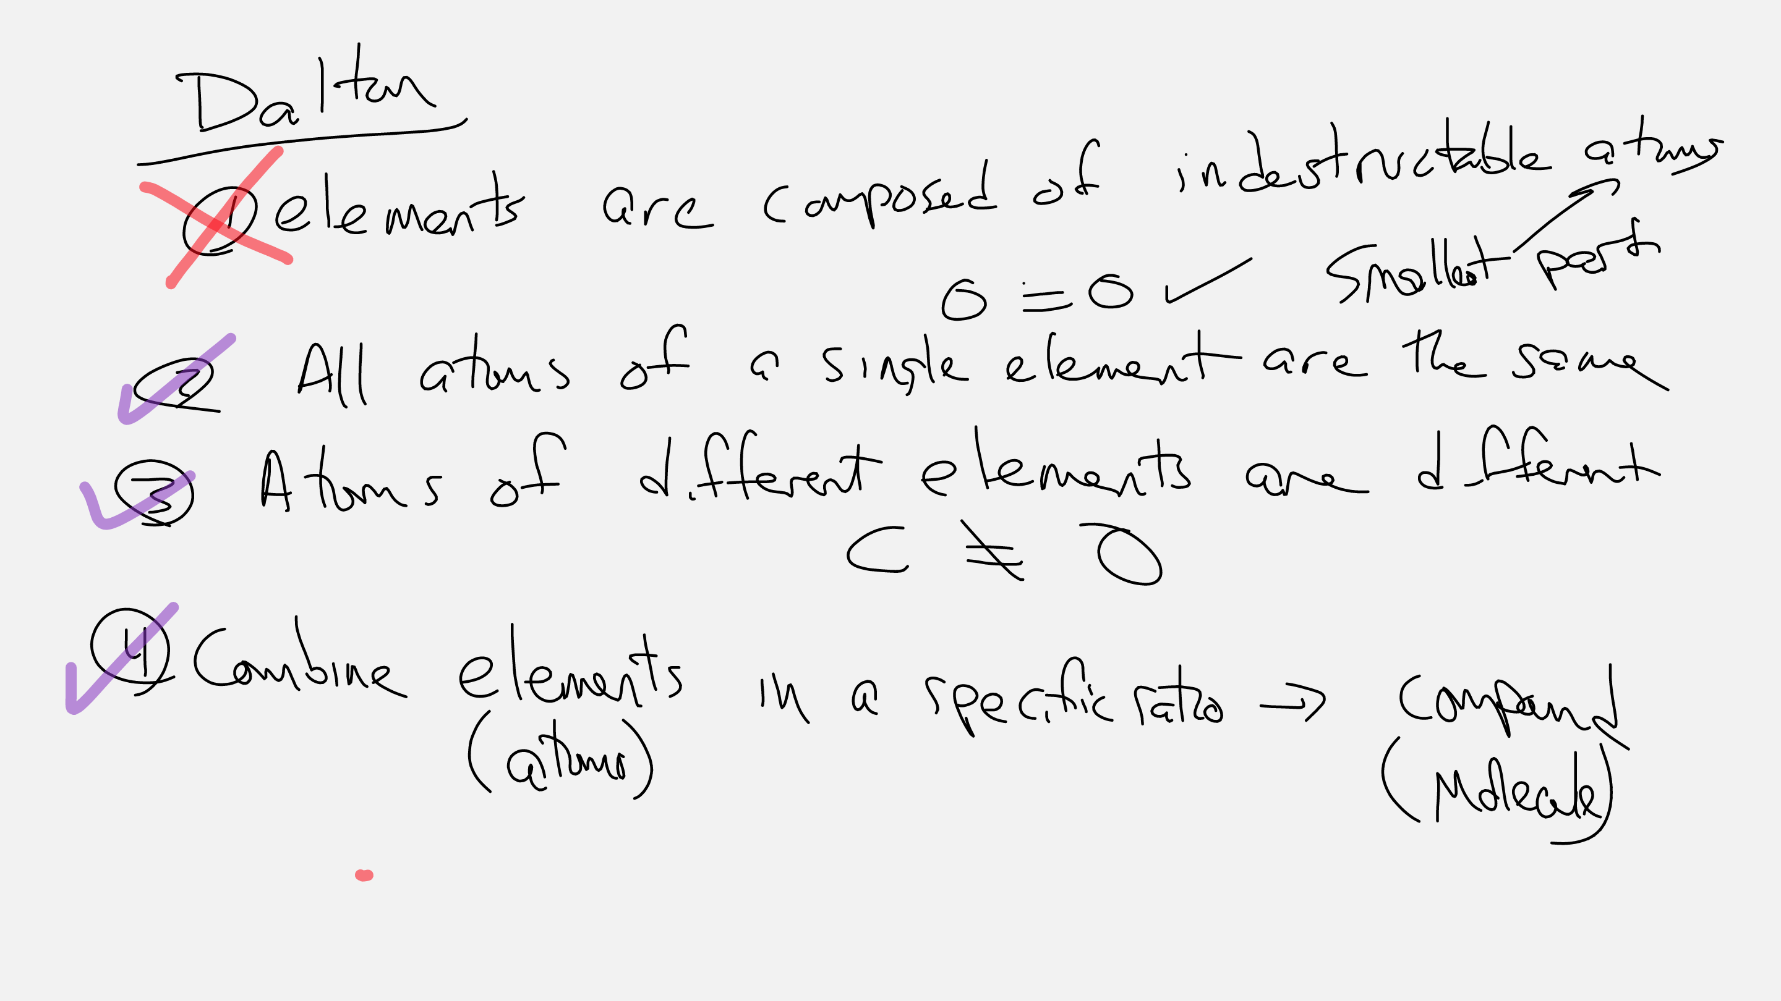

Slide 4
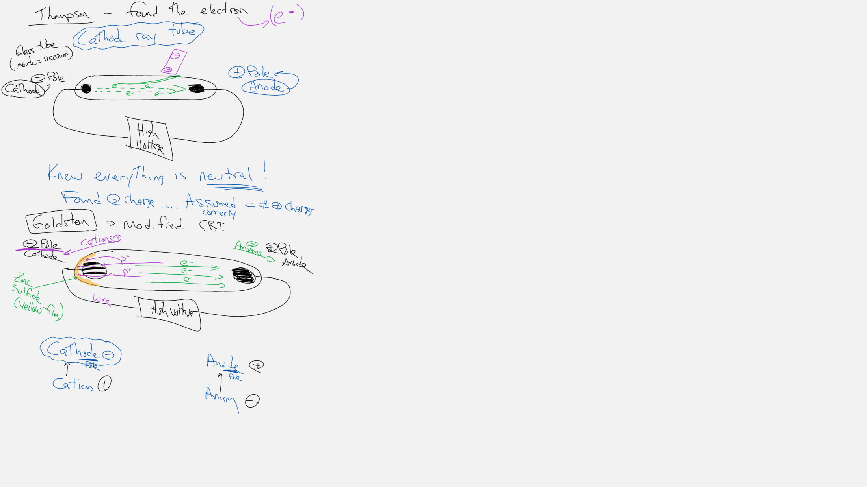

Slide 5
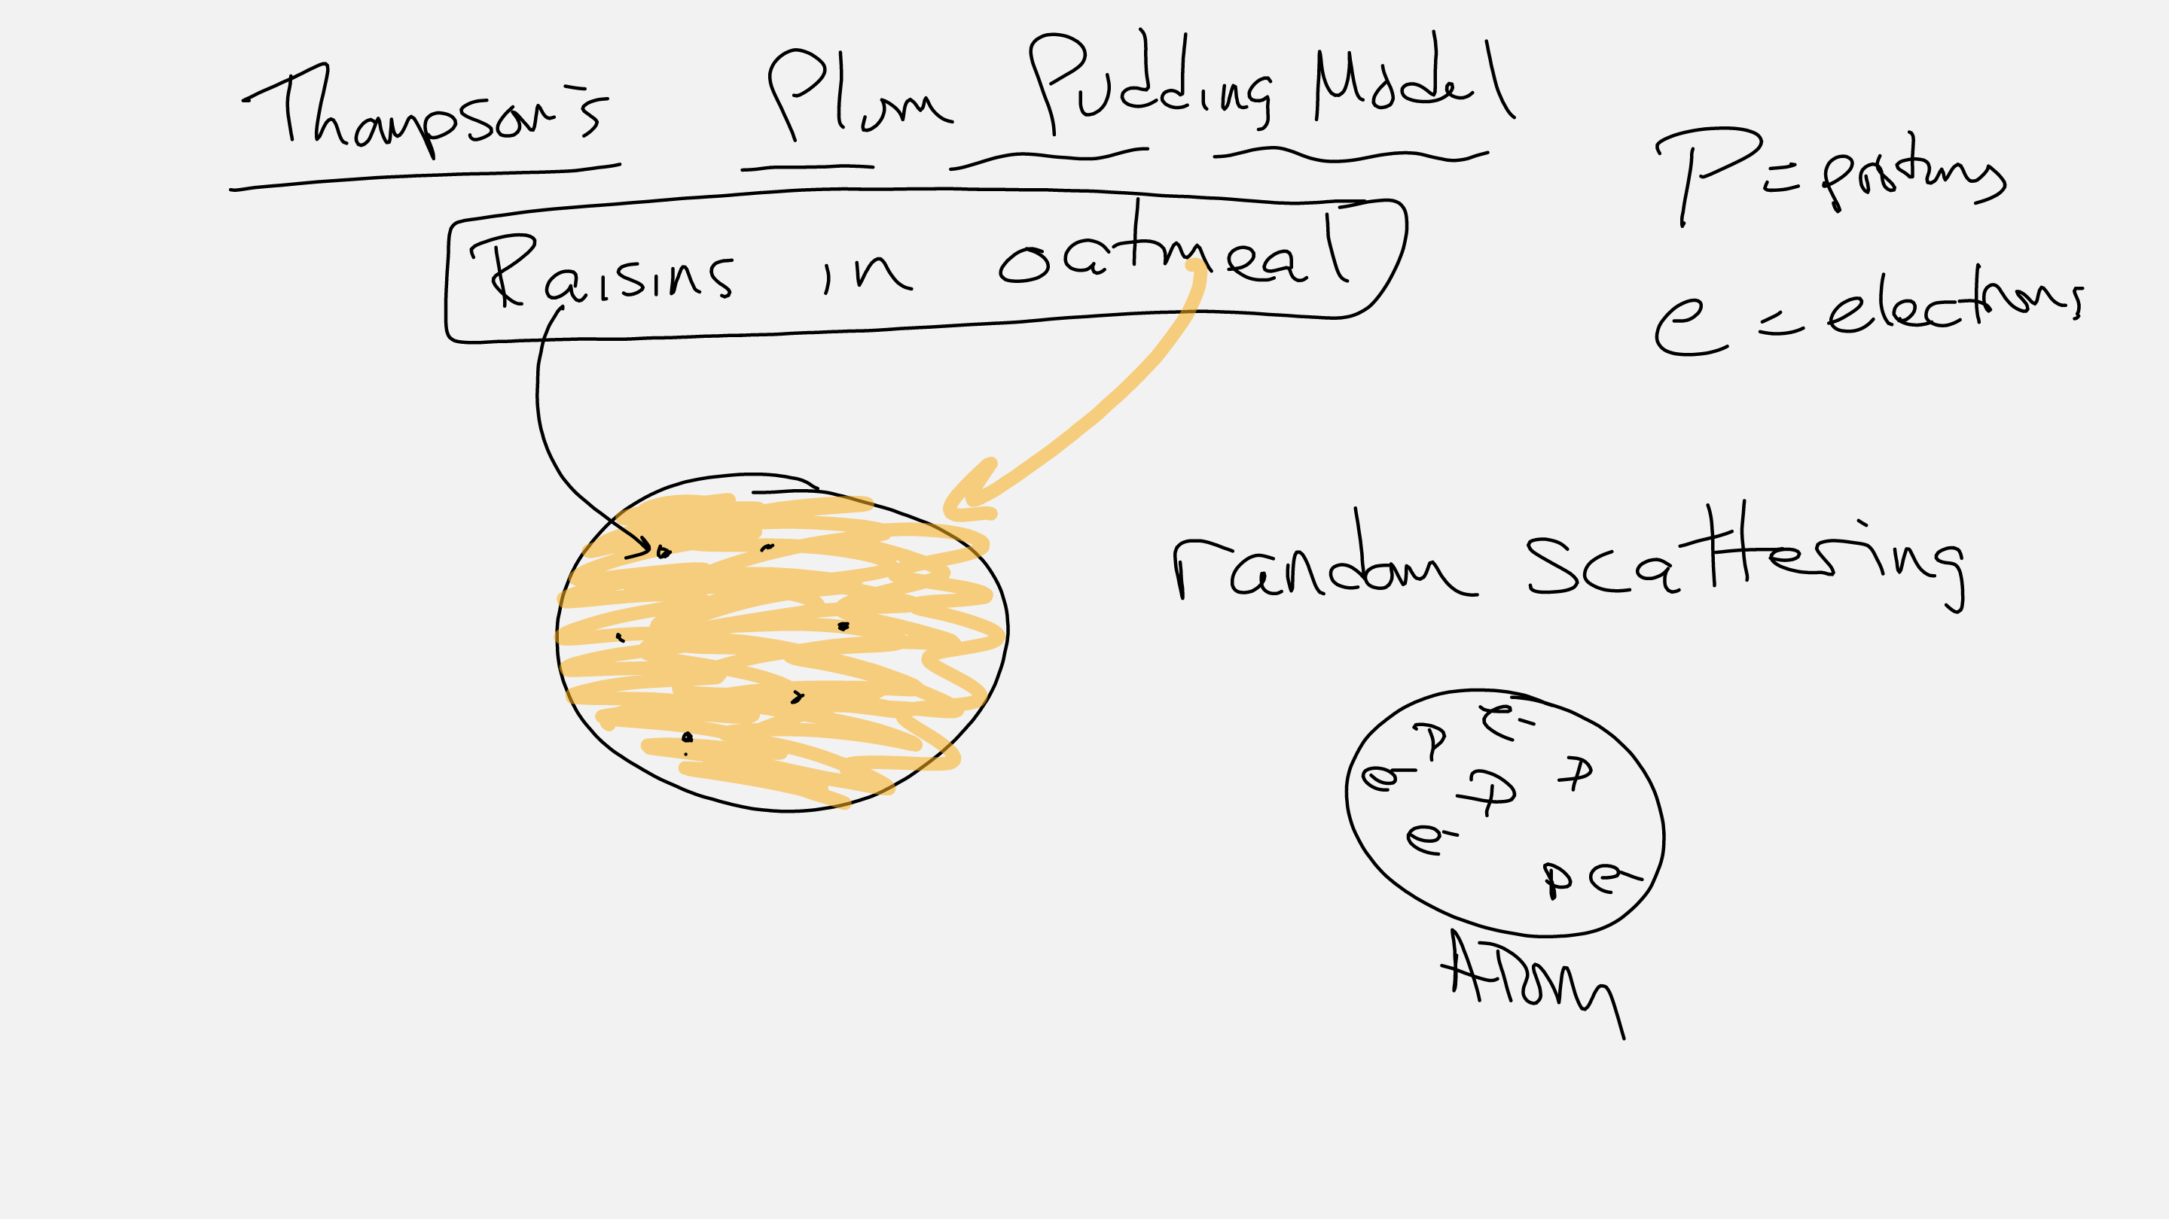

Slide 6
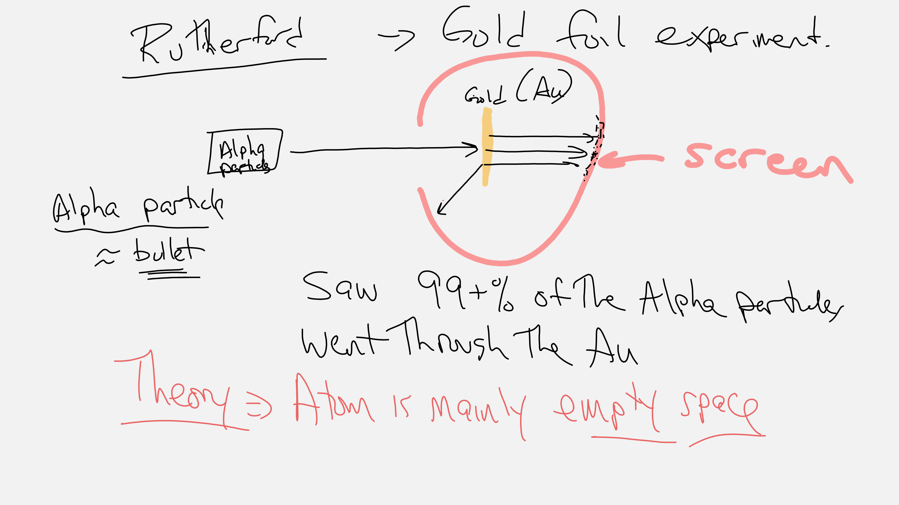

Slide 7
