Slide 1
10/04/21 SUPA Chem
3/50 HW review
Combustion analysis
Limiting reagents

Slide 2
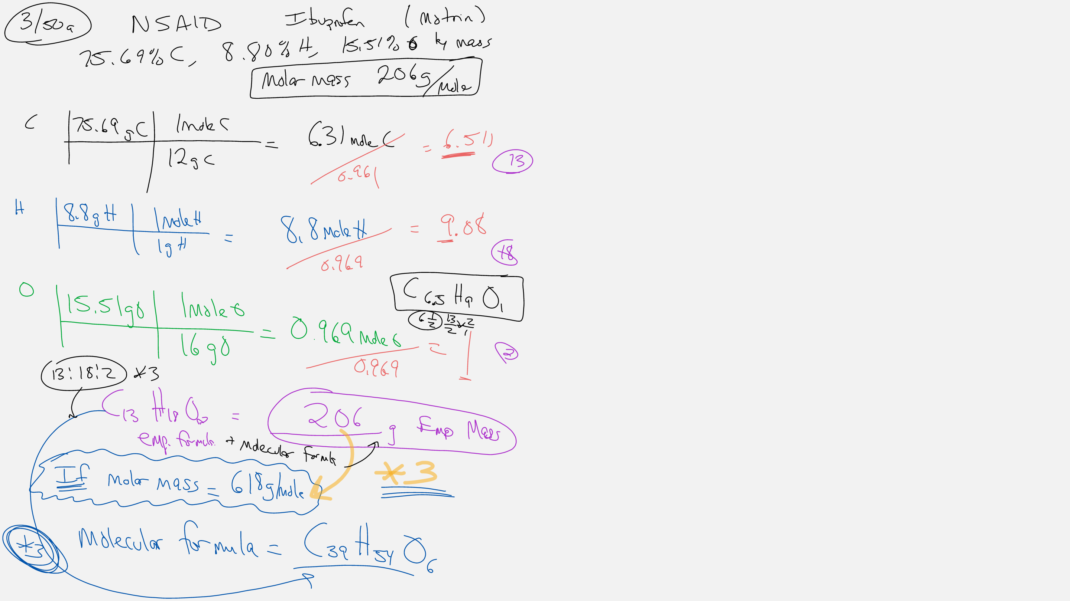

Slide 5
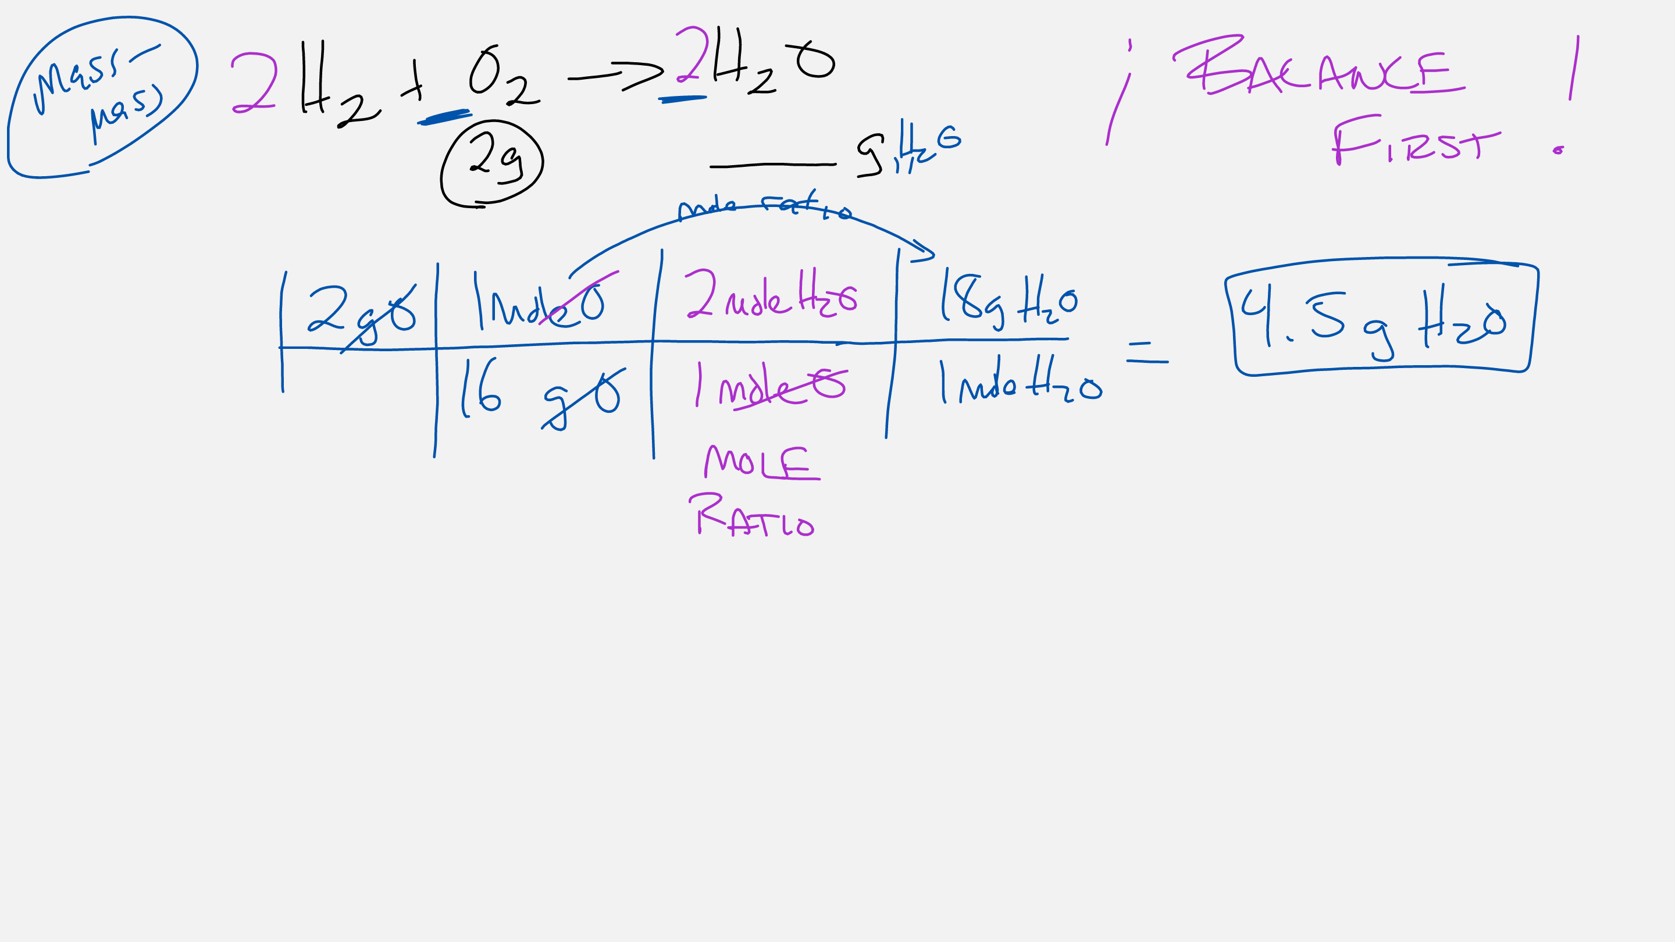

Slide 6
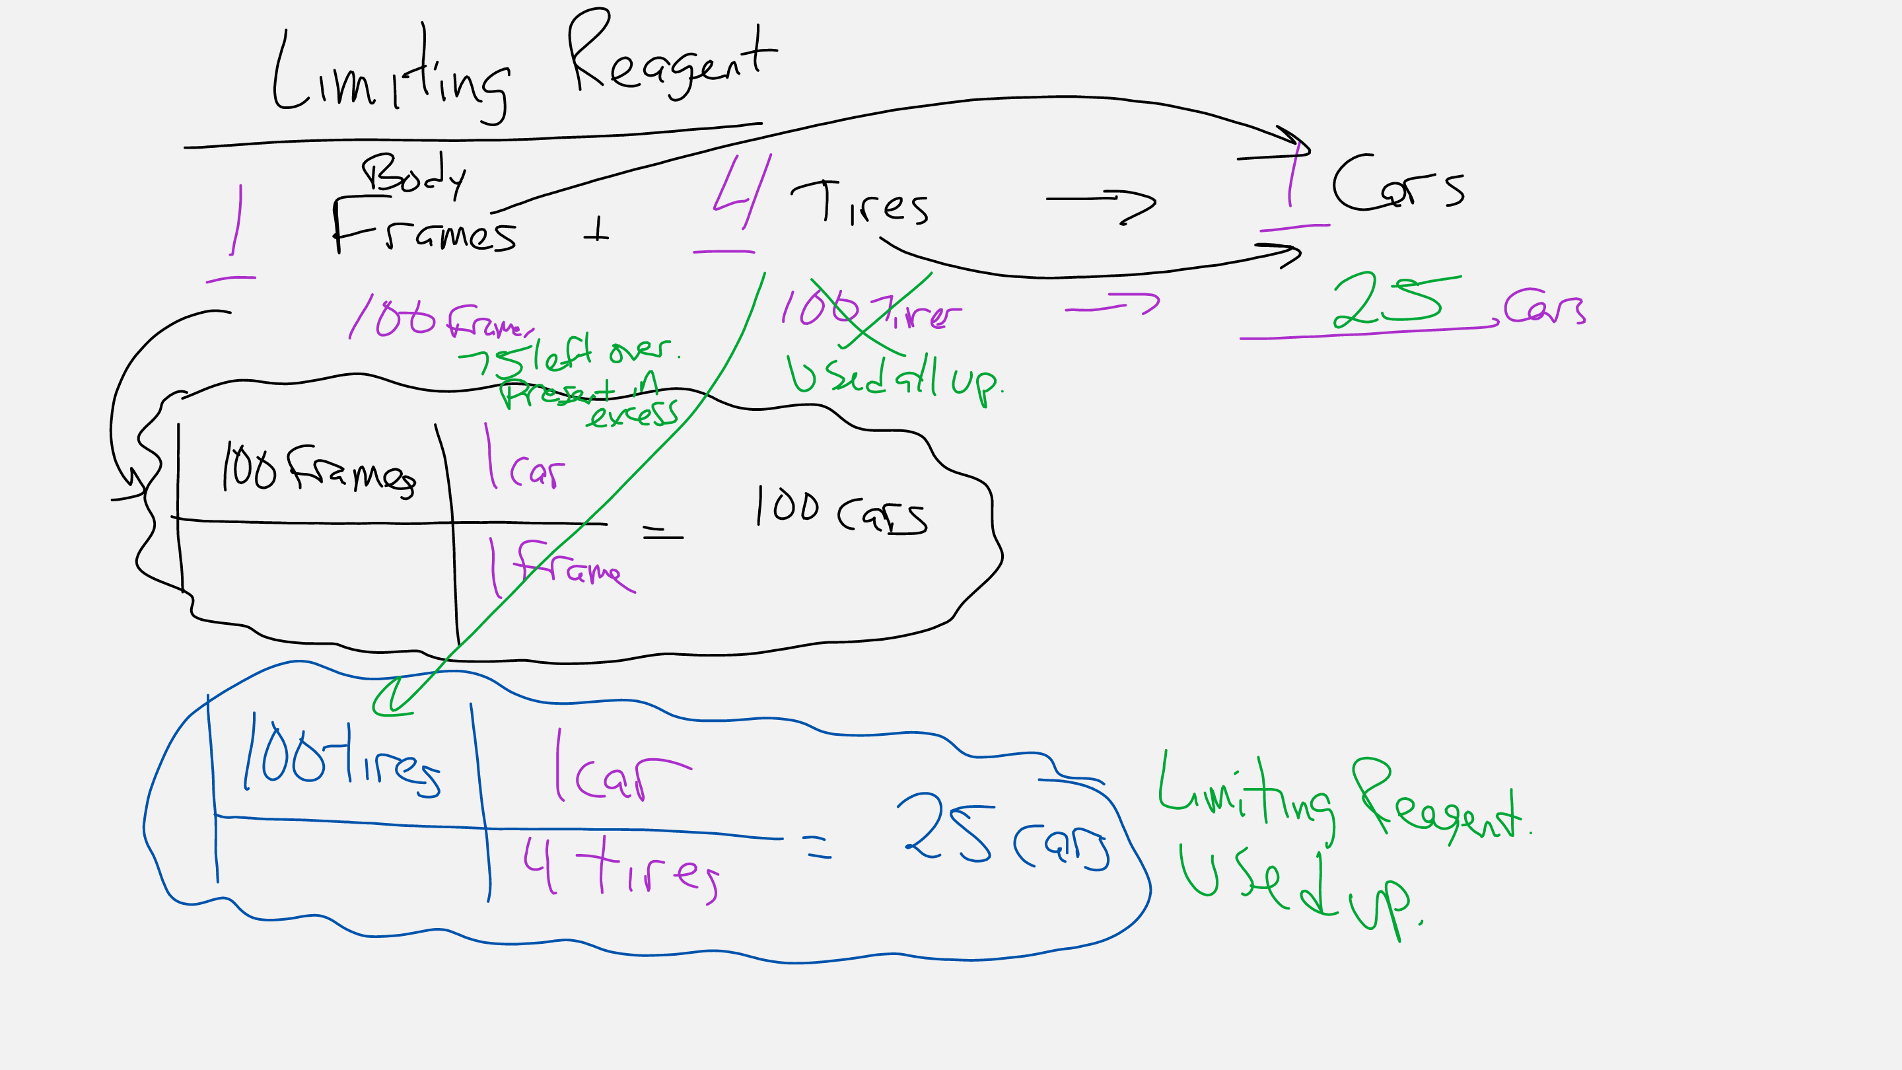

Slide 7
