Slide 1
SUPA Chem 10/05/21
Review PS 3-1

Slide 2
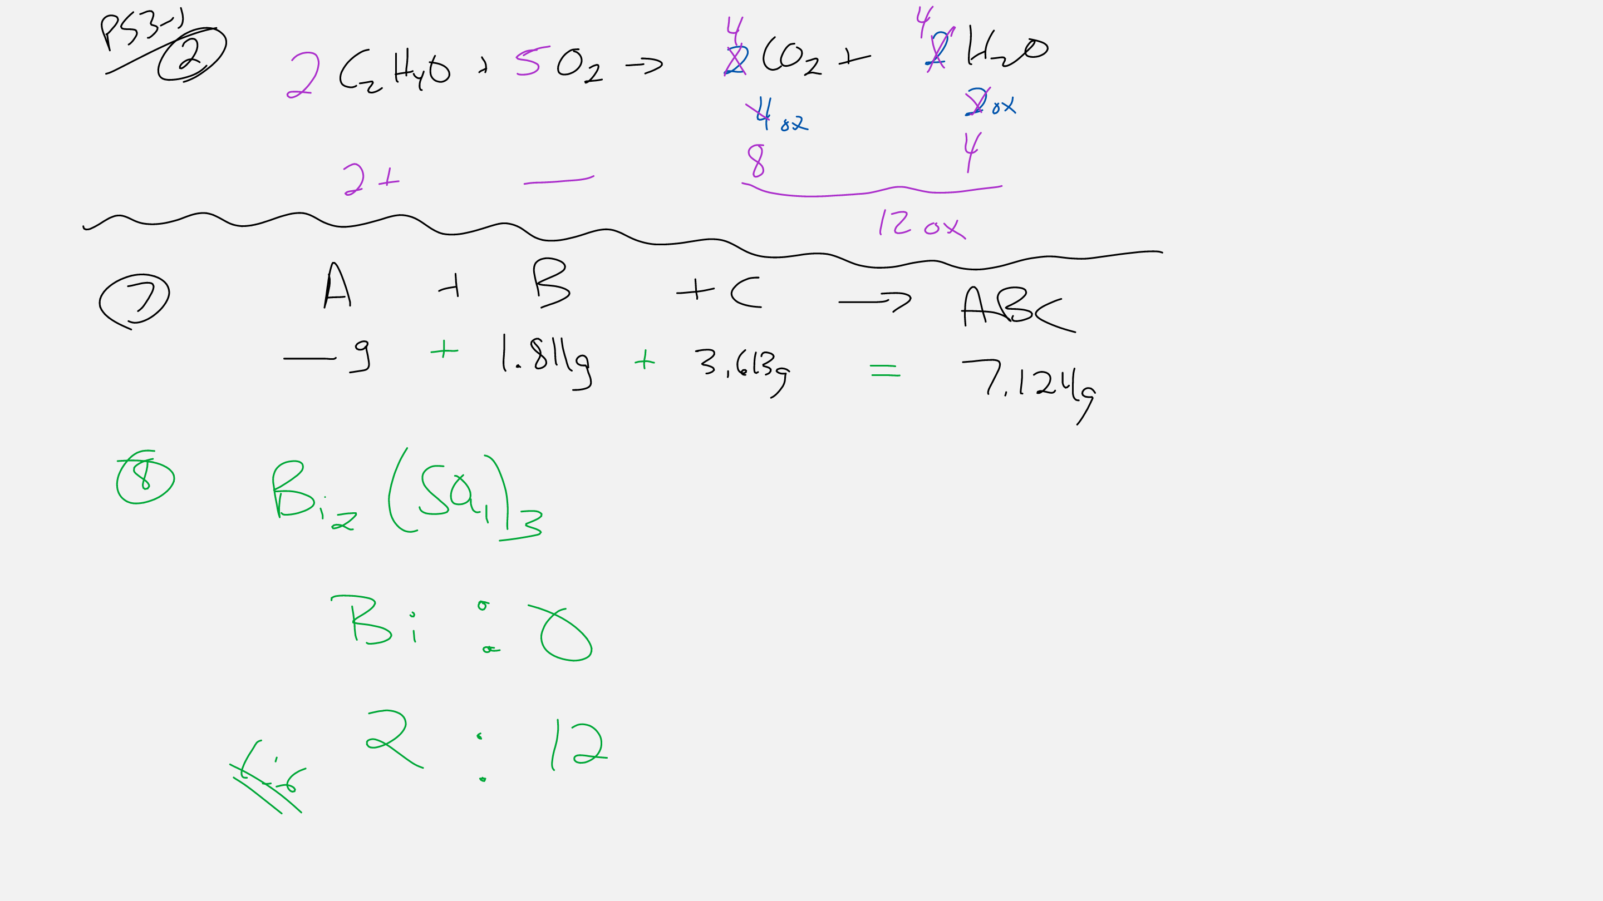

Slide 3
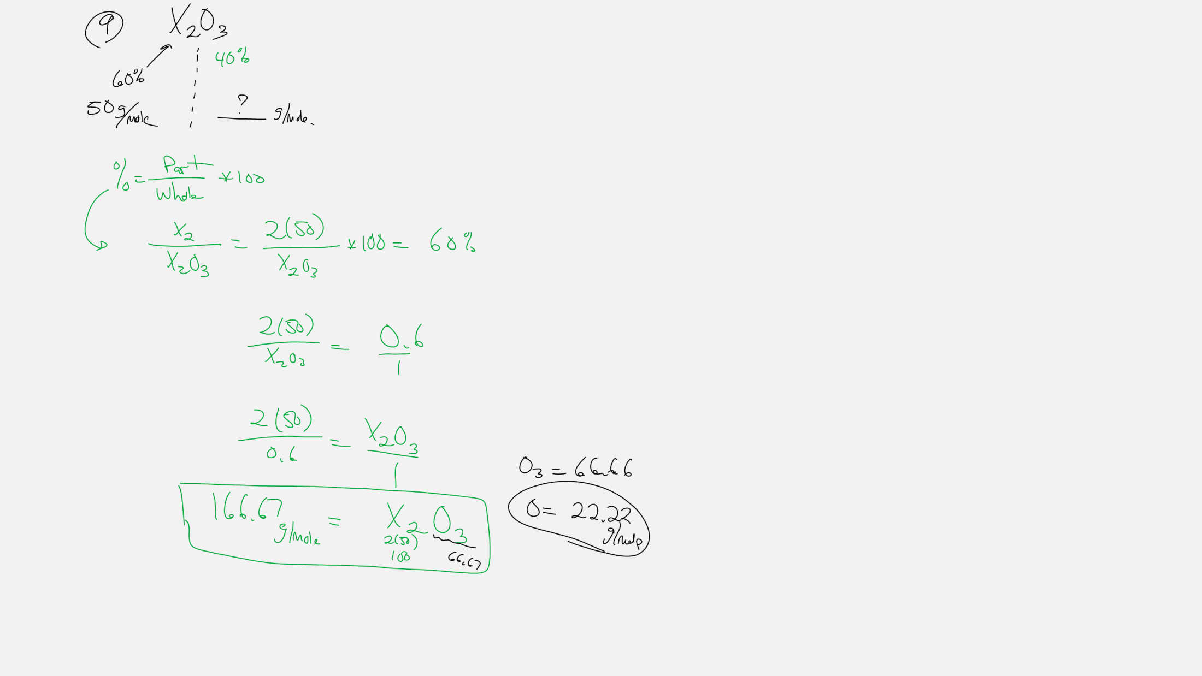

Slide 4
