Slide 1
10/06/21 SUPA Chem
Limiting Reagents
% Yield
% Error

Slide 2
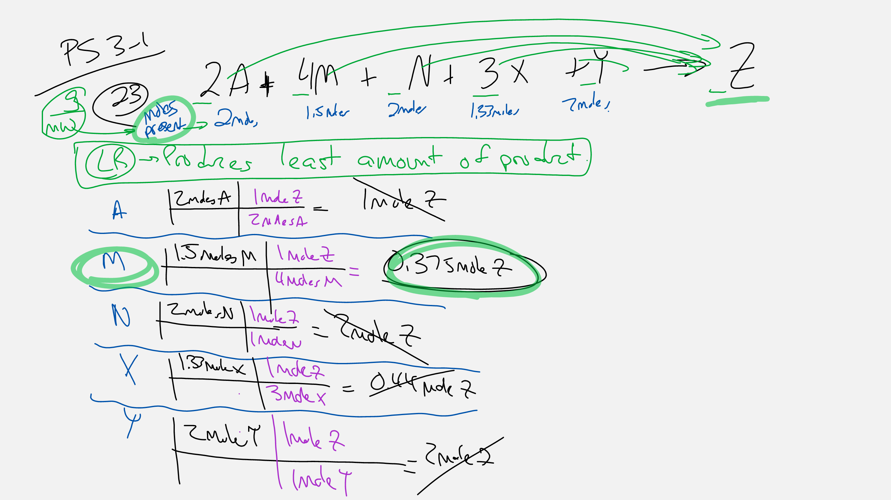

Slide 3
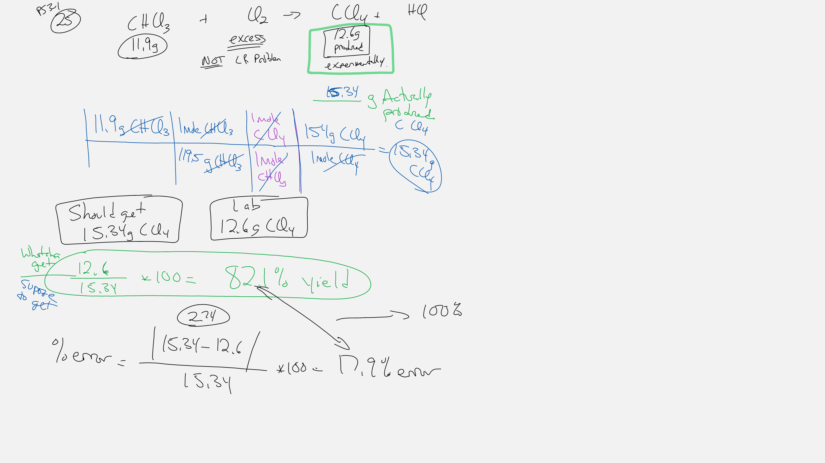

Slide 4
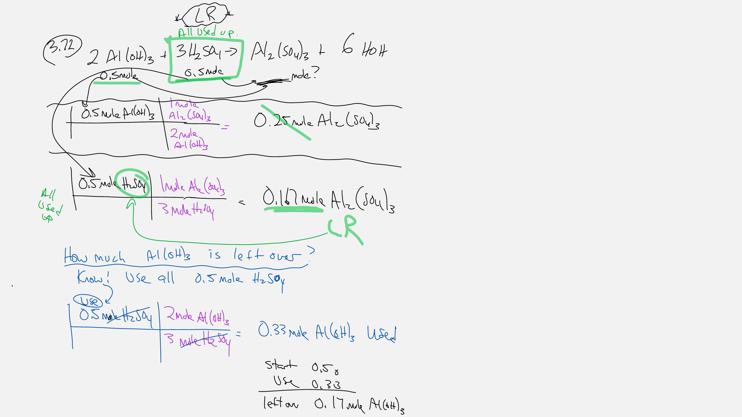

Slide 5
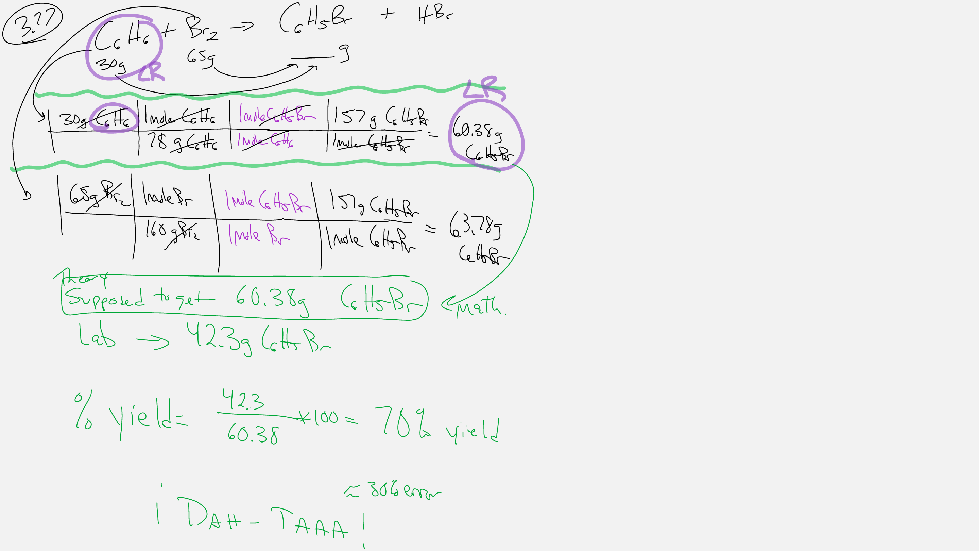

Slide 6
