Slide 1
10/08/21 SUPA chem
Review 4.62
Solubility rules
Soluble vs insoluble (Table 4.1)
Molecular, complete ionic, net ionic eqns

Slide 2
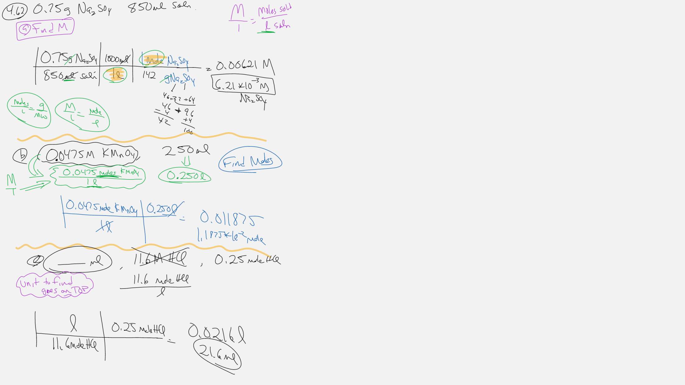

Slide 3
