Slide 1
SUPA chem 10/12/21
Net ionic eqns, PS 4-1

Slide 2
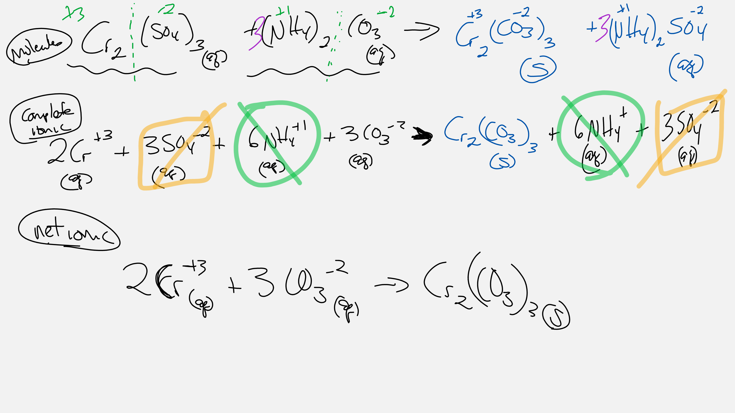

Slide 3
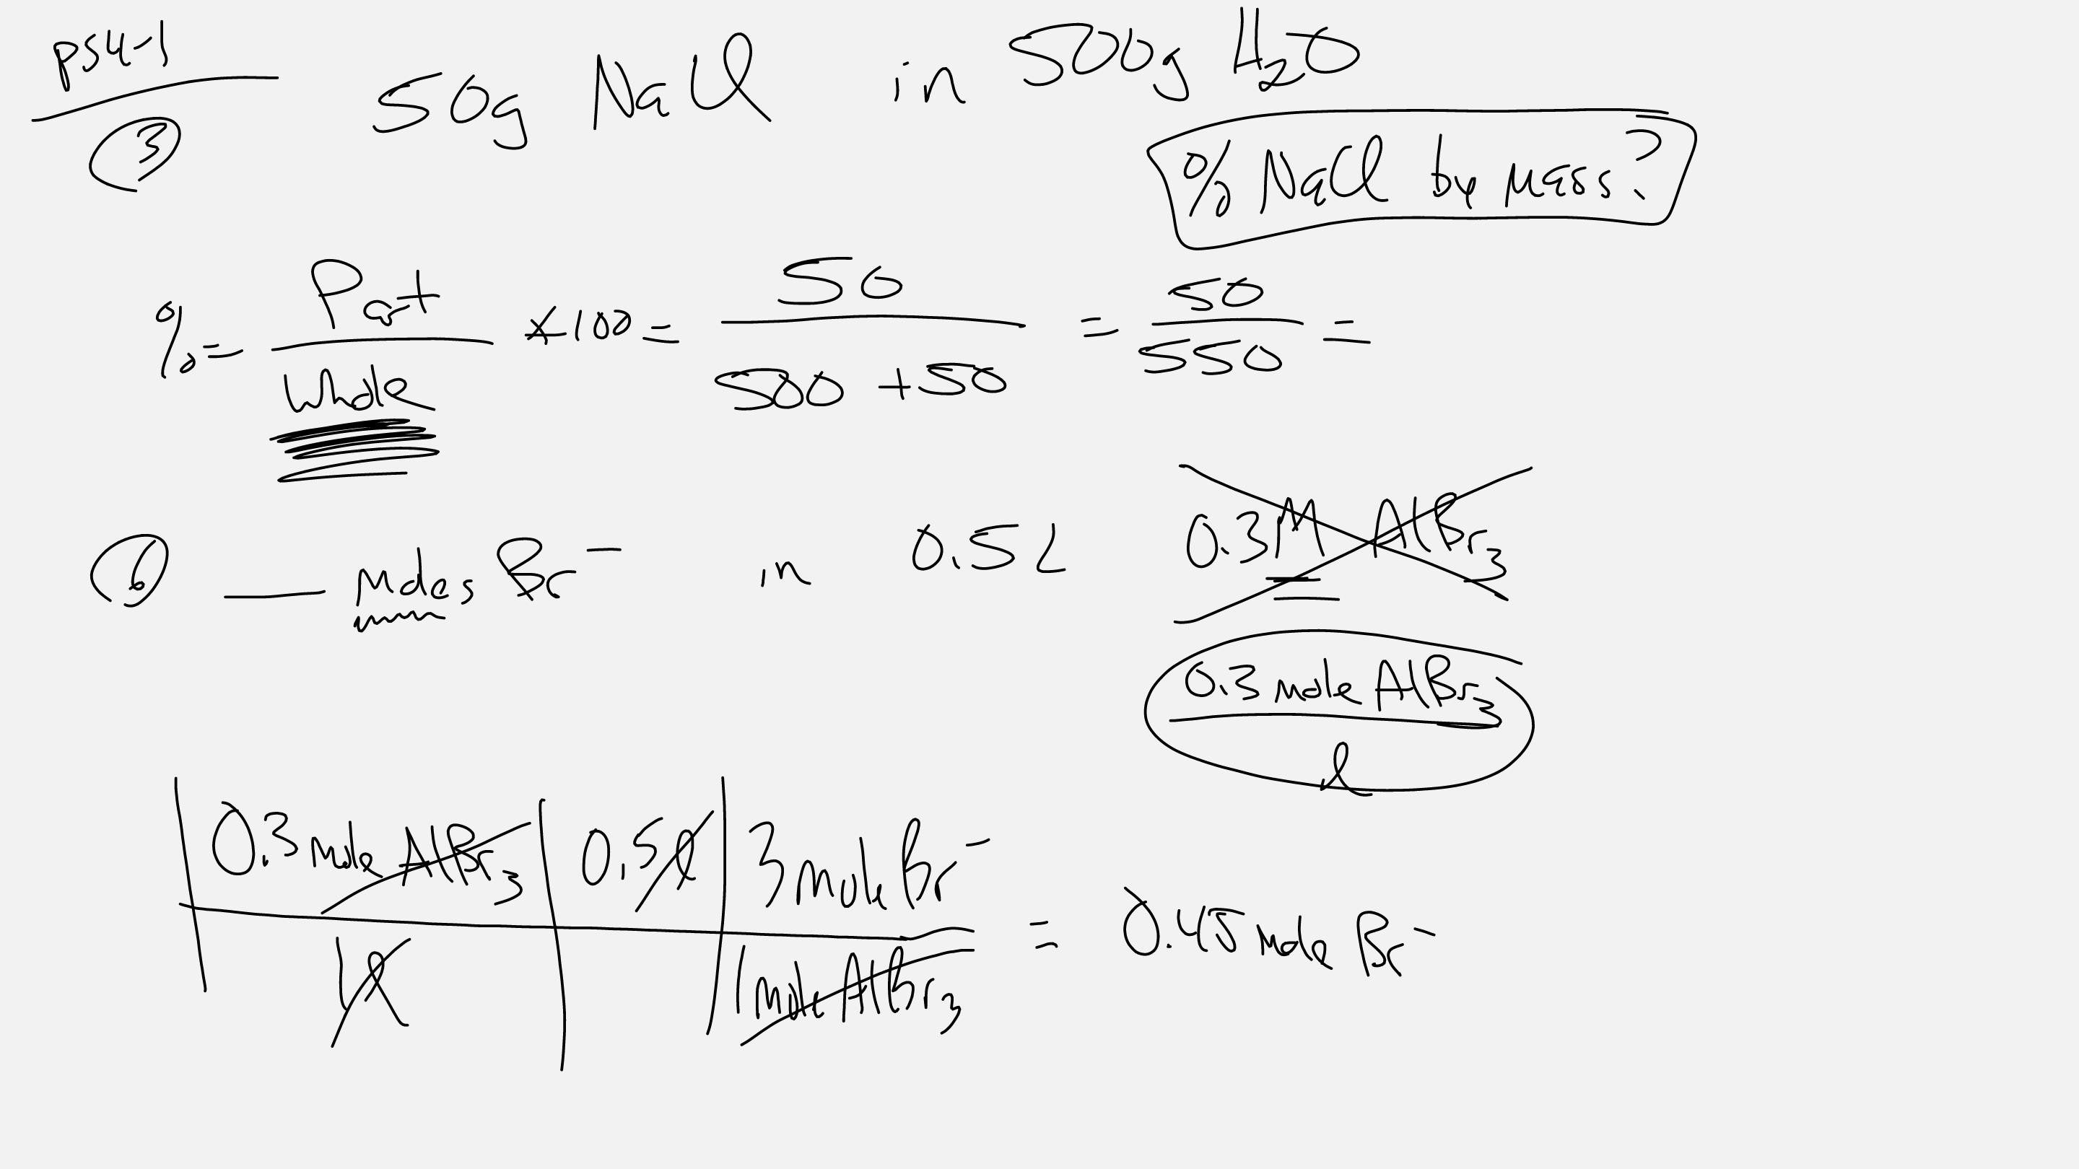

Slide 4
