Slide 1
Thursday 9/30/21
SUPA chem
Balancing types of reactions.
Stoichiometry

Slide 2
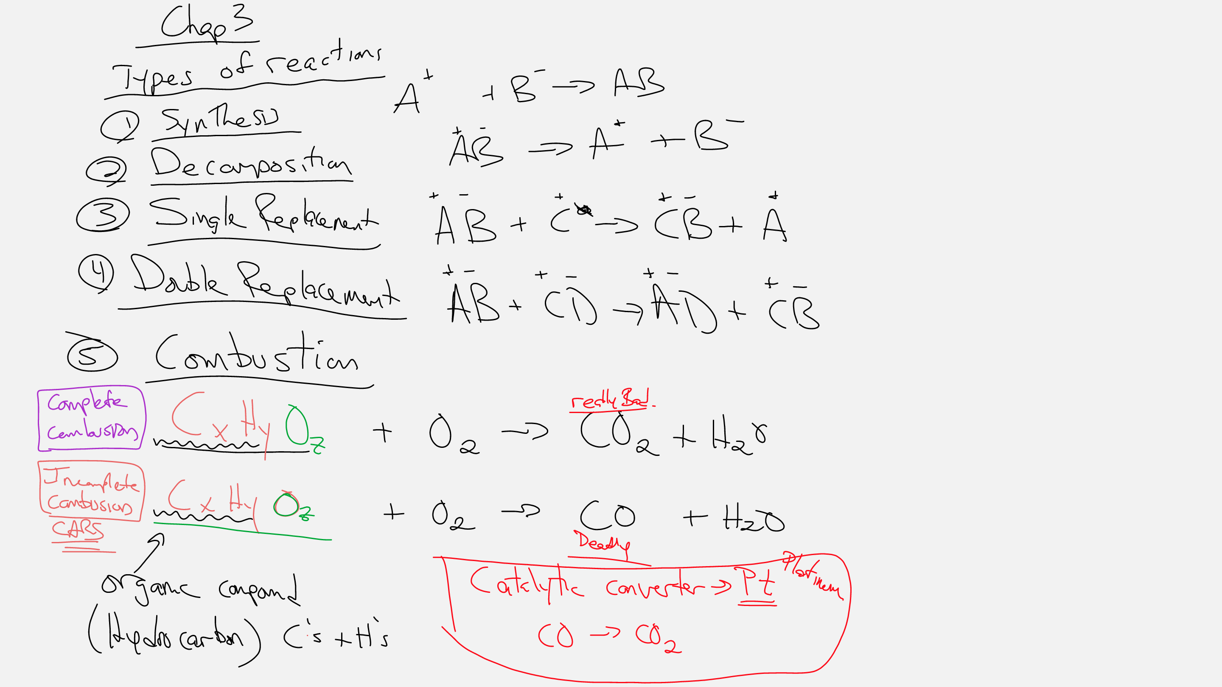

Slide 5
