Slide 1

Miranda Rights
Reem K, Madeline R, Miranda G, Emily K, & Britney F
Government 4th Hour
Mr. Baker

Slide 2

The Beginning: History of the Miranda Rights
Miranda G

Slide 3

Early life of Ernesto Miranda
Born March 9, 1941 in Mesa, Arizona
Dropped out of school in eighth grade
Didn’t get along with his father
Joined the army but didn’t stay long

Slide 4
Why we have the Miranda Rights
Ernesto got convicted of kidnapping, rape, and armed robbery.
Raped 18 year old woman and got spotted by victims brother
He confessed under police interrogation.
Signed confession saying he knew his rights.

Slide 5
Continued After Trial
During trial, found out Ernesto did not know his rights (did not have to speak or had the right to a layer)
The jury found Miranda guilty of kidnapping and rape.
He was sentenced to 20 to 30 years in jail
After jury reviewed again-they found that Miranda's Fifth Amendment right against self incrimination had been violated.

Slide 6
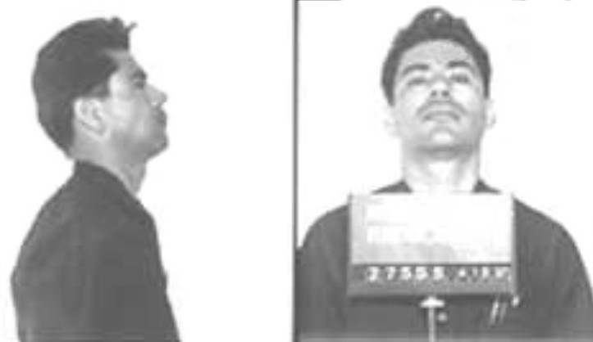
The result of not giving him his warning does not mean that he can go free
It just means they cant use the confession against him
So instead, Ernesto was convicted to 11 years in jail.

Slide 7
Miranda Rights Helping Us Now
They help protect your right against self-incrimination
We have the right not to speak unless…
Police inform you during…"You have the right to remain silent…
Ensures that(while in custody) you do not have to talk to police without an attorney present

Slide 8
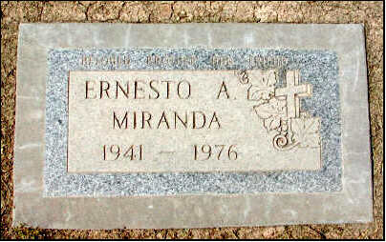
Ironic Fun Fact
Miranda was stabbed to death at a bar in 1976.
The suspect was arrested but chose to exercise his right to remain silent.
Case was dismissed and the suspect was released.
No one was ever charged for the murder.

Slide 9

The Receiving of Your Rights

Slide 10
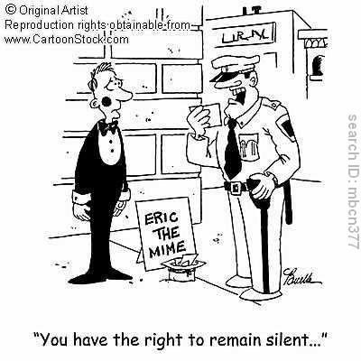
Mirandized
Police officers are required to give the suspects these rights when a suspect is officially being taken in for custody

Slide 11
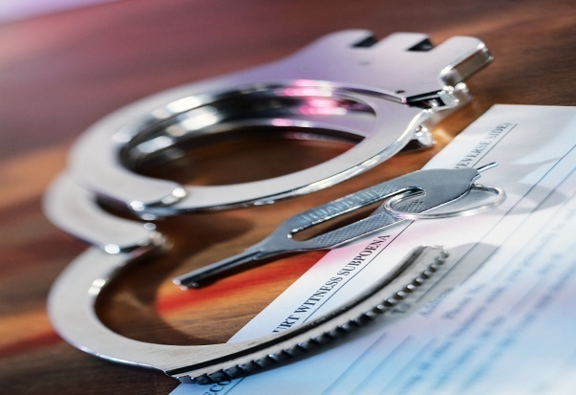
Mirandized (Continued…)
Section 504 of the Rehabilitation Act of 1973 requires police departments receiving any form of federal assistance to provide interpreters for deaf people

Slide 12

Cases Challenging the Miranda Rights

Slide 13
Illinois vs. Perkins
Perkins confessed to an undercover cop that he had committed a murder
Were Perkins' Miranda Rights violated even though he was unaware he was speaking to a cop?
Conversations between suspects and undercover cops are not protected under the Miranda Rights since they don't take place in a "police-dominated atmosphere"

Slide 14

Dickerson vs. U.S
Dickerson says he confessed involvement in a series of bank robberies prior to receiving his Miranda Rights
FBI and local detectives disagreed
The court found that Dickerson had not been read his Miranda rights before he made his statement

Slide 15
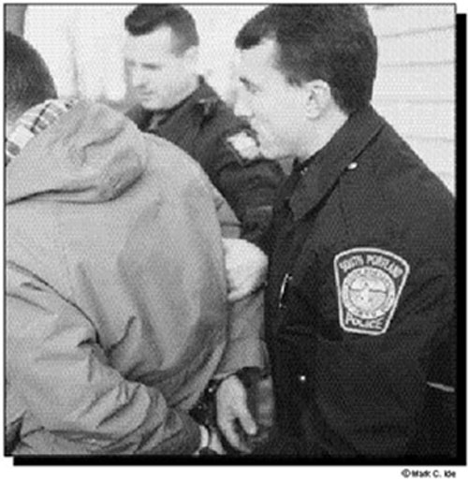
Dickerson vs. U.S (continued)
Claimed section 3501 was satisfied because Dickerson's statement was voluntary
Should Congress be able to overrule Miranda v. Arizona and its Miranda Warnings?
Since the Miranda Rights has "become a part of our national culture," it was decided that they should not be overruled

Slide 16
Harris vs. New York
Harris arrested for selling heroin to an undercover cop. Before receiving his Miranda Rights, Harris said he made the sales under the request of the officer.
Later Harris contradicted himself by testifying that he did not make those sales.
Should prosecutors be allowed to use statements made prior to receiving the Miranda Rights since at trial?
Though statements made prior to receiving the Miranda Rights couldn’t be used to convict Harris.

Slide 17

Exactly what do my rights mean?

Slide 18
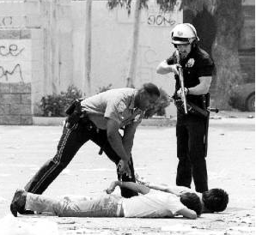
You have the right to remain Silent, Anything you say can & will be used against you.
Name, address, age, phone number, and the name of your school.
Protects your right of privacy and police can’t pressure the youth into saying something they might regret.

Slide 19
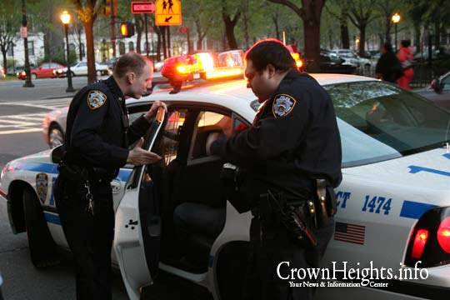
You have a right to an attorney. If you can’t afford one, one will be appointed for you.
A public defender will be provided for free.
Public defenders are paid by the government.
If you ask for a lawyer the police must stop questioning you until the lawyer is present.

Slide 20
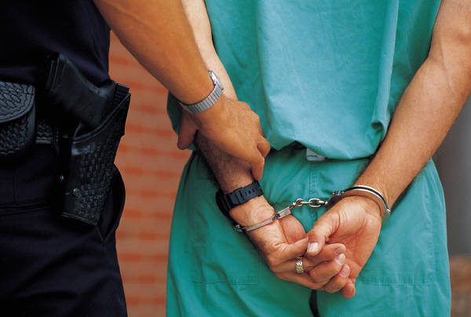
Do terrorists have Miranda Rights too?
They are considered as temporary citizens. They have the same rights as we do.
If they are not given their rights they are able to seek release as any other U.S citizen can.

Slide 21


Slide 22
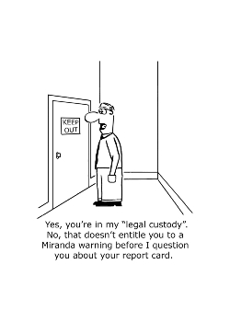
What happens if a police officer neglects to give you your Miranda Rights?
If the officer does not, then any incriminating statements made by the accused cannot be used against him.

Slide 23
What if the officer didn’t give me the Miranda Warning?
An officer is supposed to give the "Miranda warning" once he has taken a person into custody
Rights not Read then the case will not be dismissed.
But if you were interrogated after being placed in custody, those statements cannot be used against you

Slide 24
Can my Silence Be Used Against Me in Court?
When a person chooses to remain silent after receiving his Miranda warnings, that silence cannot be used against him in court
However, if a person has not received his Miranda warnings, and remains silent It is possible for that "pre-Miranda" silence to be used against him

Slide 25
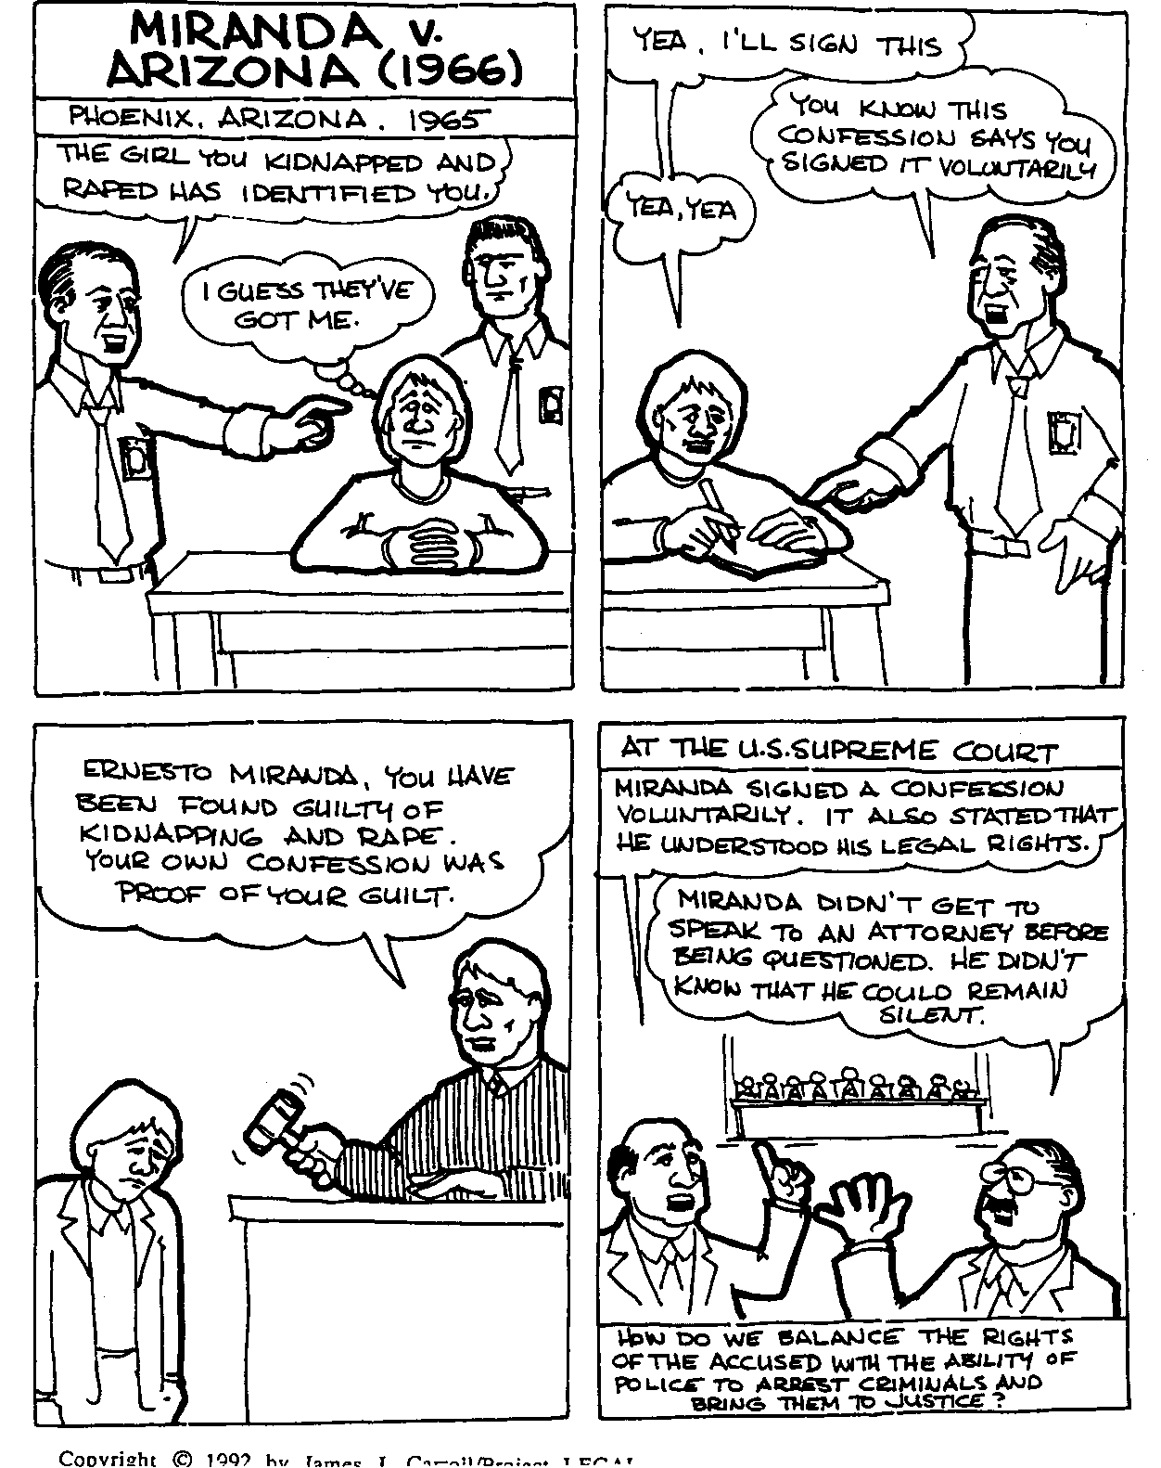
Cases in Which the Officer Neglected to Give the Miranda Rights…

Slide 26
Bibliography
http://www.expertlaw.com/library/criminal/miranda_rights.html
http://us.oyez.org/cases/1990-1999/1999/1999_99_5525
http://us.oyez.org/cases/1980-1989/1989/1989_88_1972
http://www.usconstitution.net/miranda.html

