Slide 1
Wayne Williams Case
1979 – 1981
Caught by MATH!

Slide 2
Fibers and Probability Theory
Wayne Williams Case
From 1979 to 1981, someone was killing Atlanta's youth. More than twenty-five black males, some as young as nine, had been strangled, bludgeoned or asphyxiated. A few females were killed and some children were just missing, but all potential leads turned into dead ends. The only real clue---which was valuable only if a suspect surfaced---was the presence on several of the bodies and their clothing of some kind of fiber threads. A few also bore strands of what was determined to be hair from a dog.

Slide 3
These specimens were all sent to the Georgia State Crime Laboratory for analysis, and technicians there isolated two distinct types: a violet-colored acetate fiber and a coarse yellow-green nylon fiber with the type of tri-lobed (three branch) qualities associated with carpets. They searched unsuccessfully for the manufacturer.

Slide 4
Wayne Williams Case
Since the unknown predator seemed to favor the Chatahoochee River, the police set up a stakeout.
On May 22, 1981, this strategy appeared to pay off. In the early morning hours, the stakeout patrol heard a loud splash. Someone had just thrown something rather large into the river.
On the James Jackson Parkway Bridge, they saw a white Chevrolet station wagon, and when they stopped it, they learned that the driver's name was Wayne Williams. He was a 23 year-old black photographer and music promoter. They questioned him, but when he said he'd just dumped some garbage they let him go.
(Later he would claim that he'd come there to see the stakeout, having heard about it from friends in the police force.)

Slide 5
Only two days later, the police found what they believed had been the source of the splash---the body of 27-year-old Nathaniel Cater. He was dredged up about a mile from the bridge, and despite his murderer's carefulness, a single yellow-green carpet fiber was found in his hair.

Slide 6
The police got a search warrant for Wayne Williams' home and car, and the search turned up a valuable piece of evidence: The floors of Williams' home were covered with yellow-green carpeting, and he also had a dog.
Comparisons from the samples removed from the victims showed good consistency with Williams' carpet.
Although Williams claimed to have an alibi, the description he gave of his movements the night they found him on the bridge was partly false and partly unsubstantiated. Three separate polygraph tests indicated deception on Williams' part.

Slide 7
Then FBI experts analyzed samples from his rugs. With special equipment, and in consultation with Du Pont, they managed to ascertain that the fibers came from a Boston-based textile company.
The fiber was called Wellman 181B and it had been sold to numerous carpet companies. Each uses its own dye, so that made it possible to narrow down the likely source, which was the West Point Pepperell Corporation in Georgia. Their "Luxaire English Olive" color matched that found in Wayne William's home.
There were also similarities between the hair from Williams' dog and the dog hair found on several victims.

Slide 8
Too good to be true
However, many other homes had this carpeting installed, too.
Thus, it had to be determined just how likely it was that Williams' carpeting was unique enough to persuade a jury of his connection to the murders.
The next step was calculating the odds.

Slide 9
A look into company records turned up information that they had only made that type of carpet during a one-year span of time, with over 16,000 yards of carpet distributed throughout the South.
In comparison with the total amount of carpet distributed across the country, this was a very small sample. That made the statistical probability of the carpet being in any one person's home to be slight, if it could be assumed that Luxaire English Olive had been fairly evenly distributed.
Altogether they figured that around eighty-two homes in Georgia were carpeted with Luxaire English Olive. That meant the odds were stacked against finding many homes in Atlanta: 1 in 7792.

Slide 10
To make their case, the prosecution relied on only two of the twenty-eight suspected murders---the one from the river, Nathaniel Cater, and another recovered in the same general area a month before, Jimmy Ray Payne
A single rayon fiber had been found on his shorts, which was consistent with the carpeting in Williams' station wagon.
In this second case, statistical probability was also employed. With Chevrolet's help, the investigators determined that there was a 1 in 3,828 chance that Payne had acquired the fiber via random contact with a car that had this carpeting installed.

Slide 11
Math is good
When the odds in both cases were multiplied, the law of probability that both men could have picked up these fibers in places other than Williams' home and car came out to 1 in almost 30,000,000. That seemed pretty staggering.

Slide 12
The prosecution also introduced into evidence the fibers found on the bodies of ten of the other victims (allowed in Georgia courts), which also matched those in Williams' car or home.
These, they claimed, showed a pattern, and taken altogether, it increased the odds in the fiber evidence into numbers that no one could even comprehend.
In total, there were 28 fiber types linked to Williams.
In addition, several witnesses had come forward to place Williams with some of the victims, and others claimed to have seen suspicious scratches on Williams' arms.

Slide 13
After only twelve hours, the jury returned a guilty verdict, with two life sentences. The police announced that twenty-two of the unsolved murder cases were now closed, despite the fact that there was no real proof for those victims.
Subsequently the Williams conviction has become controversial. To understand this, let's look at how fiber analysis is done.

Slide 14
Fiber Analysis
Cross transfers of fiber often occur in cases in which there is person-to-person contact, and investigators hope that fiber traceable back to the offender can be found at the crime scene, as well as vice versa.
Success in solving the crime often hinges on the ability to narrow the sources for the type of fiber found, as the prosecution did with their probability theory on the fibers in the Williams case.

Slide 15
The problem with fiber evidence is that fibers are not unique.
Unlike fingerprints or DNA, they cannot pinpoint an offender in any definitive manner. There must be other factors involved, such as evidence that the fibers can corroborate or something unique to the fibers that set them apart. For example, when fibers appeared to link two Ohio murders in the 1980s, it was just the start of building a case, but without the fibers, there would have been no link in the first place.

Slide 16
Kristen Lea Harrison
In 1982, Kristen Lea Harrison was abducted from a ball field in Ohio and her body was found six days later some thirty miles away. She had been raped and strangled.
Orange fibers in her hair looked suspiciously like those that had been found on a twelve-year-old female murder victim from eight months earlier in the same county.
Since they were made of polyester and were oddly shaped (trilobal), forensic scientists surmised that it was carpet fiber. In addition, a box found near Kristin's body and plastic wrap around her feet indicated that the killer had once ordered a special kind of van seat, but then leads dried up.

Slide 17
Kristen Lea Harrison
Some time later, a 28 year-old woman was abducted and held prisoner in a man's home. He tortured her and appeared to be intent on killing her. When he left, she escaped and reported him.
Police noticed that he had a van similar to the one into which Kristin had been forced. It proved to have orange carpeting that matched the fibers in her hair. The color was unique, which allowed scientists to trace it to a manufacturer who supplied information about its limited run.
Apparently only 74 yards of it had been shipped to that area of Ohio. That helped to narrow down possibilities. Other evidence established a more solid link and Robert Anthony Buell was eventually convicted.

Slide 18
Atlanta Child Murders
By: Ar’yea Huckabee & Darrius Brownlee
February 4, 2011

Slide 19
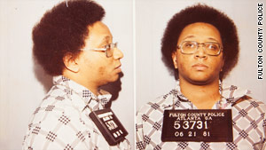
Motives
Wayne William was accused of 22 murders in Atlanta, Georgia. The string of killings happened in 1979 to 1981. Williams was only convicted of two murders and now serves two consecutive life sentences. In my opinion he was a psycho path. He killed countless children and has no remorse for it. He was out of his mind and deserves his punishment.

Slide 20
Motives
The motives of serial killers are generally placed into four categories: visionary, mission-oriented, hedonistic and power or control; however, the motives of any given killer may display considerable overlap among these categories.

Slide 21
Motives
Visionary serial killers suffer from psychotic breaks with reality, sometimes believing they are another person or are compelled to murder by entities such as the devil or god. The two most common subgroups are demon mandated and God mandated

Slide 22
Motives
Mission-oriented killers typically justify their acts as "ridding the world" of a certain type of person they perceive as undesirable, such as homosexuals, prostitutes, or people of different ethnicity or religion; however, they are generally not psychotic.

Slide 23
Motives
The main objective for this type of serial killer is to gain and exert power over their victim. Such killers are sometimes abused as children, leaving them with feelings of powerlessness and inadequacy as adults. Many power- or control-motivated killers sexually abuse their victims.

Slide 24
Fibers and Probability Theory
Wayne Williams Case
From 1979 to 1981, someone was killing Atlanta's youth. More than twenty-five black males, some as young as nine, had been strangled, bludgeoned or asphyxiated. A few females were killed and some children were just missing, but all potential leads turned into dead ends. The only real clue---which was valuable only if a suspect surfaced---was the presence on several of the bodies and their clothing of some kind of fiber threads. A few also bore strands of what was determined to be hair from a dog.

Slide 25
These specimens were all sent to the Georgia State Crime Laboratory for analysis, and technicians there isolated two distinct types: a violet-colored acetate fiber and a coarse yellow-green nylon fiber with the type of tri-lobed (three branch) qualities associated with carpets. They searched unsuccessfully for the manufacturer.

Slide 26
Victims
Police accused Williams of 22 murders. His victims range from age 7 to 28. He was only charged with two murders, Nathaniel Cater and Jimmy Ray Payne. Alfred Evans, Yusef Bell, Eric Middlebrooks, and Christopher Richardson, are just four of the victims whose cases are closed. This picture shows the victims who died during the several killing of Mr. Williams.

Slide 27
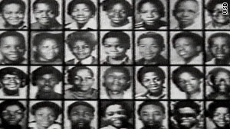
Victims

Slide 28
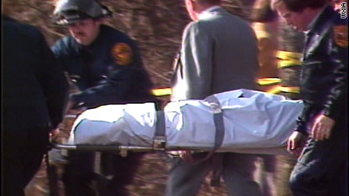
Victims
This is the beginning of a serial killer.

Slide 29
Evidence
Physical evidence was being gathered from the corpses of the victims.
The FBI secretly profiled that the killer would dump the next victim into a body of water to remove any evidence

Slide 30
Evidence
Detectives got the first major break in the case when an officer heard a splash in the water beneath the bridge.
Detectives saw a white 1970 Chevrolet station wagon slowly driving away from the bridge.
The car was later identified as William Wayne’s parents’ car.

Slide 31
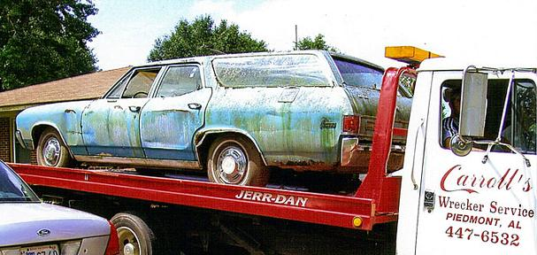
Evidence
Dog hair and fiber evidence recovered from the rear of the vehicle were later major factors in the police building a case against Williams. This is the 1972 clunker once belonged to Wayne Williams.

Slide 32

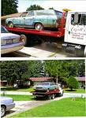
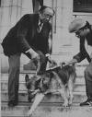

Evidence

Slide 33
Evidence
In all, investigators found 28 fiber types from nineteen items in Williams' house and car on the bodies of the murder victims.
However, no hair or fiber evidence from the victims was found in Williams' residence or vehicle.
Several witnesses testified to seeing Nathaniel Cater alive after Williams was detained on the Jackson Parkway Bridge.

Slide 34
Evidence
Others swore they had seen Williams with both Cater and Payne, even though the defendant swore he did not know either one of the victims.
The prosecution portrayed Williams as a homosexual with a "Jekyll and Hyde" personality who despised his own race.

