Slide 1
Bertillon Method
Introduced by French police expert Alhonse Bertillon in 1883
Called Bertillon system
Relied on a detailed description (portrait parle) of the subject, combined with full length and profile photographs and system of precise body measurement (anthropometry)

Slide 2
Anthropometry
Rested on the premise that the dimensions of the human bone system remained fixed from the age of 20 until death
It was thought that no 2 skeletons could have the same measurements
11 measurements of the human anatomy was recommended
Height, reach, width of head, length of left foot

Slide 3
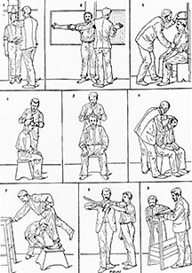

Slide 4
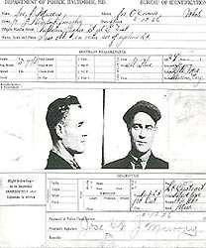
A Bertillon "booking" Card

Slide 5
What happened to Bertillon in 1903?
In 1903, a prisoner by the name Will West was sentenced to incarceration at the United States Penitentiary at Leavenworth, Kansas.
During his in processing, the records clerk obtained Will West's Bertillon measurements and photograph.
Will West denied ever being incarcerated at the facility.

Slide 6
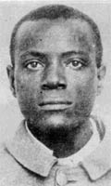
Will West's Bertillon Measurements 178.5; 187.0; 91.2; 19.7; 15.8; 14.8; 6.6; 28.2; 12.3; 9.7

Slide 7
The records clerk, having referenced his Bertillon measurements into the system, retrieved the Bertillon card for a William West.
Will West denied that the William West card was his.
Subsequent investigation disclosed that William West had previously been incarcerated in the facility until September 9, 1901.

Slide 8
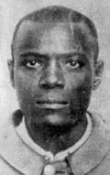
William West's Bertillon Measurements 177.5; 188.0; 91.3; 19.8; 15.9; 14.8; 6.5; 27.5; 12.2; 9.6; 50.3

Slide 9
William West Will West

Slide 10
By examining the photographs, one can see the failure of the Bertillon system.
Compare the Bertillon measurements in particular, keeping in mind the various factors that would affect the measurements.
This failure strengthened the science of fingerprints as the normally accepted method of personal identification.
The authorities compared their fingerprints and determined that Will West was not the previously recorded William West

Slide 11
Bertillon system was considered most accurate for 2 decade
In the 1900’s a new system of classification of finger ridge patterns emerged, known as fingerprints
Fingerprints are the pillar of modern criminal identification

Slide 12
Dactyloscopy The study of fingerprints
Historically
William Herschel—required Indians to put their fingerprints on contracts, and also as a means of identifying prisoners
Henry Faulds—claimed that fingerprints did not change over time and that they could be classified for identification
Alphonse Bertillon—proposed body measurements as a means of identification; termed anthropometry
Francis Galton—developed a primary classification scheme based on loops, arches and whorls.
Edward Richard Henry—in collaboration with Galton instituted a numerical classification system
Juan Vucetich—developed a fingerprint classification based on Galton’s that is used in Spanish-speaking countries

