Slide 1
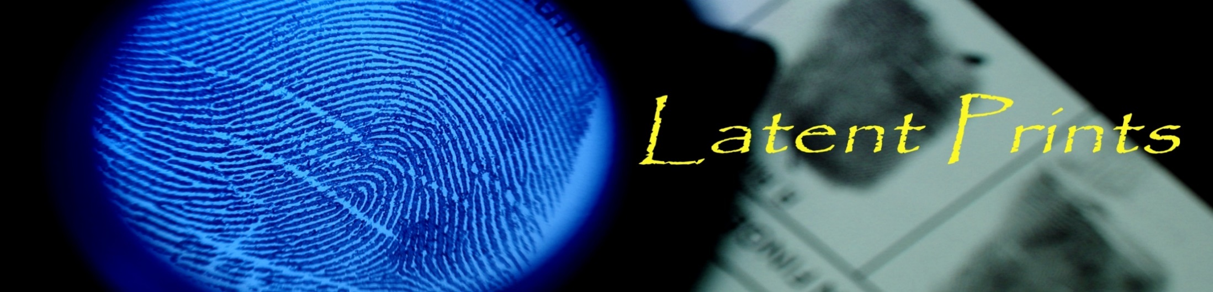

Apr. 29th, 2016
Minnowbrook Forensic Science Workshop
The Whorld of Latent Prints
David Tate, MS, CLPE
Latent Print Examiner
dptate@syr.edu

Slide 2


Objectives
Understand the role of a Latent Print examiner (LPE)
Overview of latent prints
Learn about the biology of friction ridge skin
Overview of Latent Print Analysis
Hands on with distortion factors
Touch on a couple hot topics in latent prints

Slide 3
Civilian or Sworn?
Traditionally a police function, only more recently (~20 yrs.) has there been a move towards civilianizing the latent print function.
Varies by region, even within a state

Slide 4
What is necessary to become a Latent Print Examiner?
Currently no degree in “latent prints”
Educational backgrounds are diverse but usually a 4 year science degree is required
Non-standardized training in the U.S.
Civilian v. Officer (different requirements)
Is the agency accredited?

Slide 5
The TWO MAIN PREMISES that allow friction ridge skin (FRS) to be used as a means for identification
HIGHLY VARIABLE
&
DISTINCT
PERSISTENT
Formed during 3rd to 4th month of fetal development
Arrangement of ridges remain consistent through life, except if there is injury to the basal layer of the epidermis
Differential growth of ridge units
Ridge arrangements are not predictable

Slide 6

What is a latent print ?
Latent: from the Latin ‘latens’ - to lie hidden

Slide 7
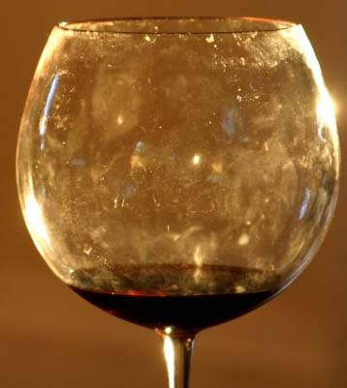
What is a latent print?
Chance impression of an area of friction ridge skin
Aka: any fingerprints and palmprints (sometimes footprints) recovered from a crime scene

Slide 8
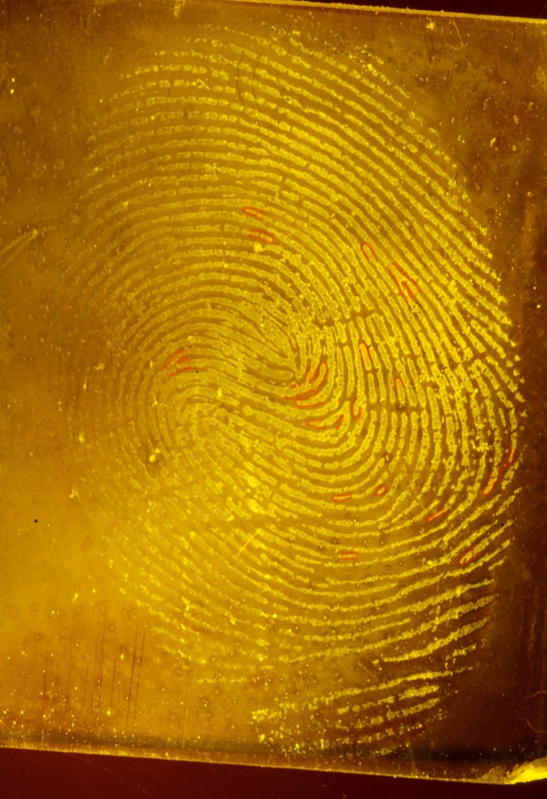
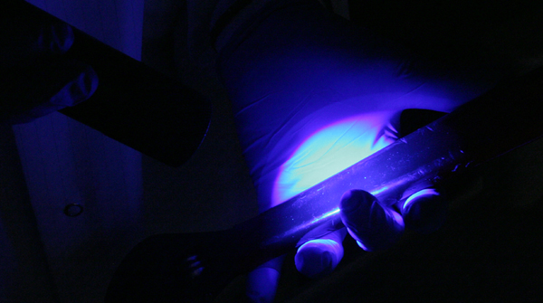
What is a latent print?
Not able to be seen with the naked eye and usually requires processing to visualize

Slide 9
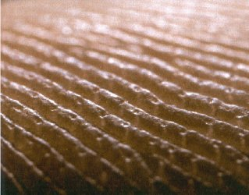
Friction Ridge Skin
Ridge
Furrow
Pore
Notes:
9

Slide 10
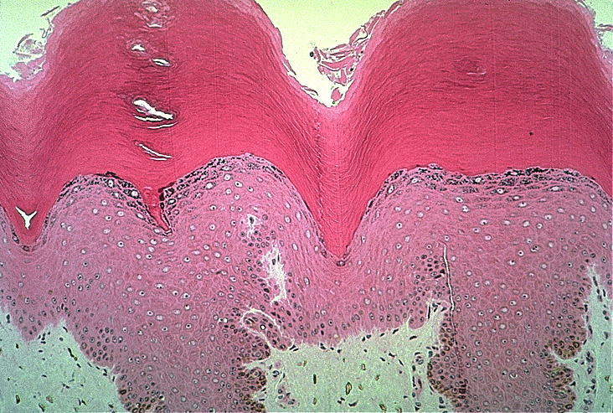
Highest concentration of eccrine sweat glands in the friction ridge skin (FRS)
Sweat glands of the FRS are the largest on the body
Sweat glands are the only epidermal appendages (like hairs and oil glands from other areas of the body) on the FR skin
Skin sweats all at once on the hands or feet
VIDEO
https://youtu.be/Itx9o4eqK5w
http://www.davidbarlowarchive.com/

Slide 11
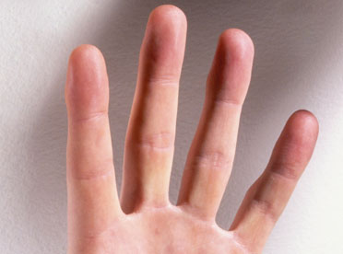
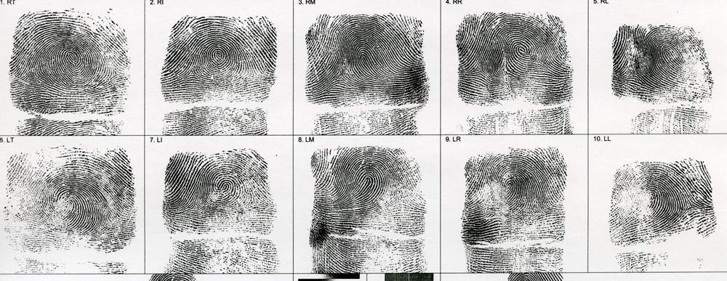
Friction Ridge Skin from…
the fingers

Slide 12
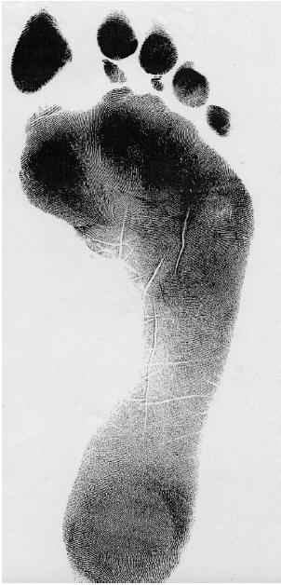
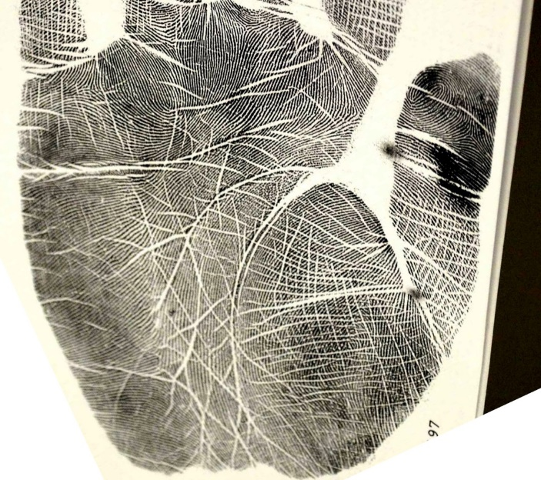
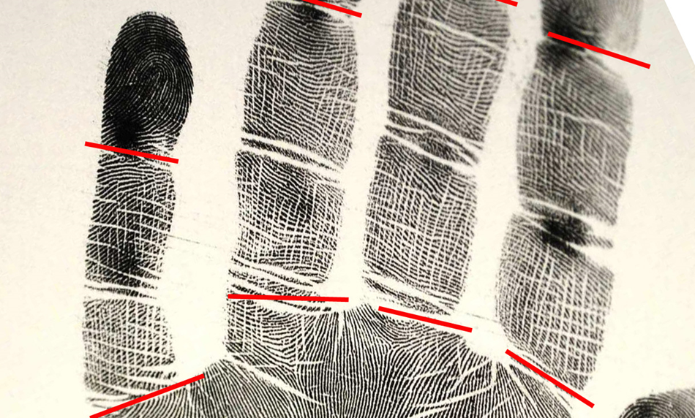
Friction Ridge Skin from…
the feet
the palms
the joints

Slide 13

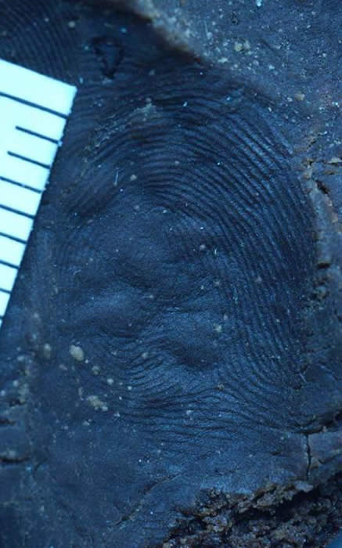
Patent
Latent
Plastic

Slide 14
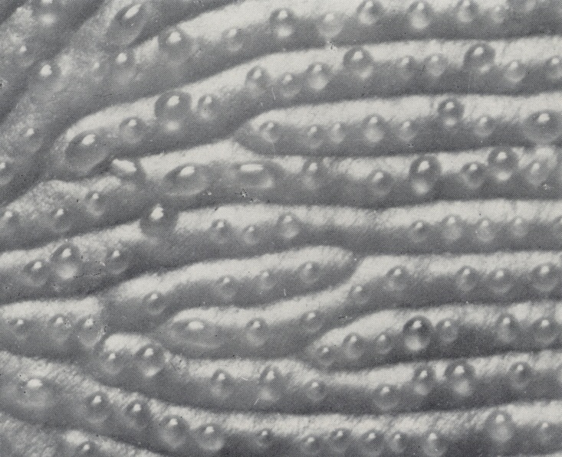
Composition of a LP?
Water
Oils, fatty acids
Organic compounds (amino acids, etc.)
Inorganic compounds (salts, etc.)
Contaminants (blood, dirt, etc.
*Composition of a LP is unknown in case work

Slide 15
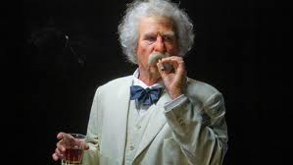
“Every human being carries with him from his cradle to his grave certain physical marks which do not change their character, and by which he can always be identified—and that without shade of doubt or question. These marks are his signature, his physiological autograph, so to speak, and this autograph can not be counterfeited, nor can he disguise it or hide it away, nor can it become illegible by the wear and mutations of time.”
[from Ch. 21 of Mark Twain’s The Tragedy of Pudd’nhead Wilson]

Slide 16

Published in
1894

Slide 17
Fingerprints in the
United States
[from Ch. 1, pg 15 of the Fingerprint Sourcebook, NIJ (2011)]

Slide 18
video

Slide 19

_{Analysis of a Latent Print}

Slide 20
_{Levels of Detail}

Slide 21
_{Level 1} _{Detail}
Overall friction ridge flow and patterns (e.g., Straight ridges, curved ridges, pattern types of arches, loops, whorls)
Used to determine anatomical source (e.g., finger, palm, toe, foot)
Cannot be used alone to individualize an impression to a single source, but may be used to exclude a source

Slide 22

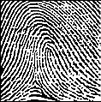
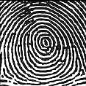
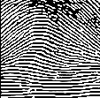
_{Level 1} _{Detail}
Pattern Types

Slide 23
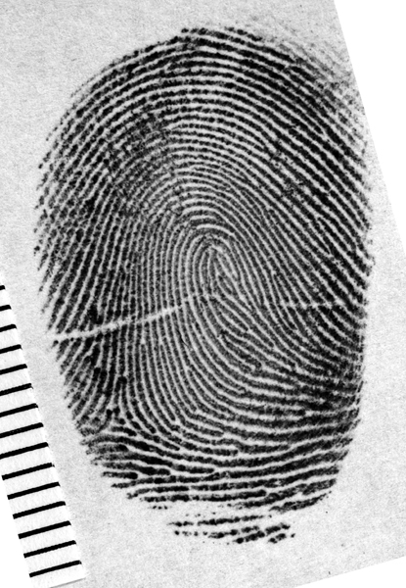
Level One Detail general ridge flow

Slide 24
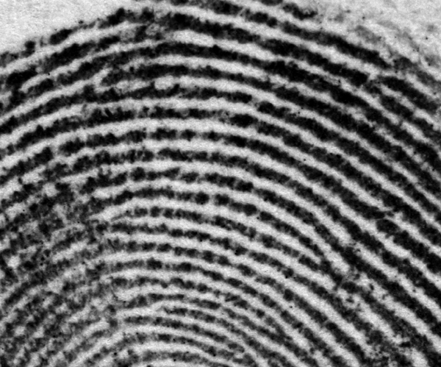
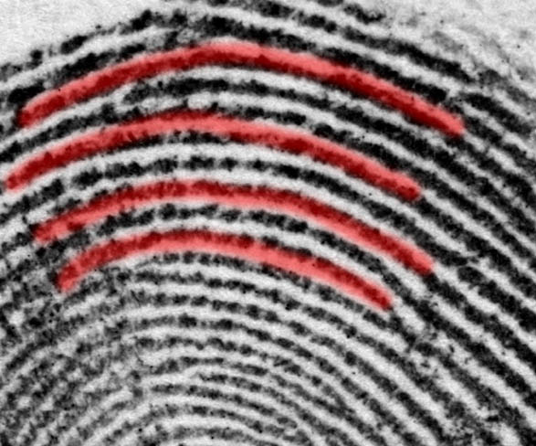
Level One Detail general ridge flow

Slide 25
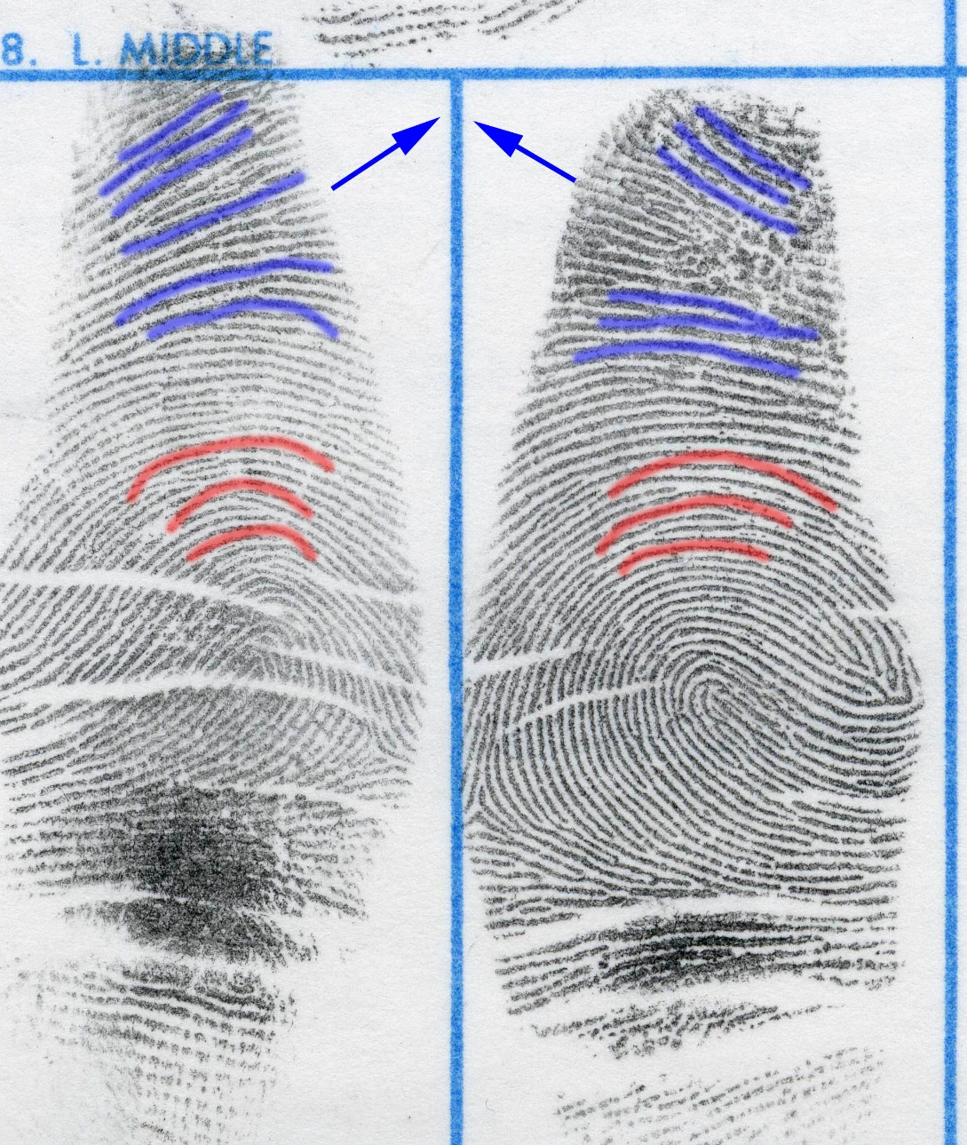
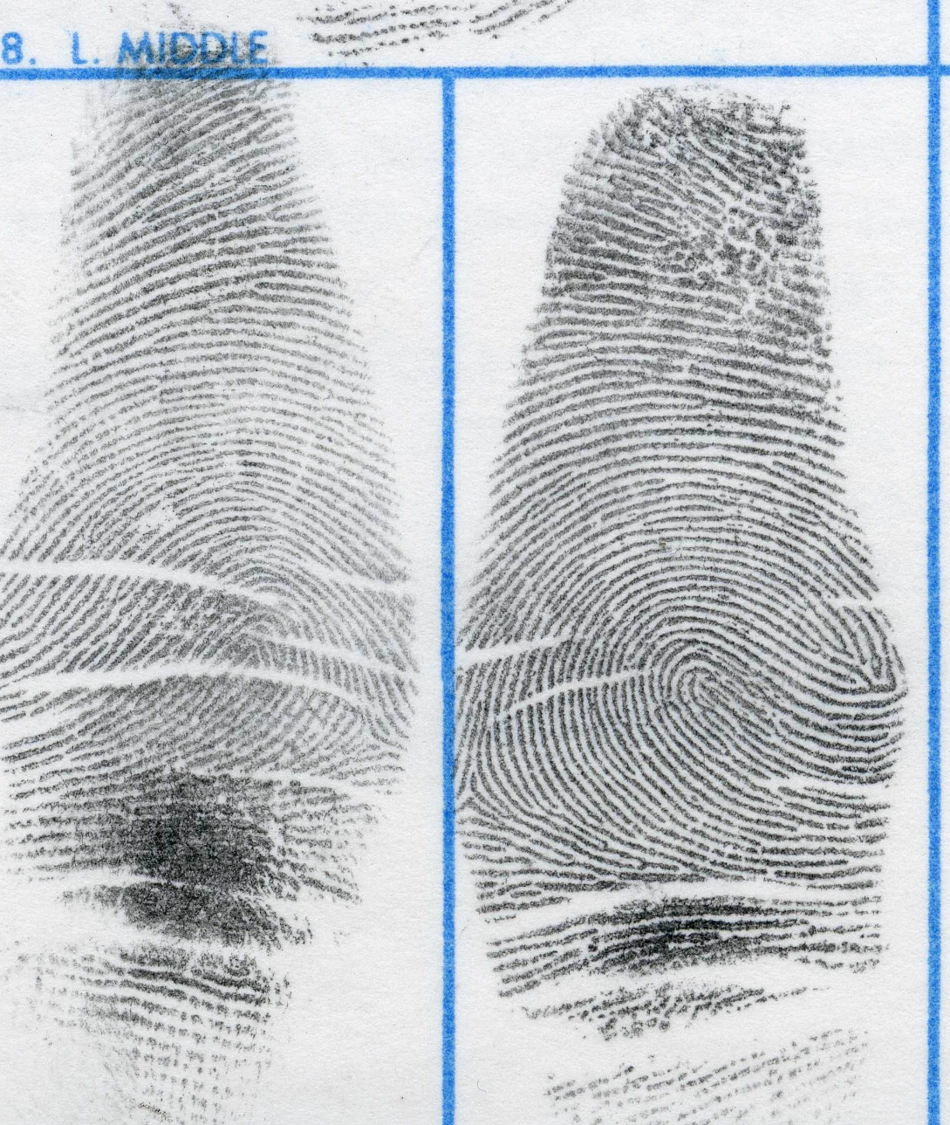
Level One Detail general ridge flow

Slide 26
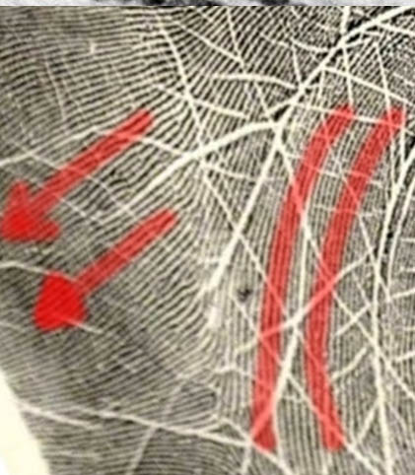
Level One Detail general ridge flow

Slide 27
_{Level 2} _{Detail}
Friction Ridge Paths
    Presence of ridge path deviations, or characteristics (i.e. bifurcations, ridge endings, dots
    Absence of ridge path deviations (e.g., continuous ridge, or open field of several continuous ridges)
    Ridge path morphology (size and shape)
Used in conjunction with level one detail to individualize, or exclude, an impression to a single source

Slide 28
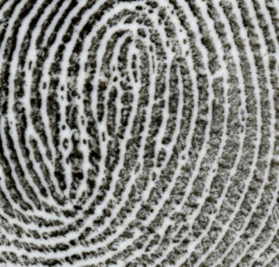
Level Two Detail

Slide 29
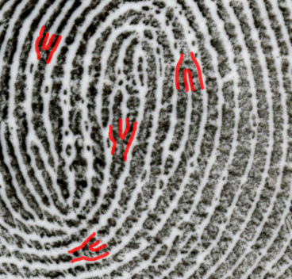
Level Two Detail – Minutiae types
_{Bifurcations}

Slide 30
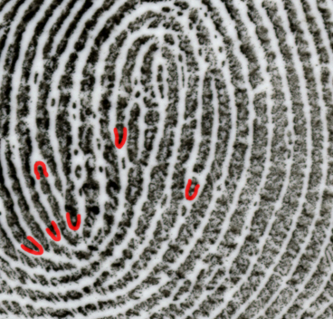
Level Two Detail – Minutiae types
_{Ridge Endings}

Slide 31
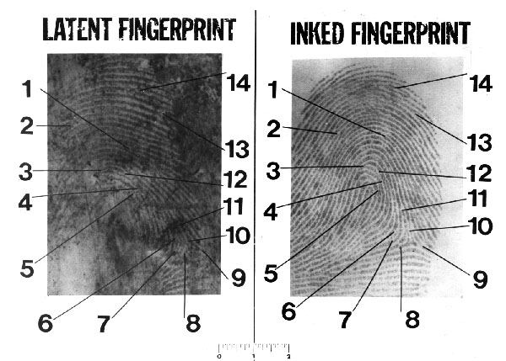
Though you may sometimes come across a chart like this, it is an incomplete way of describing the evidence

Slide 32


Slide 33
_{Quality}

Slide 34


Slide 35





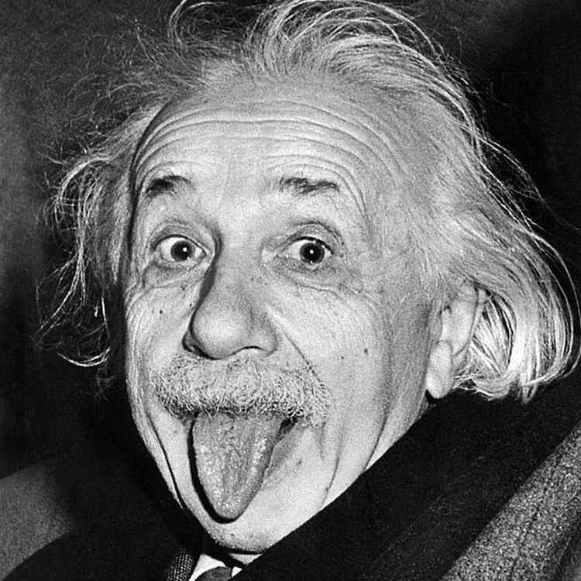

Slide 36







Slide 37






Slide 38







Slide 39



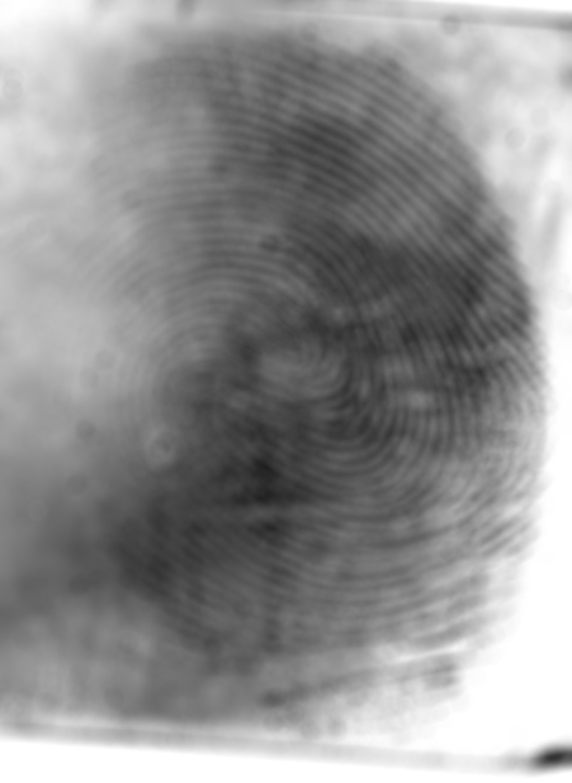


Slide 40
Though you may sometimes come across a chart like this, it is an incomplete way of describing the evidence

Slide 41
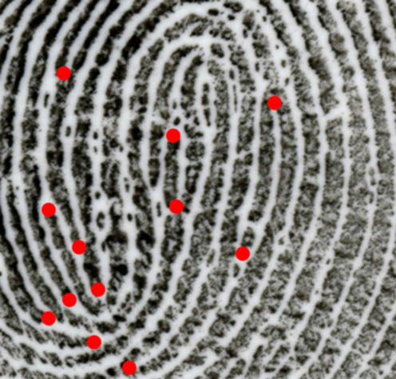
Level Two Detail

Slide 42
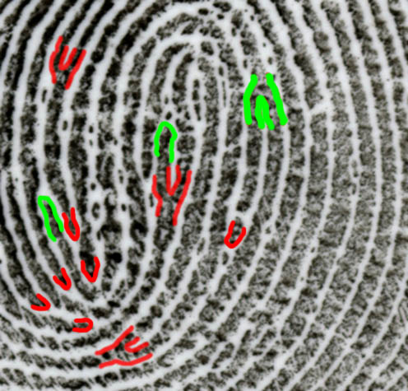
Level Two Detail

Slide 43
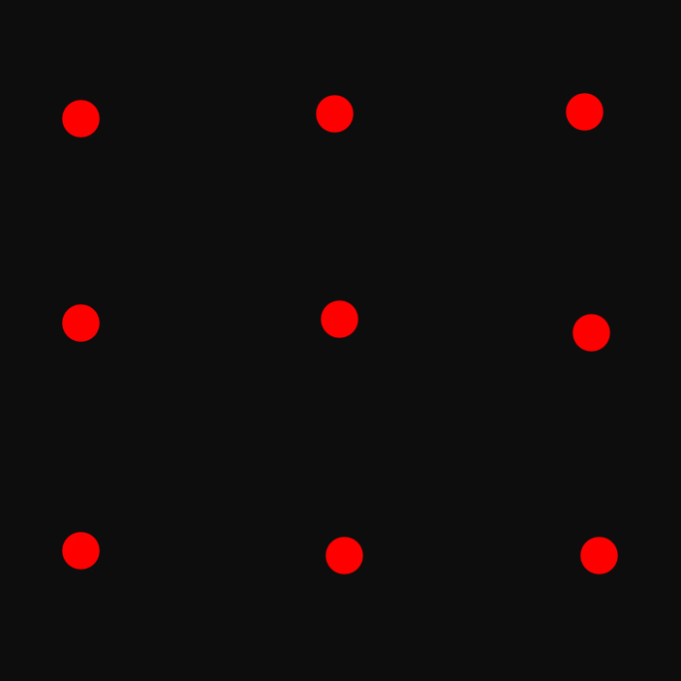
Level Two Detail – mapping ridge paths
Looking at the number of Minutiae only

Slide 44
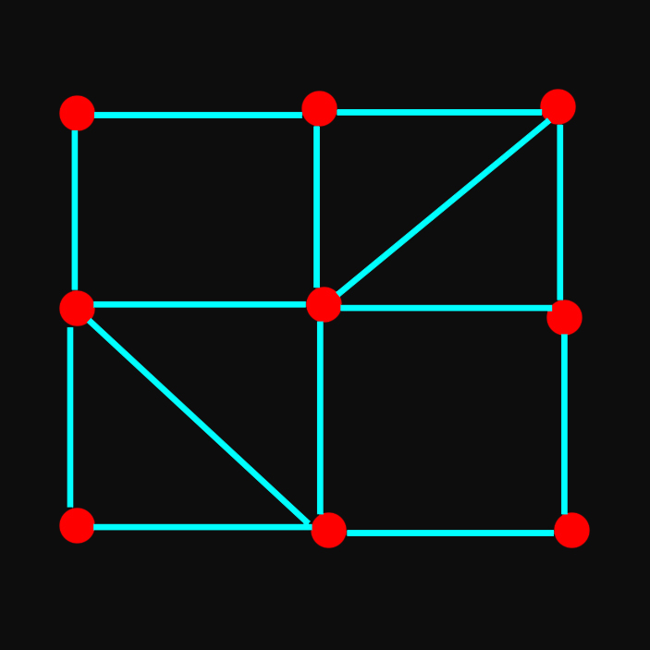
Level Two Detail – mapping ridge paths
Road map 1 – “ridges” with minutiae

Slide 45
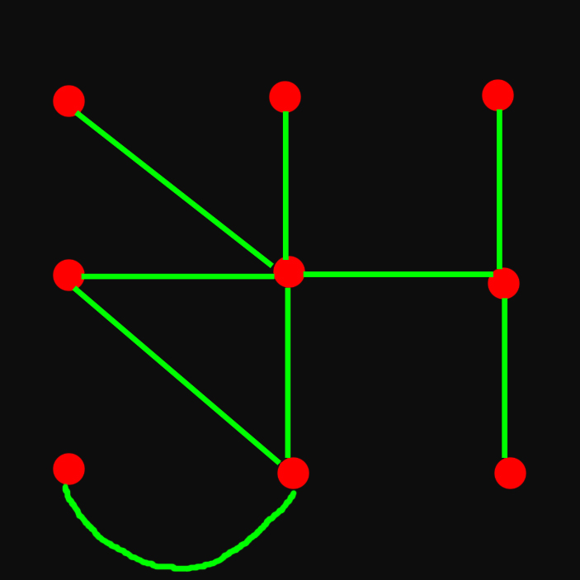
Level Two Detail – mapping ridge paths
Road map 2 – same number of minutiae in same location but very different “ridge paths”

Slide 46
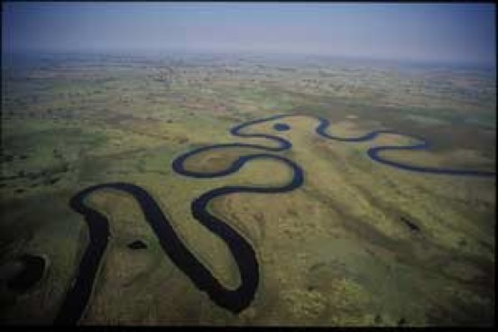
Level Two Detail – mapping ridge paths

Slide 47
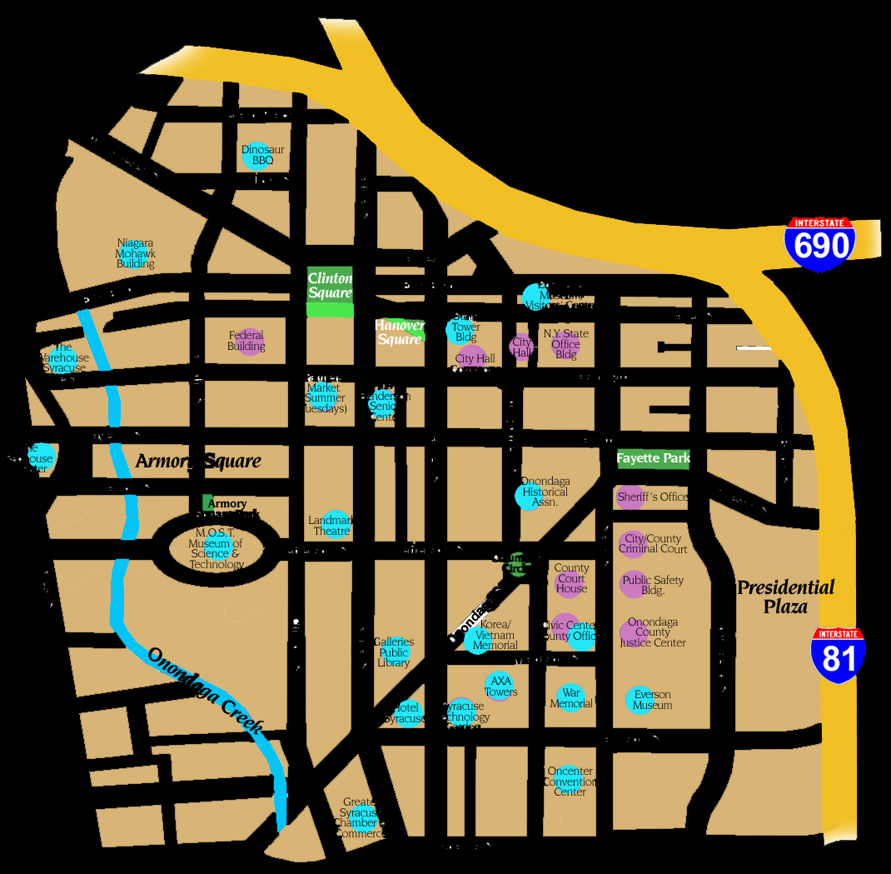
Level Two Detail – mapping ridge paths

Slide 48
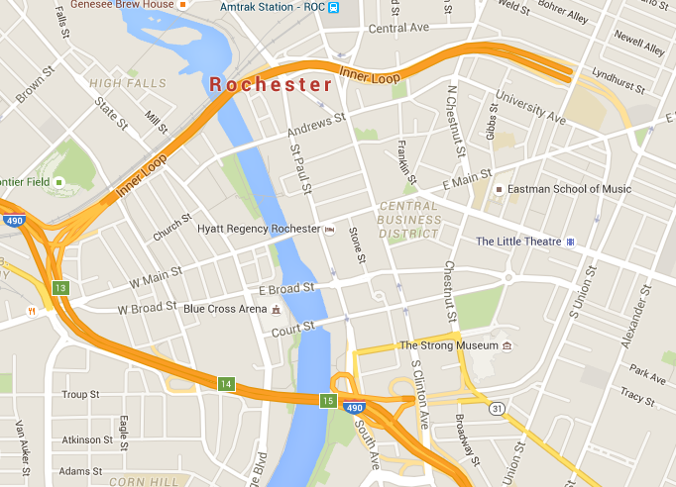
Level Two Detail – mapping ridge paths

Slide 49
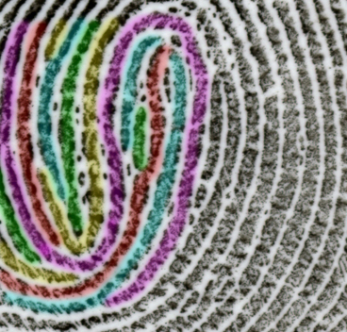
Level Two Detail
It’s about ridges, not just minutiae

Slide 50
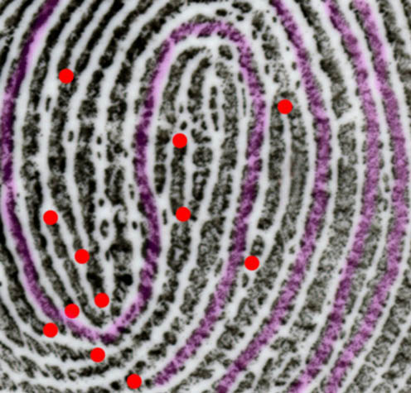
Level Two Detail
continuous ridges and the sequence of the arrangement

Slide 51
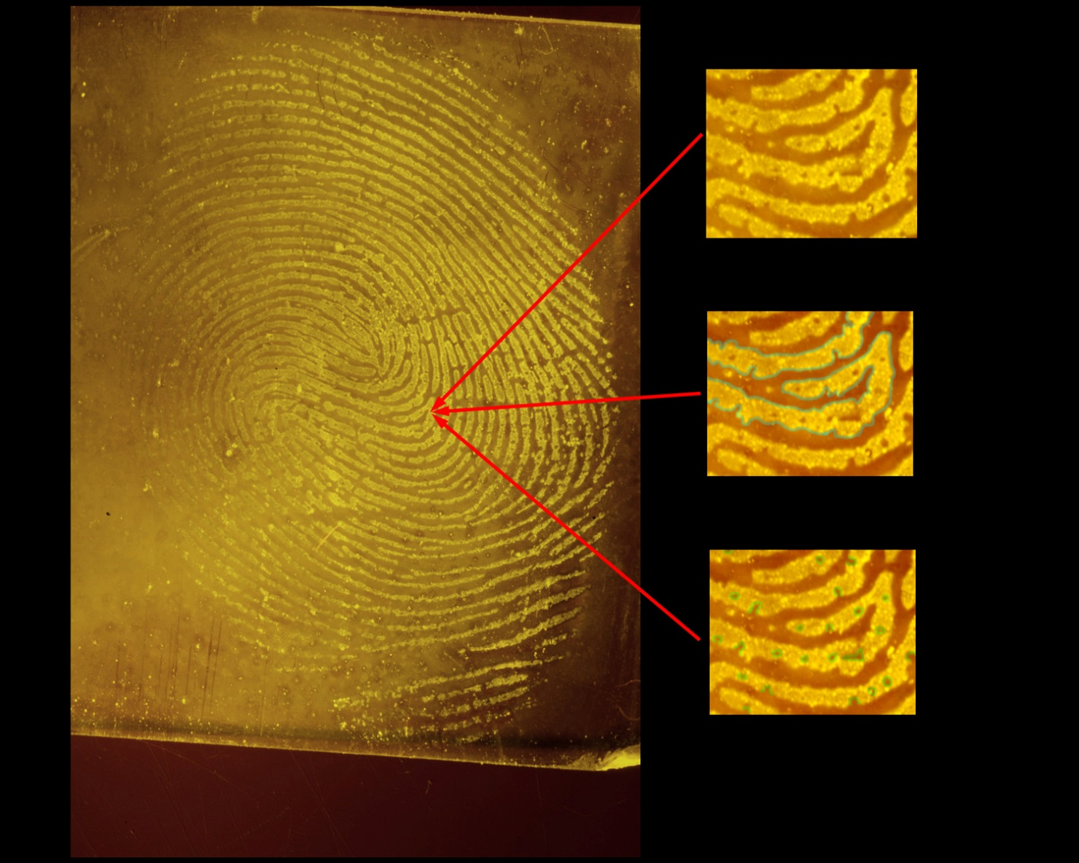
Level Three Detail

Slide 52
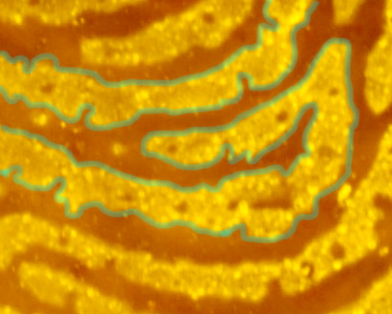
Level Three Detail

Slide 53
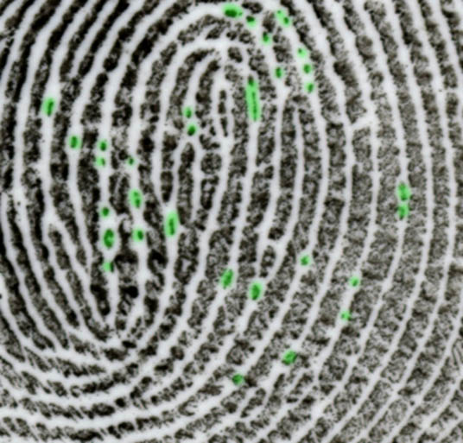
Level Three Detail

Slide 54
_{Quantity}

Slide 56
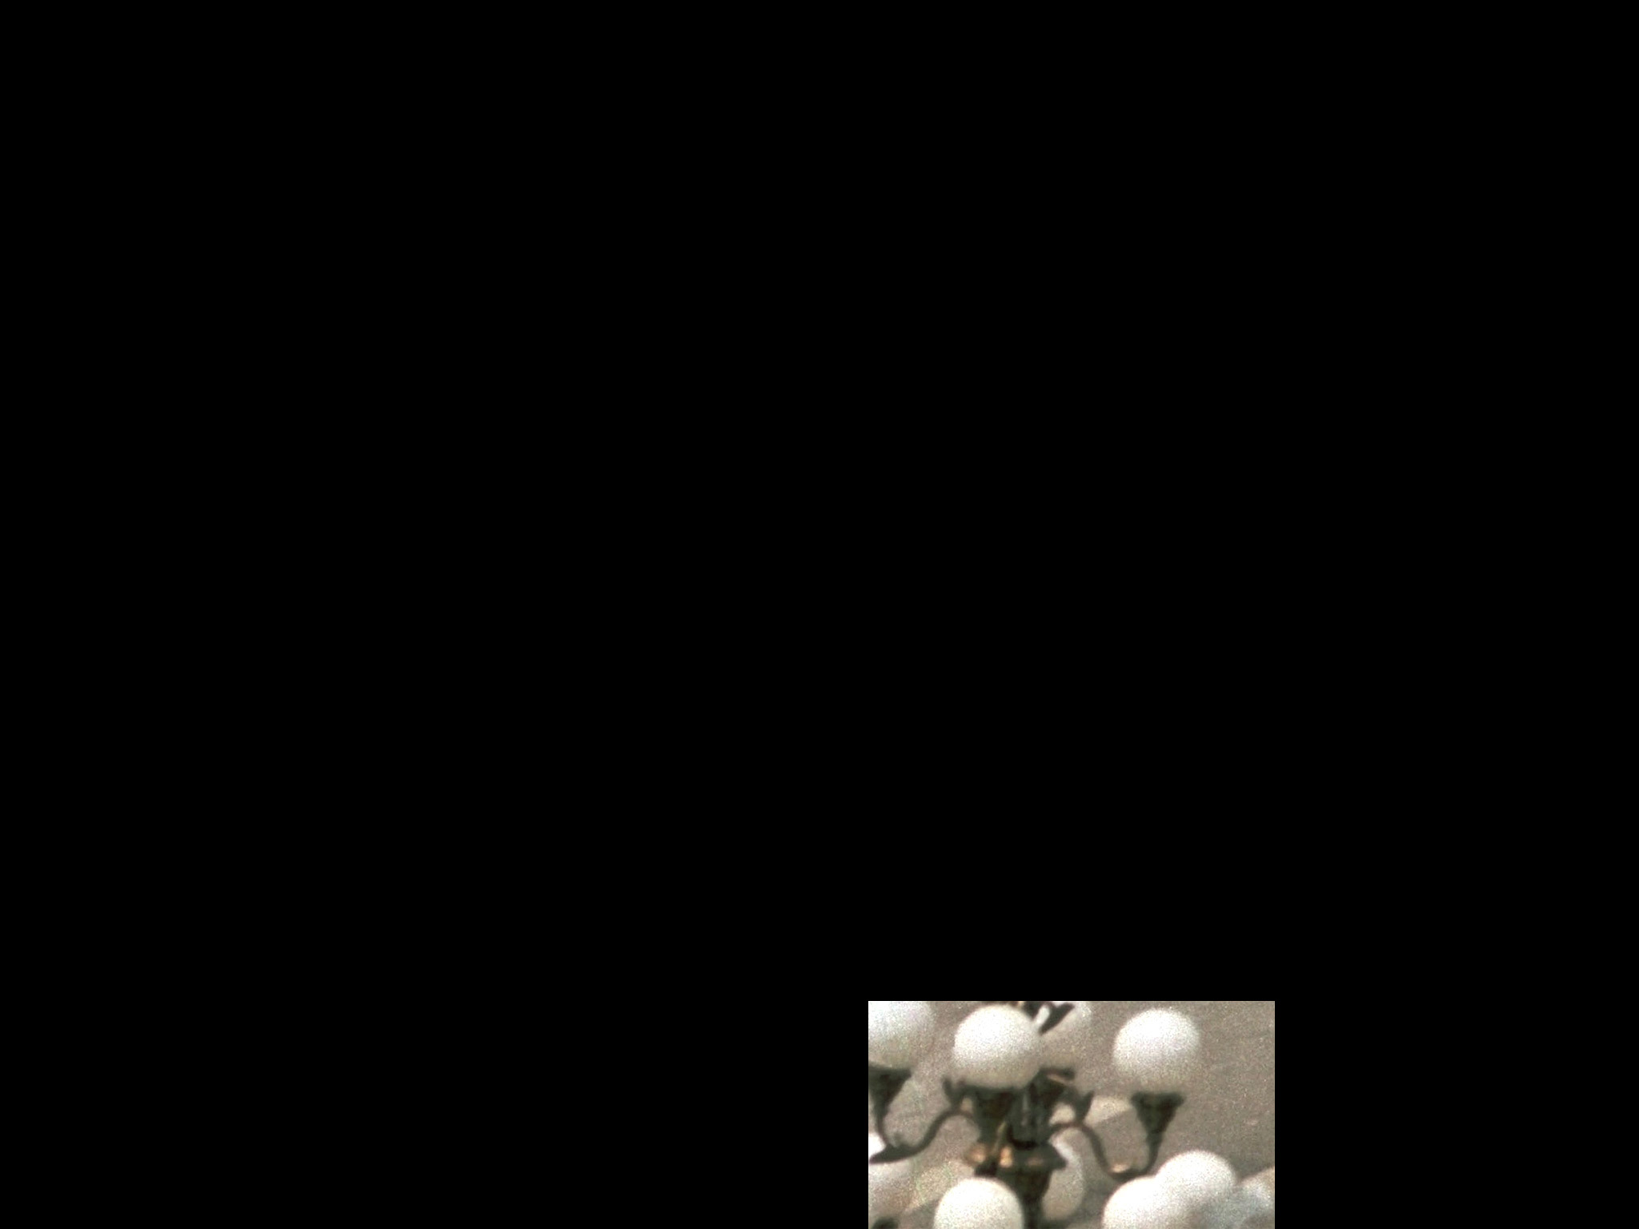
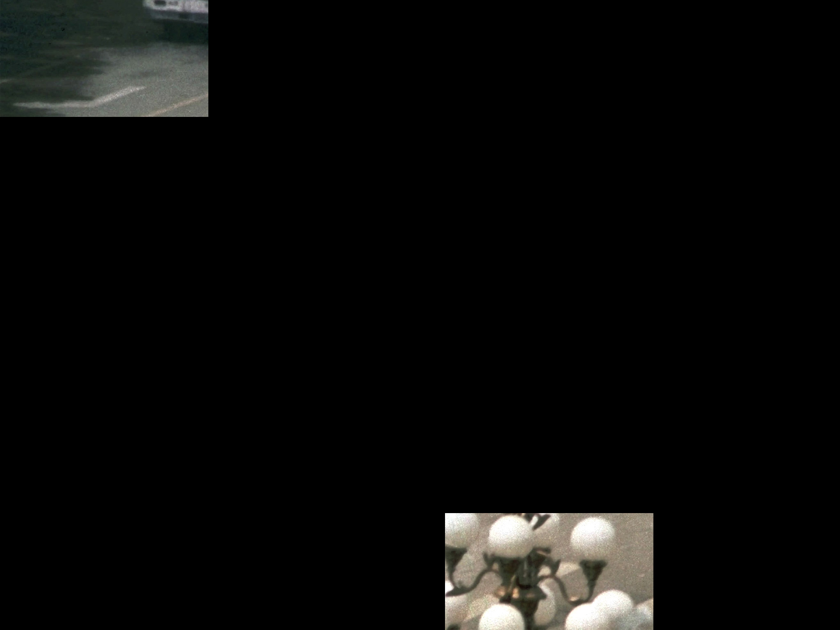
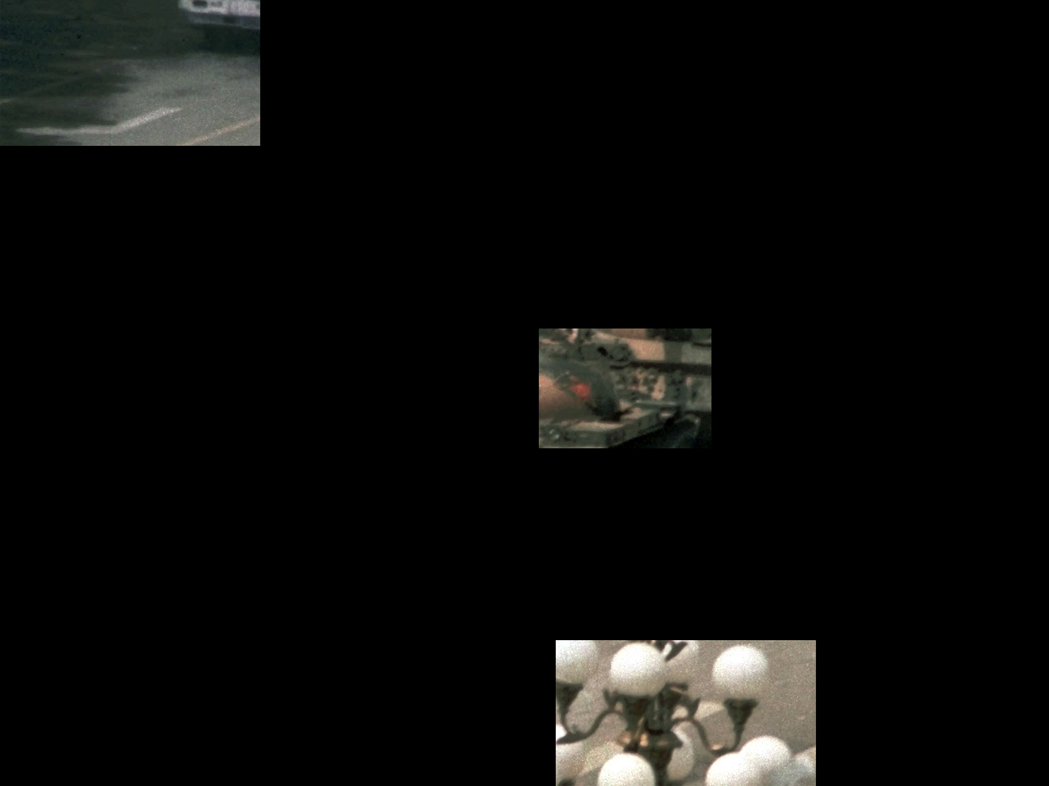
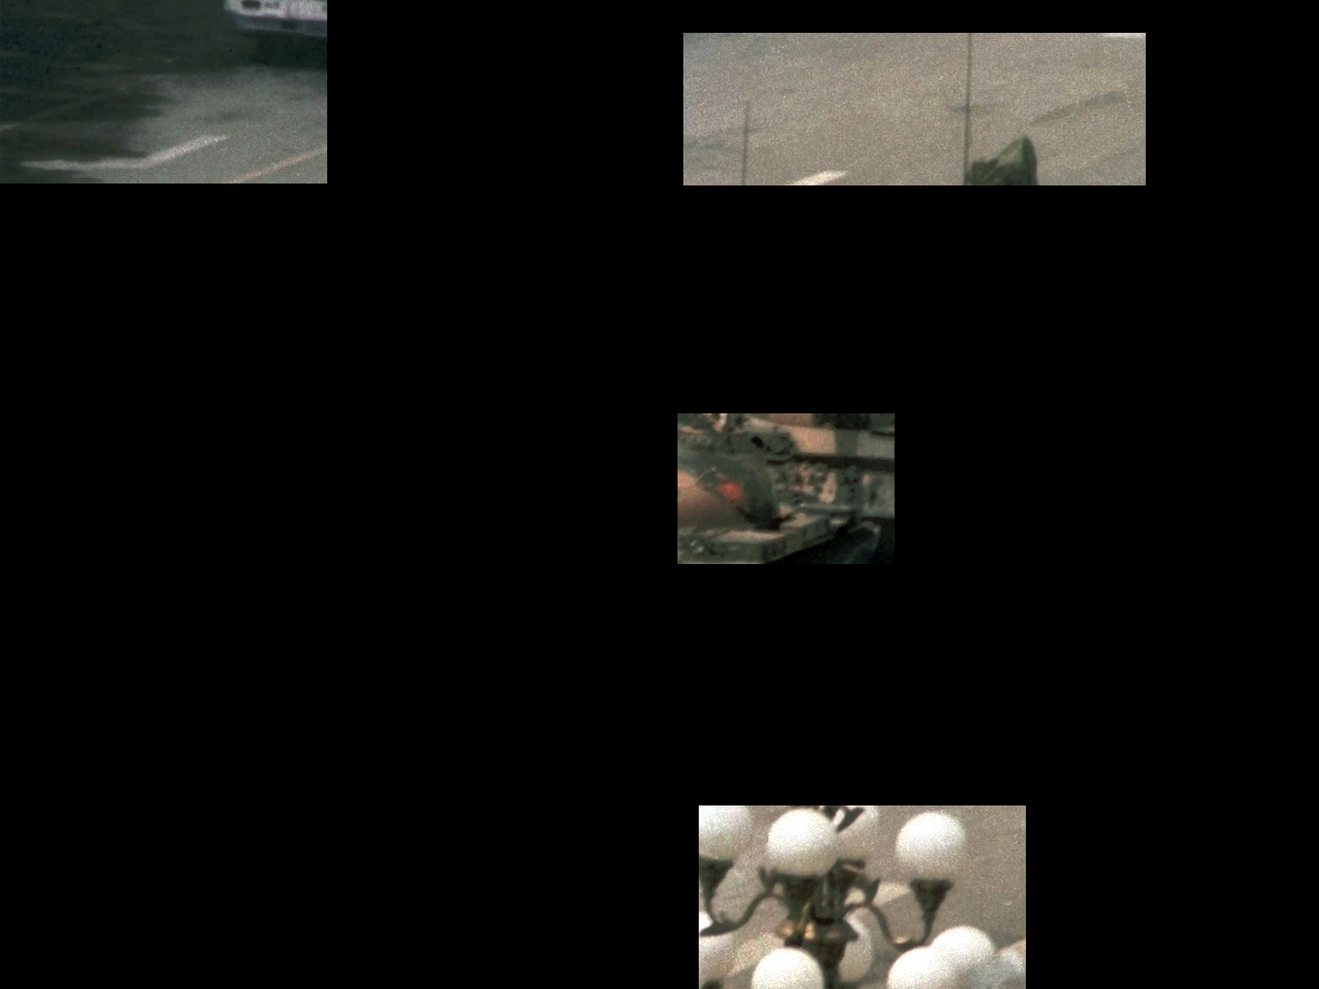
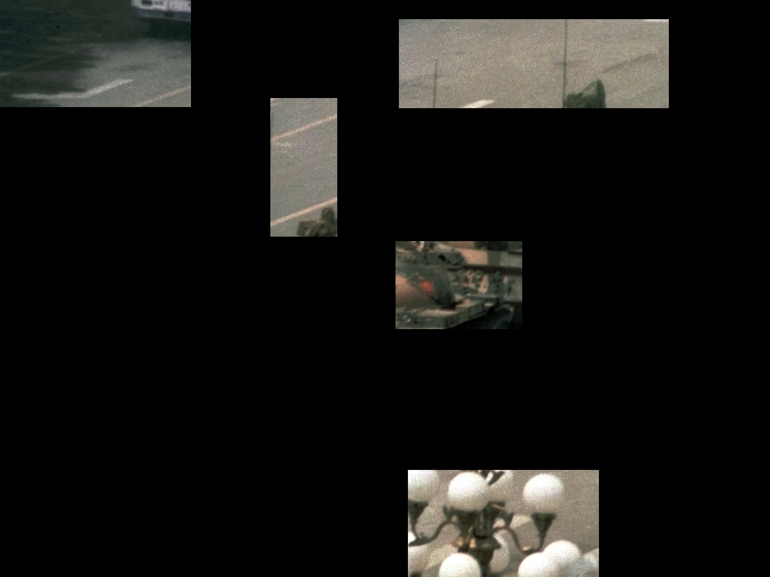
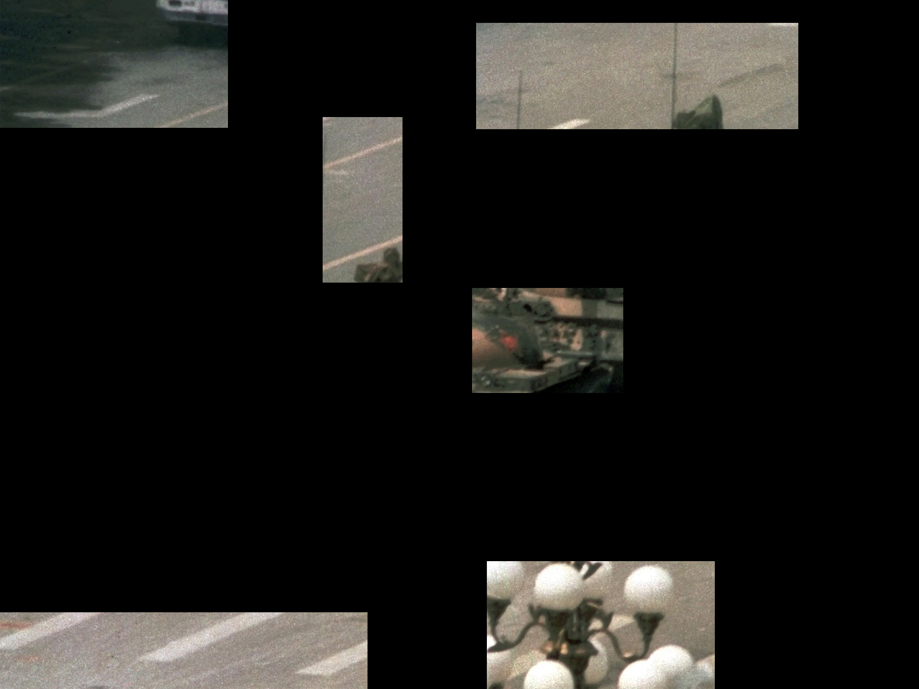
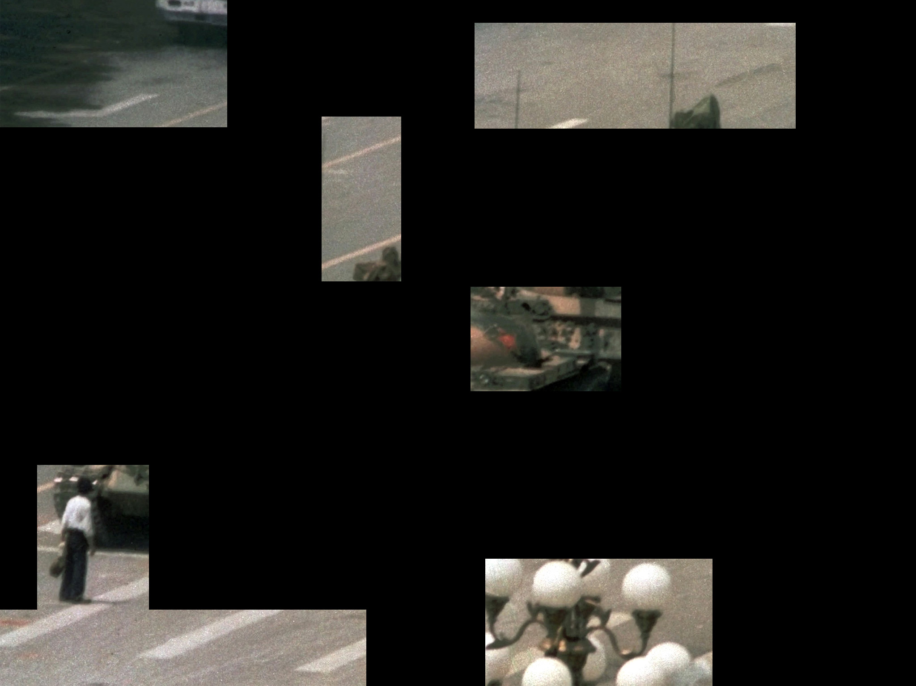
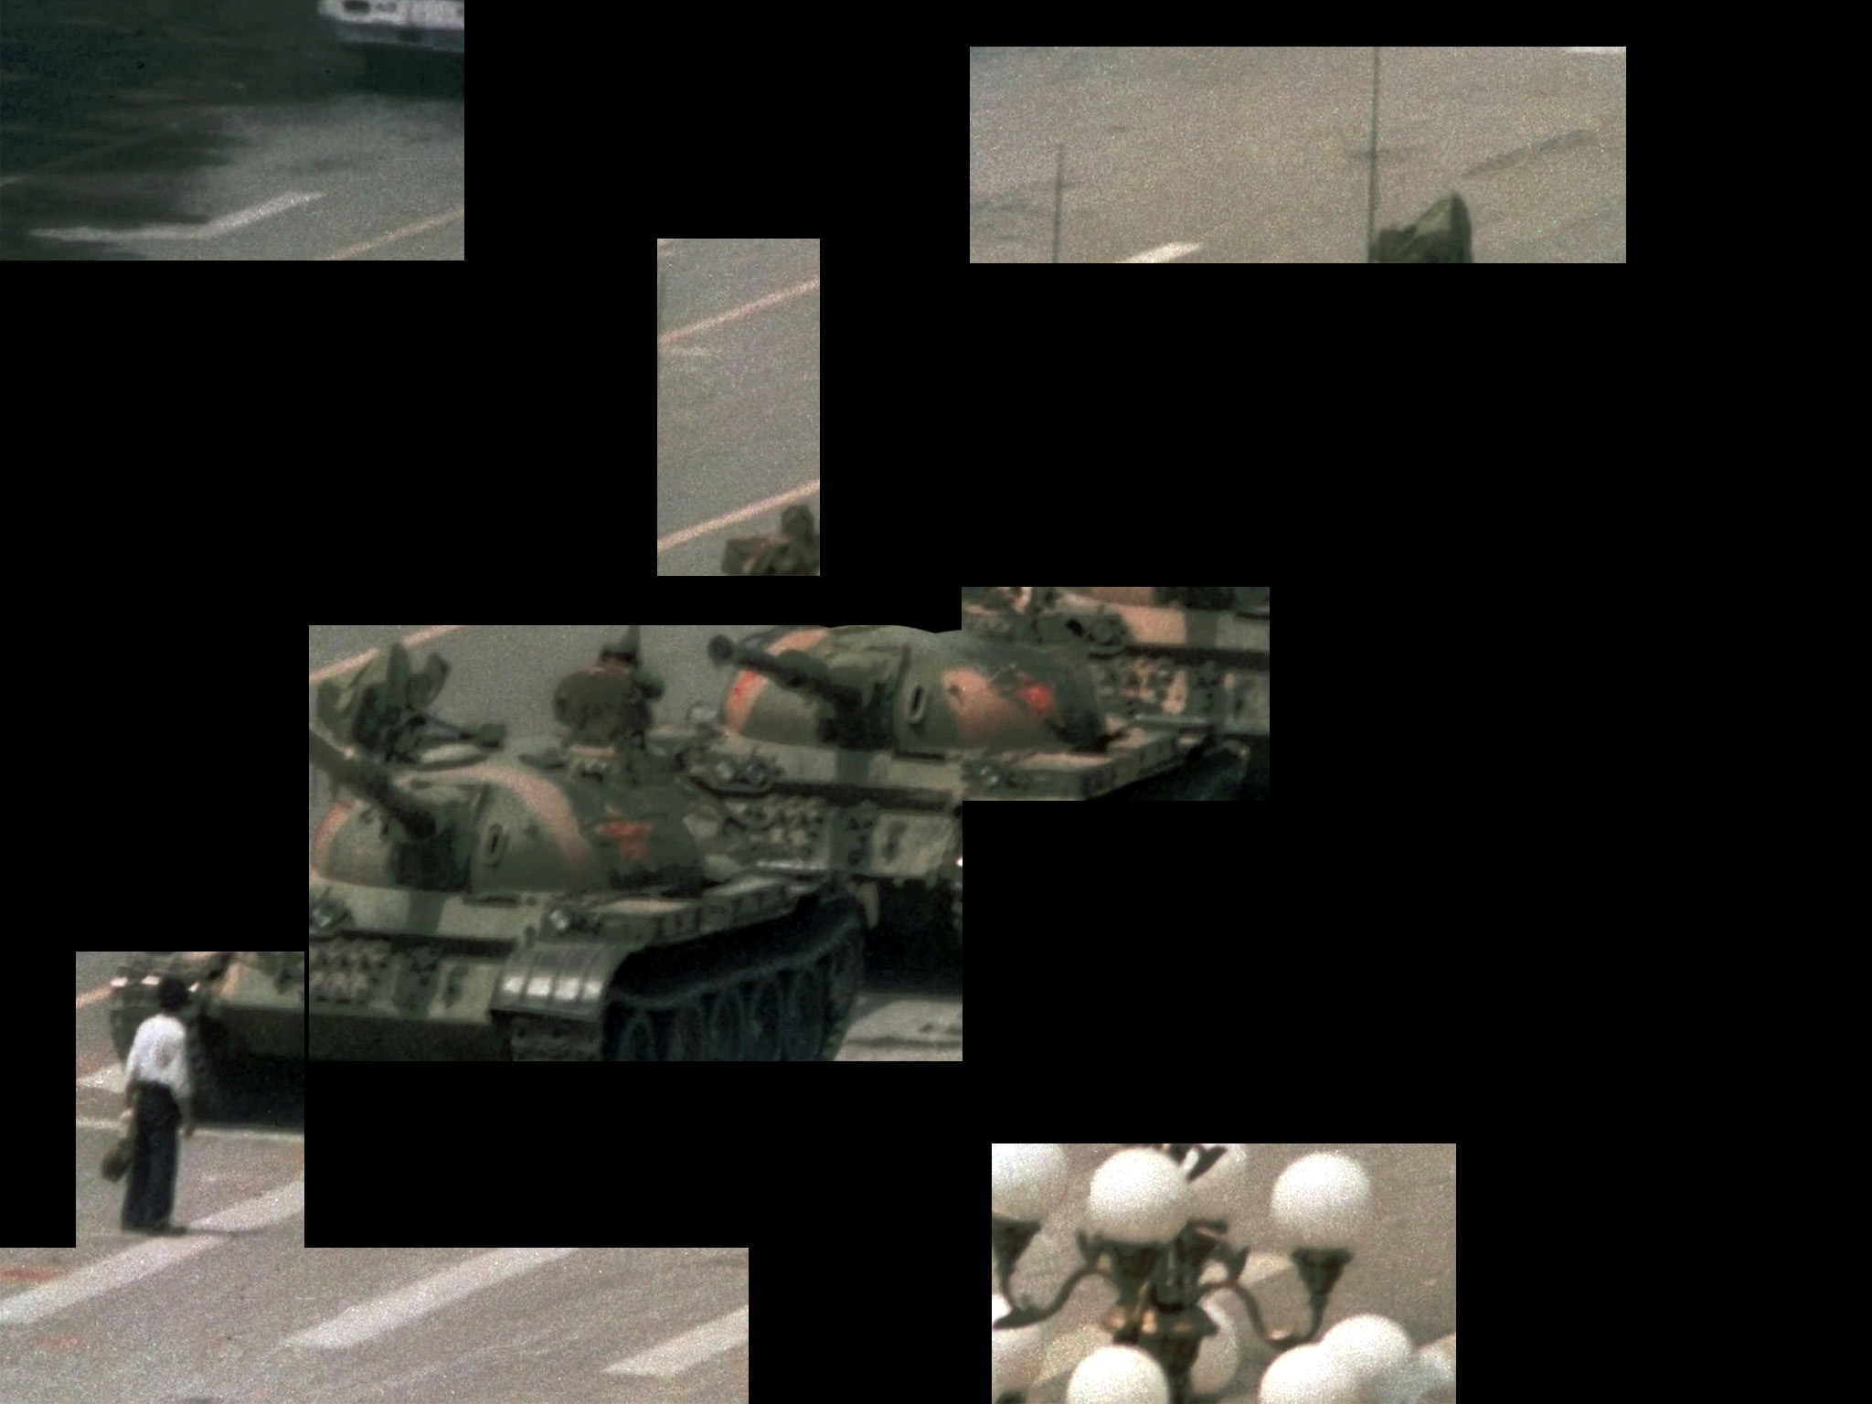



Slide 57








Slide 58


Slide 59

_{Elements of a Latent Print}
_{Anatomical aspects}
_{Lateral Movement}
_{Deposition pressure}
_{Development medium}
_{Matrix}
_{Substrate}
Ashbaugh, D.R. (1999). Quantitative-Qualitative Friction Ridge Analysis: An Introduction Basic and Advanced Ridgeology; CRC Press, New York, NY.

Slide 60
Distortion
_{Elements of a Latent Print}
_{Anatomical aspects}
_{Lateral Movement}
_{Deposition pressure}
_{Development medium}
_{Matrix}
_{Substrate}
Ashbaugh, D.R. (1999). Quantitative-Qualitative Friction Ridge Analysis: An Introduction Basic and Advanced Ridgeology; CRC Press, New York, NY.

Slide 61

QUESTIONS?

Slide 62
THANK YOU !
QUESTIONS?

