Slide 1
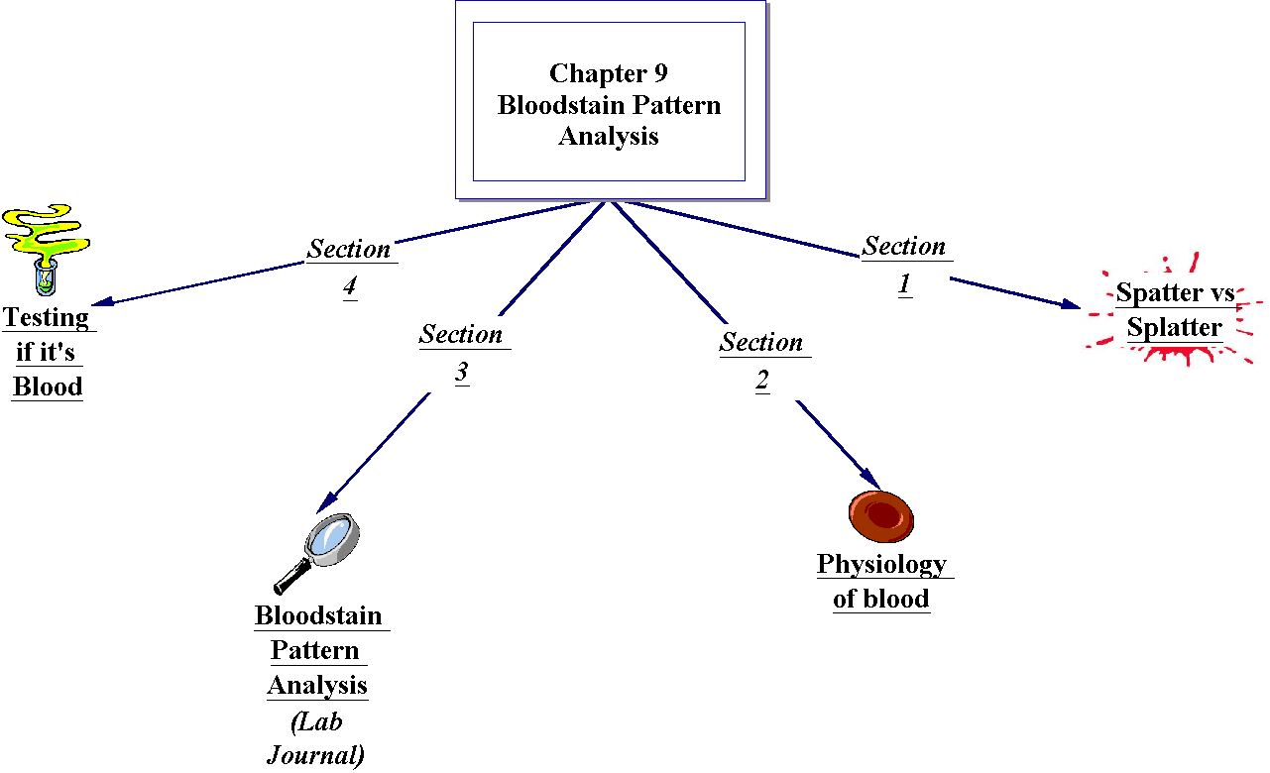
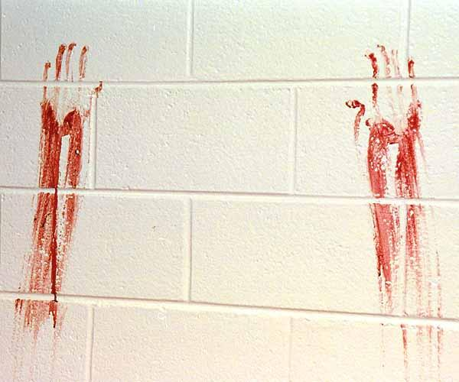

Slide 2
Spatter vs splatter
Splatter: random, unorganized
Spatter: Not random, affect by gravity, predictable
Blood stain Pattern: The pattern of a stain and the quantity of blood present can be important clues to the nature of the accident or crime.
BSP Interpretation:
what does the blood tell you?

Slide 3
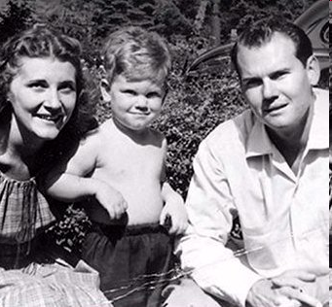
The Sheppard Family Story

Slide 4
Dr Sam and Marilyn Sheppard
Marilyn Sheppard
35 blows,
28 to the head
Unknown instrument
12> inches
None of these blows were fatal
2 broken teeth
Torn fingernail.
Blood found on most of the walls along with covering a dresser.
Dr. Sam Sheppard:
Bruises
chipped teeth
fractured vertebra in his neck.
Found shirtless

Slide 5
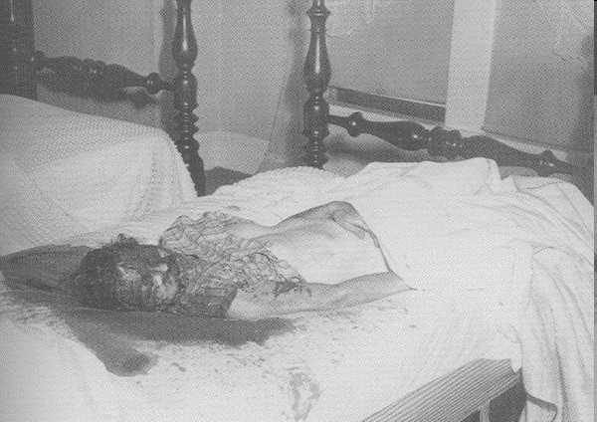
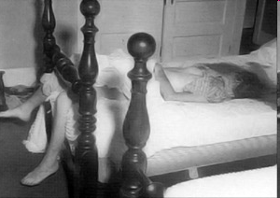
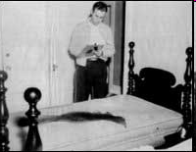
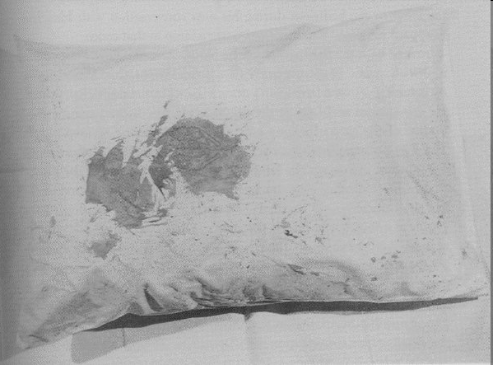
Crime Scene pictures
Spatter
?
Sheppard Images

Slide 6
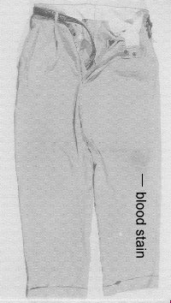
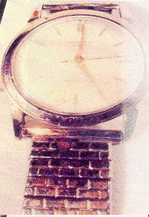
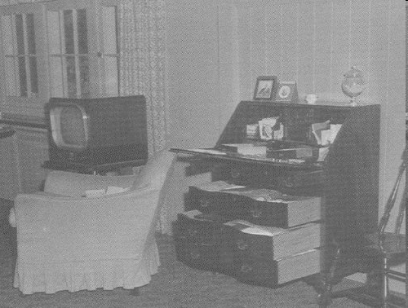
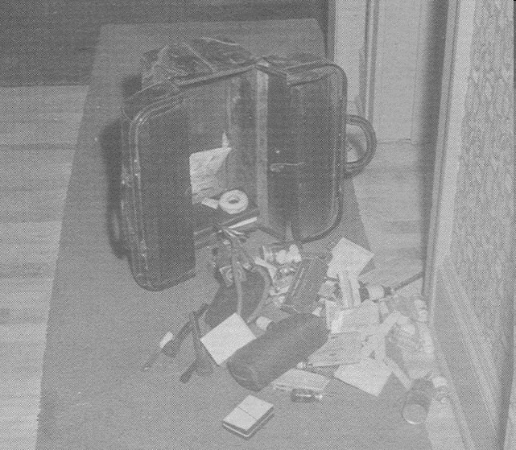
Crime Scene pictures

Slide 7
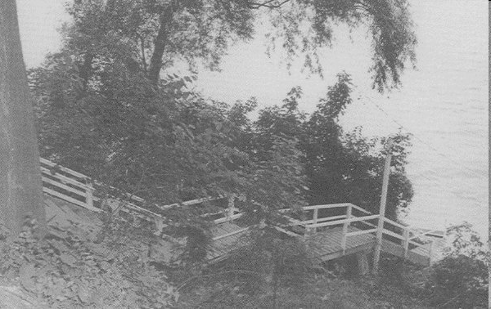
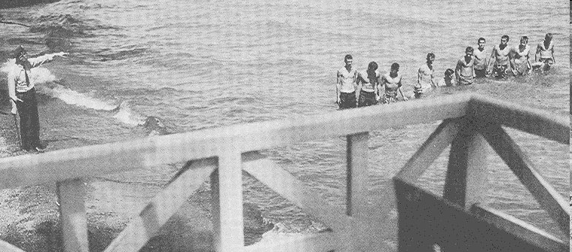

Slide 8
Questions
What Biological evidence will blood provide,, in the bedroom?
What information does the Blood stain evidence provide?

Slide 9
Dr Sam Sheppard
July 4 1954,
Reading:
http://www.youtube.com/watch?v=nV4zKeGM3fc
HW link: main site: http://law2.umkc.edu/faculty/projects/ftrials/sheppard/samsheppardtrial.html
http://law2.umkc.edu/faculty/projects/ftrials/sheppard/evidence.html
Police report: http://law2.umkc.edu/faculty/projects/ftrials/sheppard/sheppardreports.html

Slide 10
Do Now: What Biological evidence will blood provide, in the bedroom?
DNA
Blood type(s)
Tool marks/ voids
Toxicological Reports
Diseases
Spatter marks (Blood trails, movements)

Slide 11

What can Spatter (Bloodstain Evidence) Evidence reveal:
.
.
.
.
.
.
.

Slide 12
What can Spatter (Bloodstain Evidence) Evidence reveal:
Origin(s) of bloodstain
Position of victim & assailant
Movement of victim & assailant
Number of blows/shots
Distance of bloodstain from target
Direction from which blood impacted
Speed with which blood left its source

Slide 13
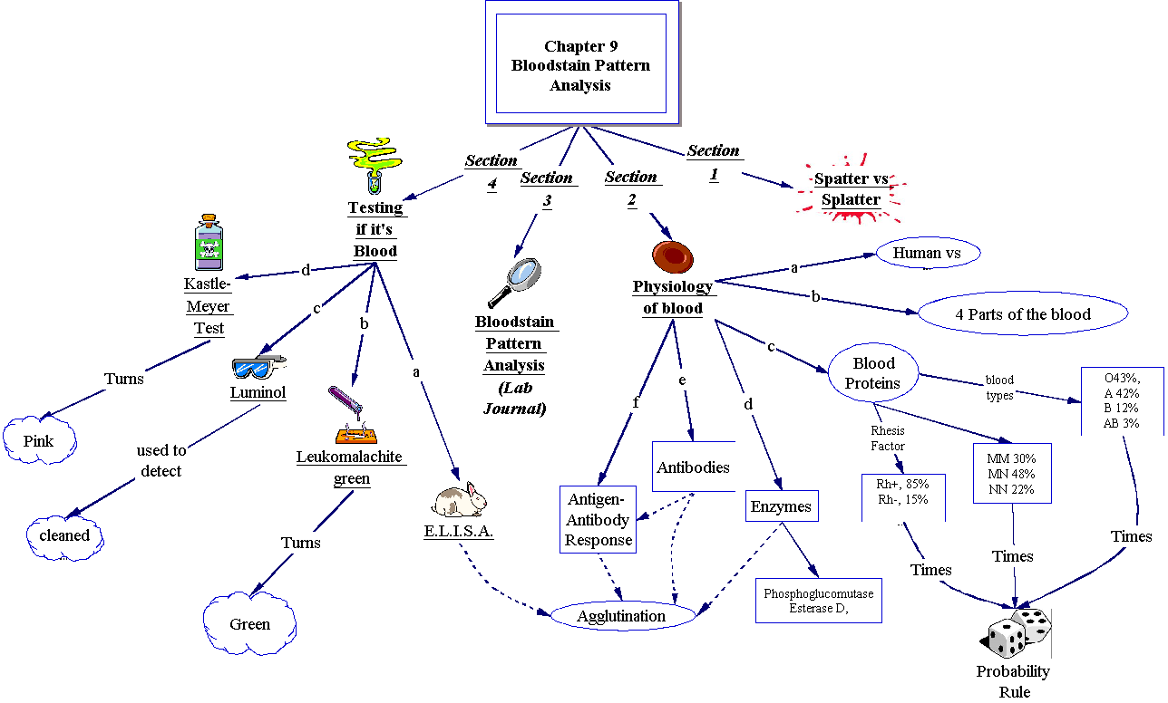

Slide 14
Serology
The study of antigen-antibody reactions.
Tells us human vs. nonhumans
Serologists Questions
Is the sample blood?
Is the sample animal blood?
If animal blood, from what species?
If human blood, what type?
Can the sex, age, and race of the source of blood be determined?

Slide 15
History of Blood!!!
With early Transfusions =instant death due to Coagulation
1. 1901, Karl Landsteiner introduced the A-B-O system
2. 1937,Alexander Weiner, Rhesus monkey, Rh Factor was and over 100 factors actually must be considered when performing a transfusion.
Most people are only familiar with the Rh factor, which is technically the D antigen.
There are more than 256 antigens, and 23 blood group systems based on association with these antigens.
Us Populations: O 43%, A 42%, B 12 %, AB 3%

Slide 16
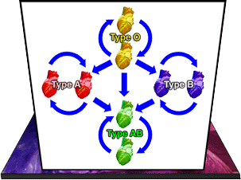
Blood Typing

Slide 17
Statement analysis
http://www.statementanalysis.com/cases/

Slide 18
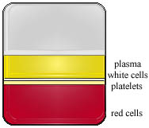
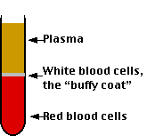
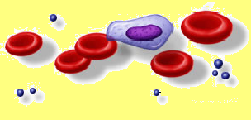
Structure of Blood:
Plasma, mostly water
Cells
Erythrocytes: (RBC)
Leukocytes: (WBC)
Platelets

Slide 19
Major components of Blood, Plasma:
Straw colored liquid consisting mainly (90%) of water and (7%) dissolved proteins.
Can be found outside of the circulatory system.
Also transports:
Proteins: (albumin, globulins, fibrinogen)
Salts, Glucose
Amino acids
Fatty acids,
Vitamins, Hormones,
Cellular wastes

Slide 20
DNA in BLOOD
DNA can be extracted from blood (if white blood cells which always contain a nucleus are present), and also from sperm, bone marrow, tooth pulp, and hair roots.

Slide 21
Blood, however, is commonly used in DNA testing, as per the following steps:
Blood samples are collected from the victim, defendant, and crime scene
White blood cells are separated from red blood cells
DNA is extracted from the nuclei of white blood cells
A restrictive enzyme is used to cut fragments of the DNA strand
DNA fragments are put into a bed of gel with electrodes at either end
Electric current sorts DNA fragments by length
An absorbent blotter soaks up the imprint; it is radioactively treated, and an X-ray photograph (called an autoradiograph) is produced

Slide 22
Liquid Blood
2
Physical properties
viscosity
surface tension
specific gravity
Behaves as a projectile in motion
biology, physics, maths

Slide 23
Surface Tension
3
Resistance to penetration & separation
Surface acts to reduce surface area
Smallest SA to Volume ratio is offered by sphere

Slide 24
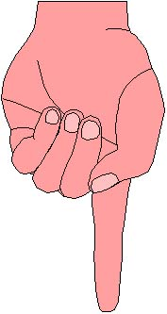
Dripping Blood
4
Blood trickles downwards
Blood drop grows until Wt (G) > S.T.
Single drop breaks free (teardrop shape)
Surface tension pulls in vertically
And horizontally
Shape settles into sphere (0.05 ml)
Does not break up until impact

Slide 25


Drop size
5
Standard drop
size 50ul (0.05ml)
Rapid bleeding gives
slightly larger drop
Shaking/movement
casts off smaller drops
.
.
.

Slide 26
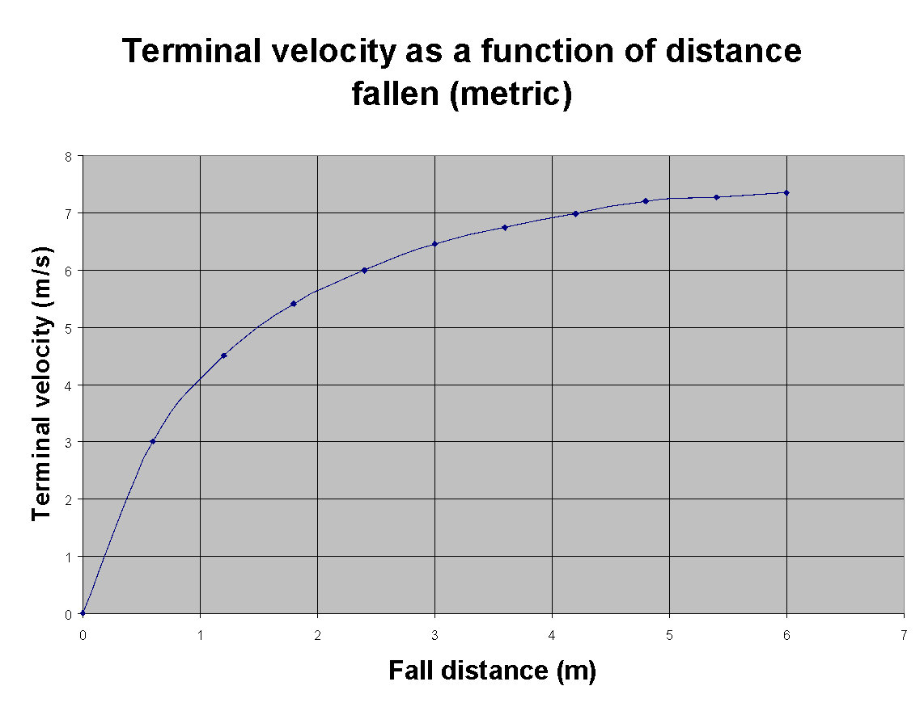
Terminal Velocity v Distance Fallen (metric)
6

Slide 27
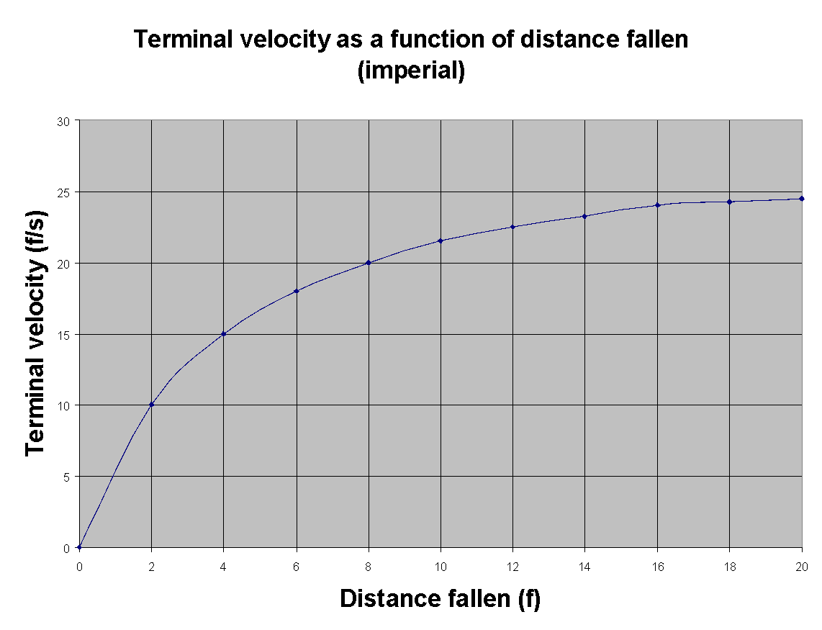
Terminal Velocity v Distance Fallen (imperial)
7

Slide 28
Free Falling Blood Droplets
8
0.06 ul
1.1 mm
0.12 ul
1.32 mm
0.5 ul
2.12 mm
50 ul
4.6 mm
0.5 to
0.65 m
0.84
to 1 m
.
.
2.4 to
3 m
.
4.2 to
5.4 m
2.2 m/s
3.3 m/s
.
4.6 m/s
7.5 m/s

Slide 29
Shape & Size of Bloodspot
9
Depends mostly on nature of target surface
texture (rough or smooth)
porous or non porous
Size is related to distance fallen, provided:
standard 50 ul drop of blood
There is little change in spot diameter beyond a fall distance of 1.2 m

Slide 30
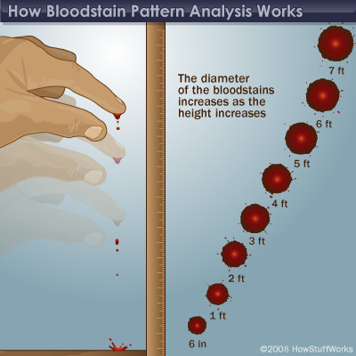
Shape & Size of Bloodspot
9

Slide 31
What information does this questionable droplet provide?
9

Slide 32

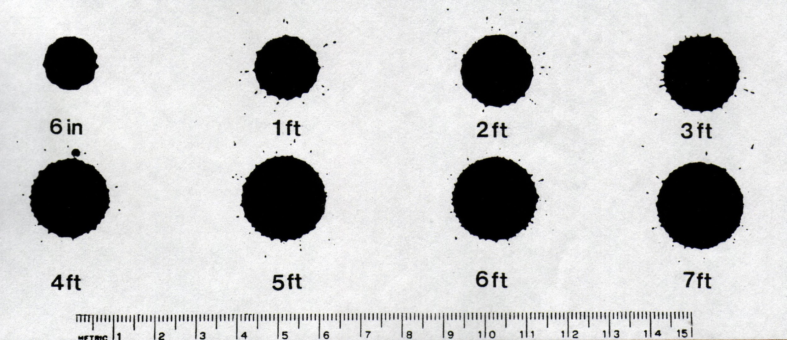
Height Fallen
10
Single drops of blood falling from fingertip onto smooth cardboard from various heights.
No change in diameter beyond 7 ft.
Adapted from
Introduction to Forensic Sciences,
W. Eckert, CRC, 1997

Slide 33
Effect of Target Surface
11
.
.
.
.
.
.
Spreads out smoothly
ST of spreading edge is
broken by irregular surface

Slide 34
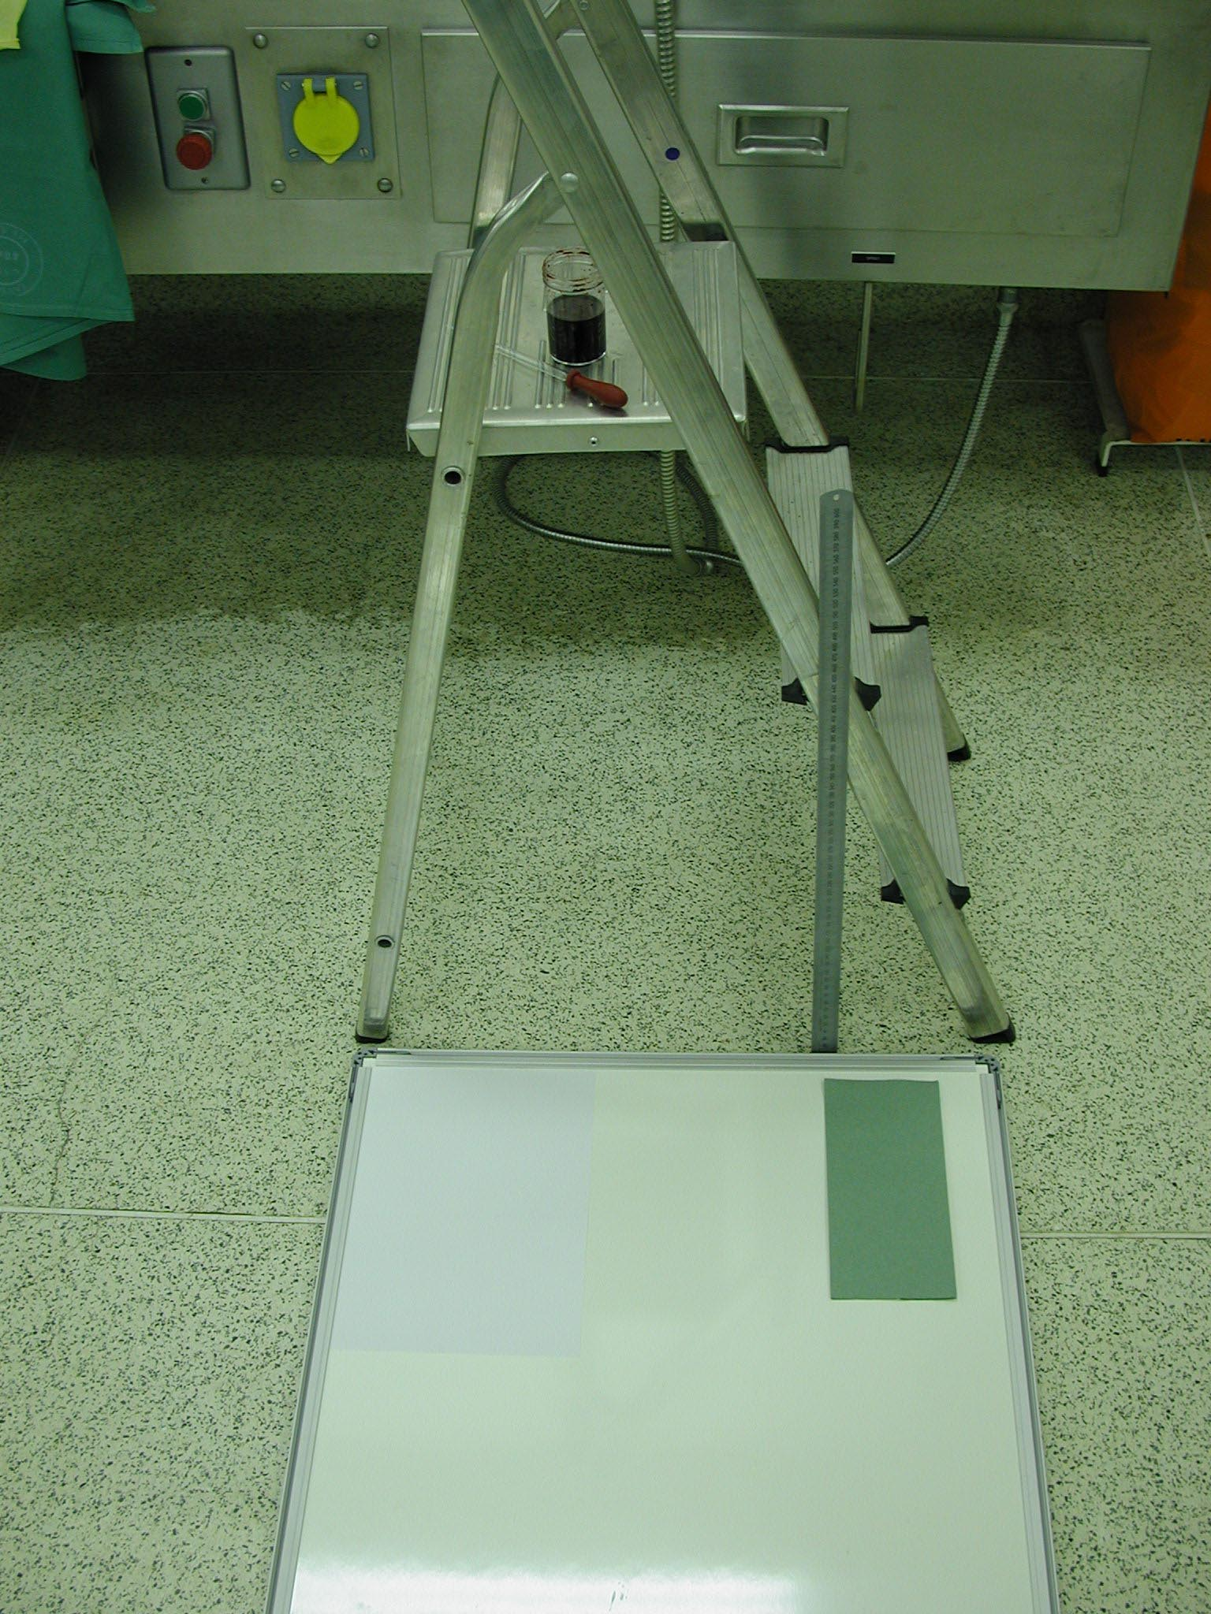
Experiments with Falling Blood Droplets
12
blood
Height
Target Surface
dropper
ruler
Fabric (theatre green)
rough paper towel
paper
whiteboard
Terazzo floor

Slide 35
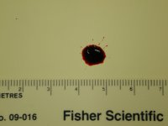
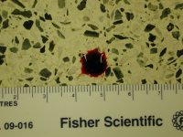
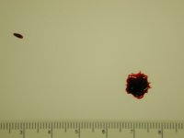
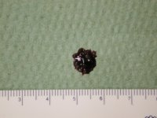
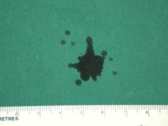
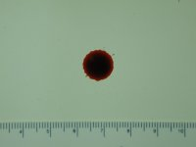
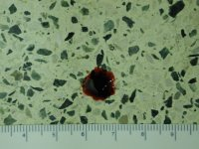
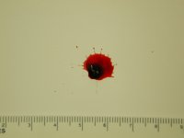
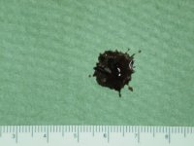
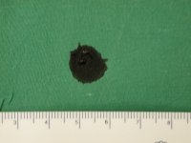
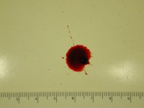
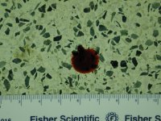
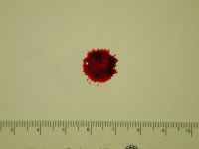
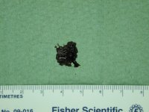
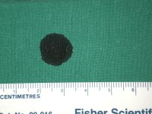
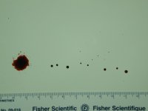
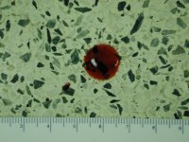
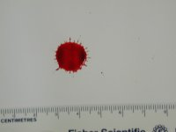
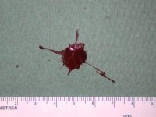
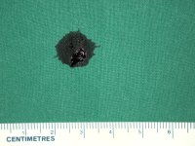
Height/Surface
13
Single drop of blood falling from various heights (m) onto various surfaces
0.5
0.5
1
1
2
2
3
3
smooth
floor
paper
towel
fabric

Slide 36
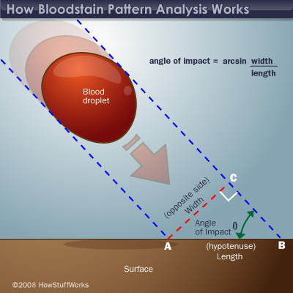
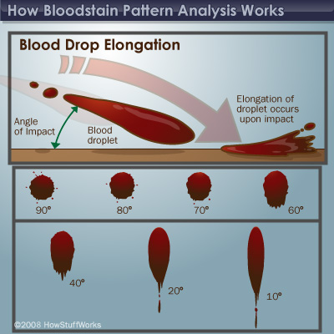
Angle of Impact
14
Adapted from
Introduction to Forensic Sciences,
W. Eckert, CRC, 1997

Slide 37
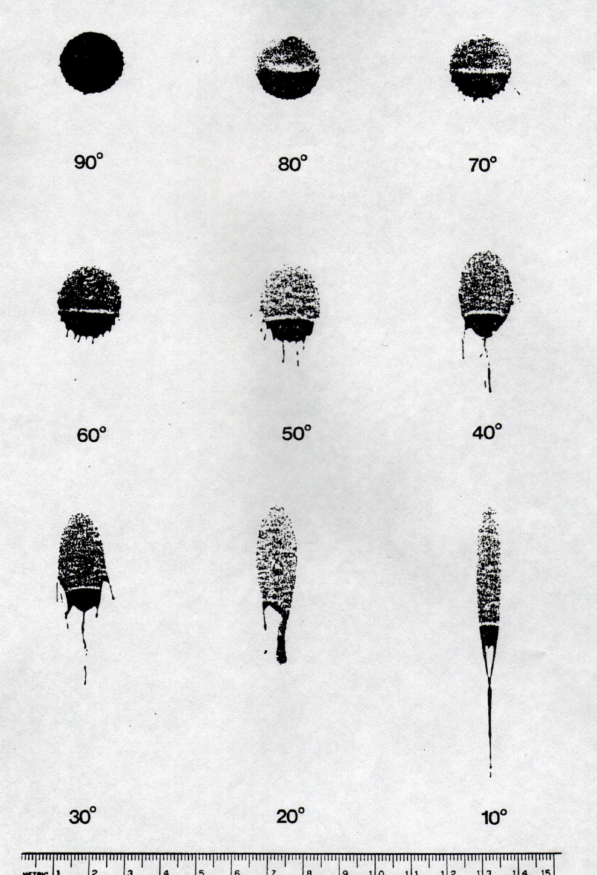
Angle of Impact
14
90°
80°
70°
60°
50°
40°
Gravitational dense zone
at lower edge
30°
20°
10°
Adapted from
Introduction to Forensic Sciences,
W. Eckert, CRC, 1997

Slide 38
Wave Cast-off
15
Tail of elongated stain
points in direction of travel
.
Tail of wave cast-off points
back to parent drop
Parent drop
wave cast-off

Slide 39
Point of Convergence
16

Slide 40
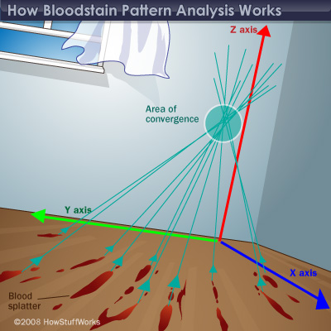
Point of Convergence
16

Slide 41
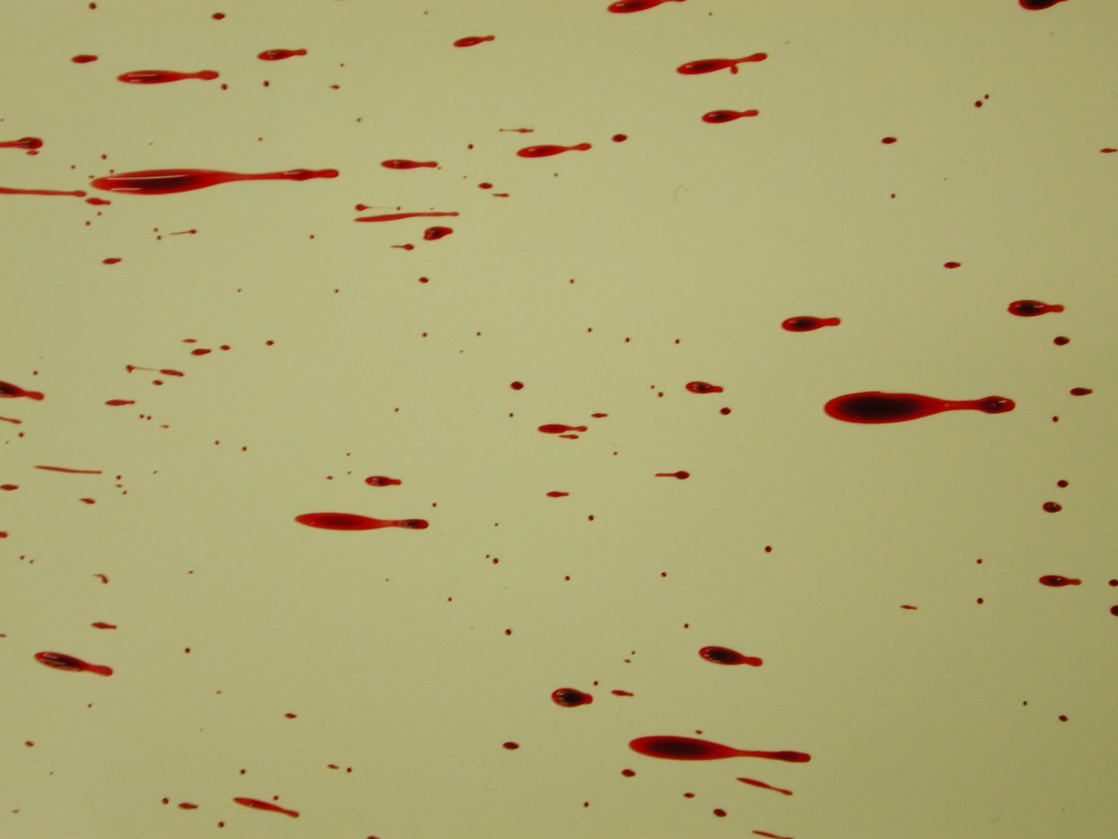
Point of Convergence
17
5 ml blood squirted from a
syringe from height of 1 m

Slide 42
Point of Origin
18
1
length
Origin
width
Height above point of convergence
Angle of impact = arc sin W/L
85°
60°
45°
30°
Distance from point of convergence

Slide 43
Tracing Origin of Bloodspots
19
Point of convergence method
2 dimensional image
Point of origin method
adds 3rd dimension to image
In practice:
use of string & protractor at scene
use of computer at laboratory

Slide 44
Blood Spatter
20
Low velocity (5 f/s, 1.5 m/s)
e.g. free-falling drops, cast off from weapon
Medium velocity (25 - 100 f/s, 7.5 - 30 m/s)
e.g. baseball bat blows
High velocity (>100 f/s, 30 m/s)
e.g. gunshot, machinery

Slide 45
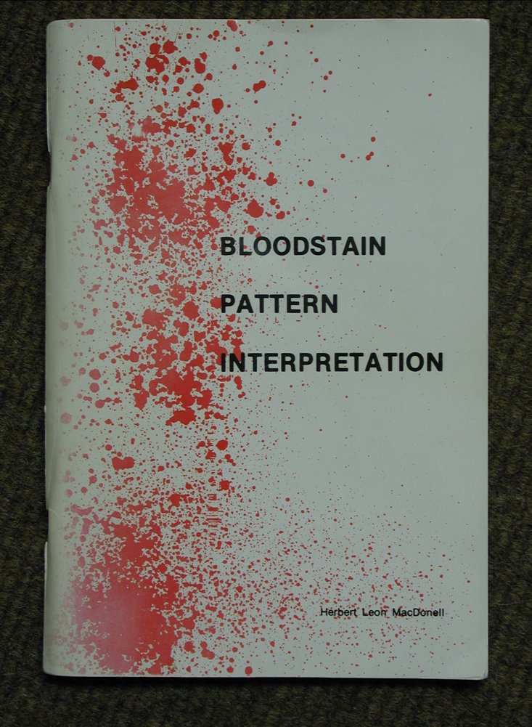
Herbert Leon MacDonell,
Laboratory of Forensic Science,
P.O. Box 1111,
Corning,
New York,
14830,
USA
21

Slide 46
Low Velocity Blood Spatter
22
Blood source subjected to LV impact
< 5 f/s (1.5 m/s)
Spot diameter: mostly 4 - 8 mm
some smaller, some larger
Free-falling drops (gravity only)
Cast off from fist, shoe, weapon
Dripping
Splashing
Arterial spurting

Slide 47
Cast-off from Weapon
23
First blow causes bleeding
Subsequent blows contaminate weapon with blood
Blood is cast-off tangientially to arc of upswing or backswing
Pattern & intensity depends on:
type of weapon
amount of blood adhering to weapon
length of arc

Slide 48

Downswing of Hammer
24

Slide 49
Cast-off from Weapon
25
ceiling

Slide 50


Overhead swing with bloodied metal bar
26

Slide 51
Cast-off Pattern (1/2)
27

Slide 52
Cast off Pattern (2/2)
28
1
2
3

Slide 53
What does this tell you?
29

Slide 54
Cast off Pattern (2/2) Sequence?
29

Slide 55
Cast off Pattern (2/2) Sequence?
30
1
(4 spots)
2
(3 spots)
3
(2 spots)
If weapon does not pick up more blood, spatter from subsequent backswings becomes progressively less.
In practice weapon picks up more blood with each successful blow.

Slide 56

Three overhead swings with hatchet
31

Slide 57

Cast-off & medium velocity spatter
32

Slide 58

Cast-off & medium velocity spatter 2
33

Slide 59
Cast-off Pattern.
34

Slide 60
Cast-off Pattern from hand
35

Slide 61

Cast-off pattern from bloodied hand swung in front of target
36
6” ruler

Slide 62
Drip Pattern
37
Free-falling drops dripping into wet blood
Large irregular central stain
Small round & oval satellite stains
.
.
.
.
.
.
.
.
.
.
.
.
.
.
.
.
.
.
.
.
.

Slide 63

Drip 1:
38
Blood dripping into itself from height of 1 m (8 drops)

Slide 64

Drip 2
Blood dripping into itself from height of 1 m (8 drops)
39

Slide 65

Dripping onto steps
40

Slide 66
Splash Pattern
41
Volume > 1 ml
Subjected to LV impact
Thrown
Tipped
Large central irregular area surrounded by elongated peripheral spatter pattern

Slide 67

Splash 1
42
5 ml blood squirted from a syringe from a height of 1 m

Slide 68

Splash 2
5 ml blood squirted from a
syringe from a height of 1 m
43

Slide 69

Splash 3
44
5 ml blood squirted from a syringe from a height of 1 m

Slide 70

Splash onto vertical surface
45
10 ml blood thrown 1 m onto
a vertical target surface
6” ruler

Slide 71

Stamping in blood 1
46
Area seen in close-up
in next slide

Slide 72

Stamping in blood Close-up of heel area
47

Slide 73

Stamp 1
48
Blood pool (10 drops) before stamping

Slide 74

Stamp 2
49
Blood pool (10 drops) after stamping

Slide 75
Arterial Spurt Pattern
50
Blood exiting body under arterial pressure
Large stains with downward flow on vertical surfaces
wave-form of pulsatile flow may be apparent

Slide 76

Small arterial spurt
51
spatter
broken pottery

Slide 77

Neck incisions (scene)
52

Slide 78

Neck incisions
53
‘Hesitation’ injuries
Probe in carotid artery
Thyroid cartilage

Slide 79
Medium Velocity Blood Spatter
54
Blood source subjected to MV impact
(25 - 100 f/s, 7.5 - 30 m/s)
Spot diameter: mostly 1 - 4 mm
Blows with weapon (e.g. baseball bat)

Slide 80

Medium velocity blood spatter. Point of impact 15 cm in front of vertical target surface
55
6” ruler

Slide 81

Flick 1:
Blood flicked between
middle finger & thumb
onto a vertical smooth surface
from a distance of 15 cm
56

Slide 82

Blood flicked between
middle finger & thumb
onto a vertical smooth surface
from a distance of 15 cm
Flick 2:
57

Slide 83
High Velocity Blood Spatter
58
Blood source subjected to HV impact
> 100 f/s, 30 m/s
Fine mist: spot size < 0.1 mm
Small mass limits spread to 1 m
!Some larger droplets reach further
Gunshot
back-spatter from entry wound
forward spatter from exit wound
High speed machinery

Slide 84

Gunshot: back& forward spatter
59
Bloodstained foam held just above target surface.
Bullet passing L to R just above sheet
bullet exits foam
Bullet enters
foam
bullet
Back-spatter
on entry
Forward spatter
on exit

Slide 85
Gunshot Back Spatter
60
Arises from entrance wound
Passes back towards weapon & shooter
Seen only at close range of fire
Seen on:
inside of barrel
exterior of weapon
hand, arm, chest of shooter

Slide 86

Back spatter on steadying hand
61

Slide 87
Gunshot Forward Spatter
62
Arises from exit wound
Passes forwards in same direction as shot
More copious than back-spatter
Can be seen at any range of fire
Seen on nearby surfaces, objects, persons
especially on wall behind victim

Slide 88

Forward spatter (5 ms after bullet impacted at 1000 f/s)
63
bullet
blood soaked
target
2.5 cm

Slide 89

Forward spatter onto target placed 15 cm behind point of HV bullet impact (bullet passing towards screen) 1
64
6” ruler

Slide 90

Forward spatter (closer view)
65

Slide 91

Forward spatter (closest view)
66
5 mm

Slide 92
Wipe Patterns
67
Object moves through a wet bloodstain
Feathered edge suggests direction

Slide 93
Transfer Patterns
68
Wet, bloodied object contacts a secondary surface
Transfer from:
hand, fingers
shoes, weapon
hair
Transfer to:
walls, ceilings
clothing, bedding
Produces mirror-image of bloodied object

Slide 94

Transfer from hair (hair-swipe) 1
69

Slide 95

Transfer from hair (hair-swipe) 2
70

Slide 96

Flow Patterns
71
Blood flows horizontally & vertically
Altered by contours, obstacles
Often ends in pool

Slide 97

Flow pattern
72

Slide 98

Trapped!
73

Slide 99

Stabbing 1
74

Slide 100

Stabbing 2
75

Slide 101

Blood flow on shirt
76
Horizontally to R side

Slide 102

Pattern on shirt
77

Slide 103

Bloodspots on trousers
78

