Slide 1
May 1st, 2016
Minnowbrook Forensic Science Workshop
an omnium-gatherum
of Latent Print topics
David Tate, MS, CLPE
Latent Print Examiner
dptate@syr.edu

Slide 2
omnium–gatherum
noun om·ni·um–gath·er·um \ˌäm-nē-əm-ˈga-thə-rəm\
Popularity: Bottom 10% of words
Definition of omnium–gatherum
plural omnium–gatherums
: a miscellaneous collection (as of things or persons)
http://www.merriam-webster.com/dictionary/omnium-gatherum

Slide 3
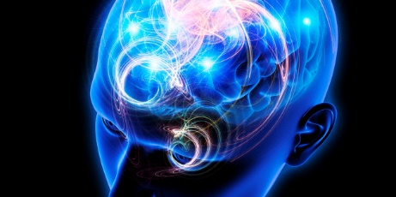
http://i.huffpost.com/gen/1574293/images/n-BRAIN-EYE-628x314.jpg

Slide 7
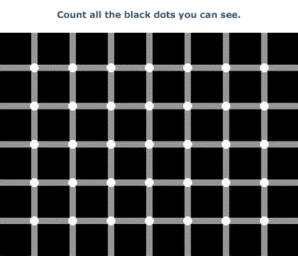

Slide 8
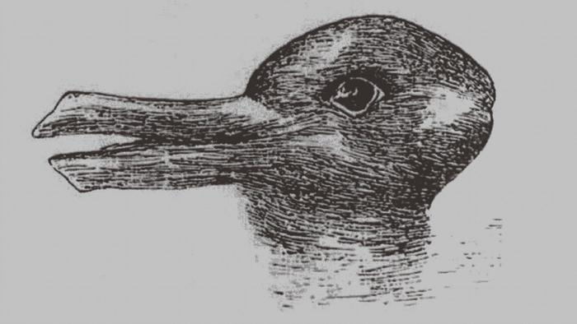

Slide 9
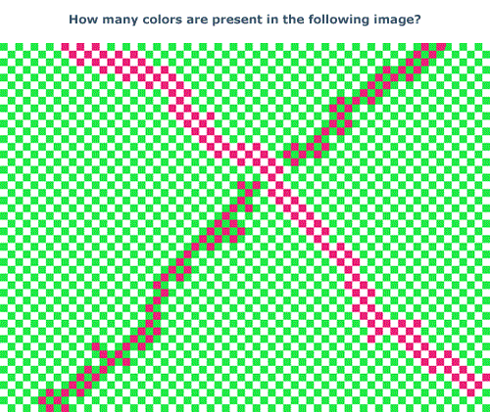

Slide 10
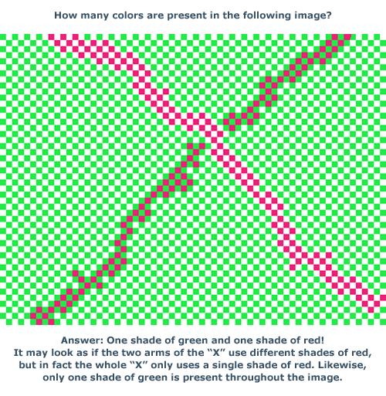

Slide 11
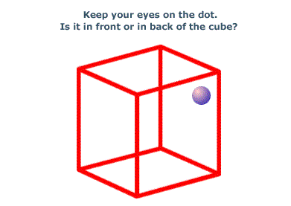

Slide 12
CONTEXT IS EVERYTHING

Slide 13
Selective Attention

Slide 14
video

Slide 31
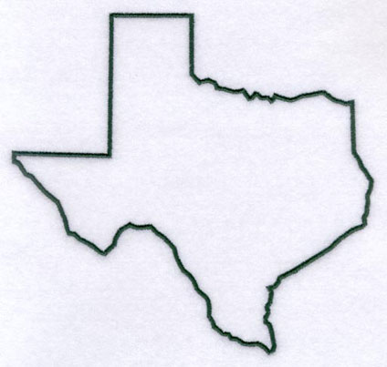

Slide 32
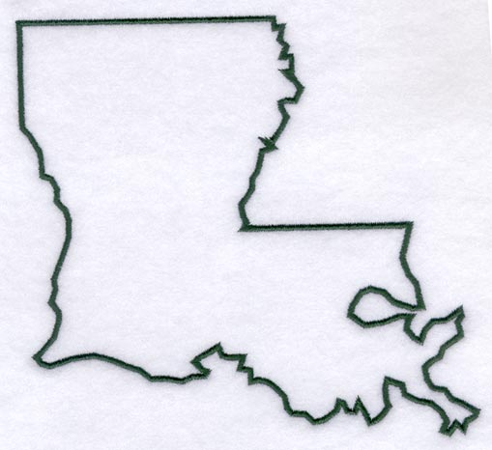

Slide 33
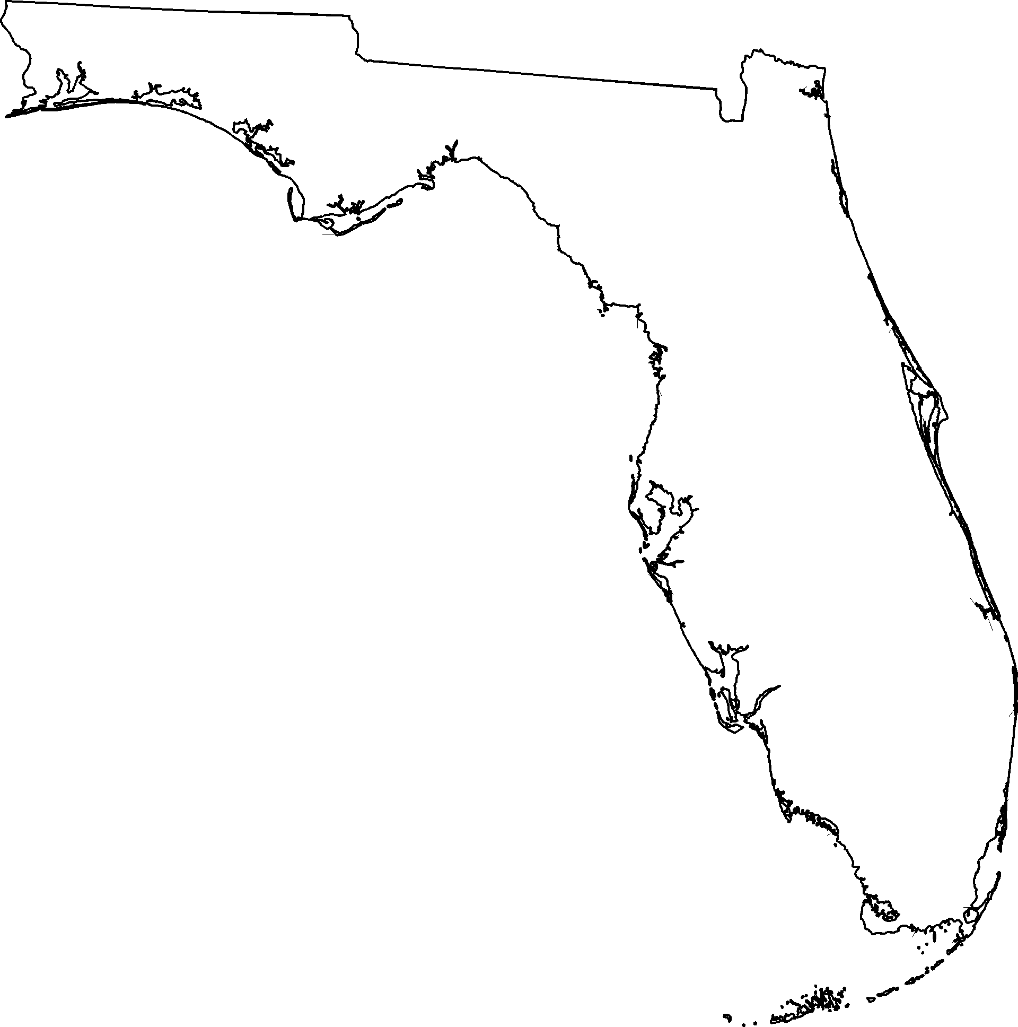

Slide 35
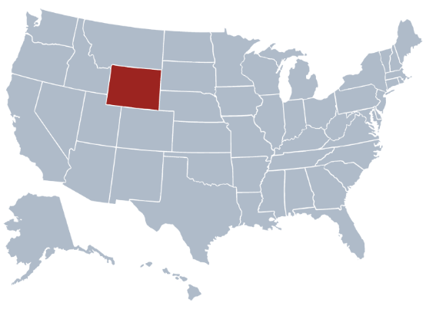

Slide 36
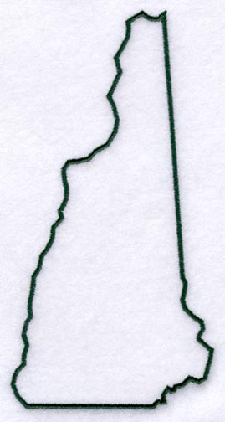

Slide 38
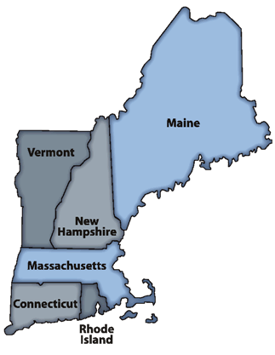

Slide 41
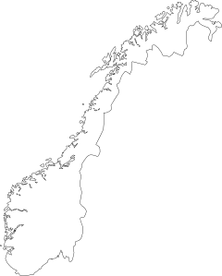

Slide 43
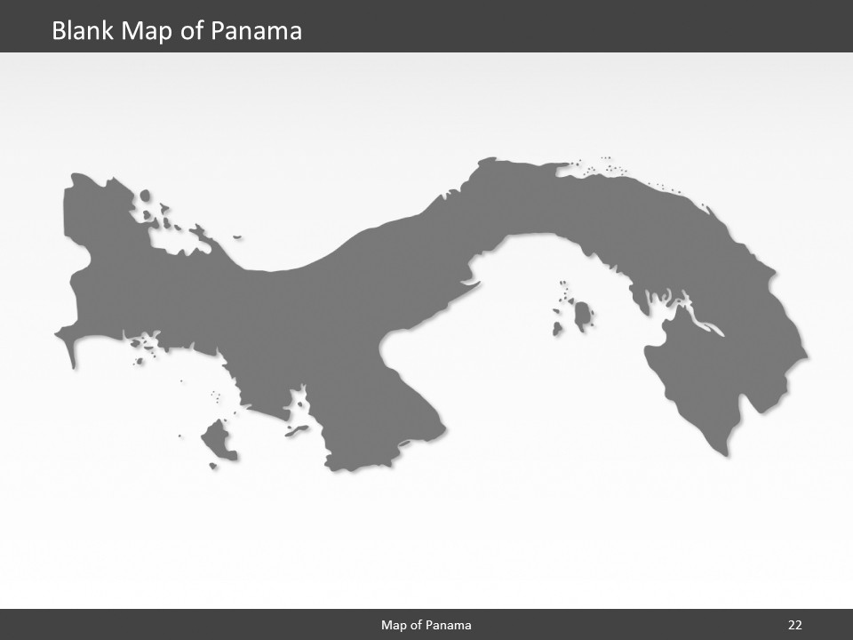

Slide 44
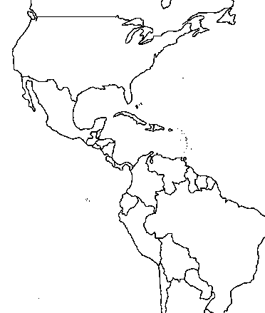
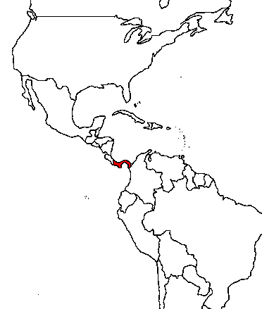

Slide 47
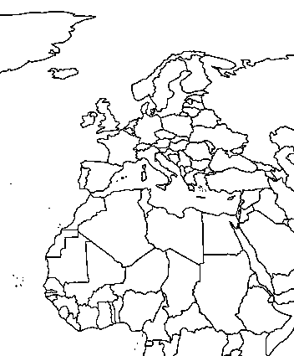
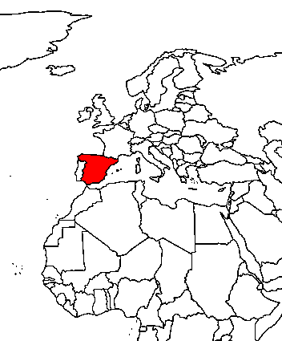

Slide 48
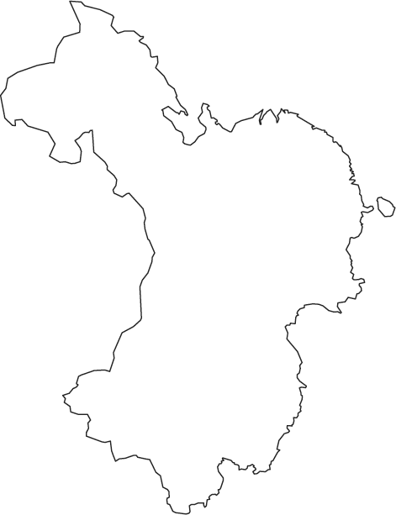

Slide 49
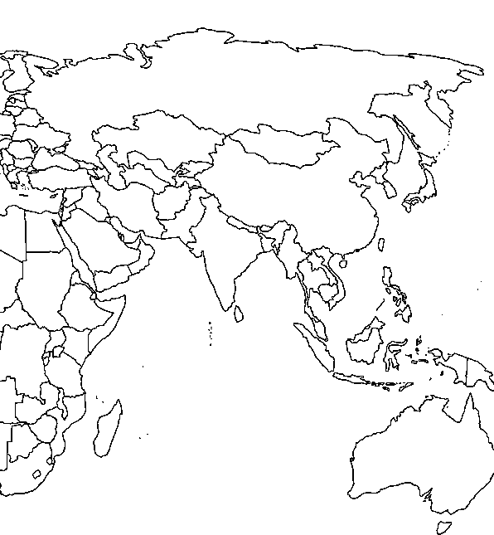
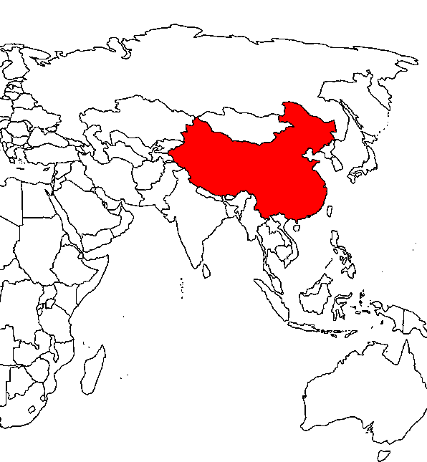

Slide 50
video

Slide 52
Is this a fingerprint?

Slide 53
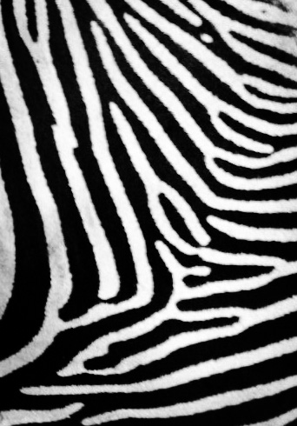

Slide 54
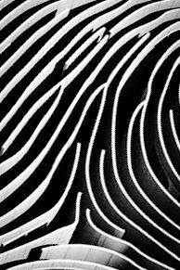

Slide 57
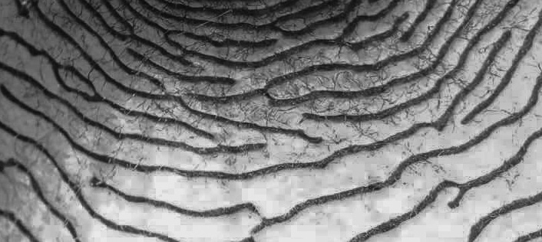

Slide 58
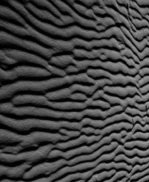

Slide 60
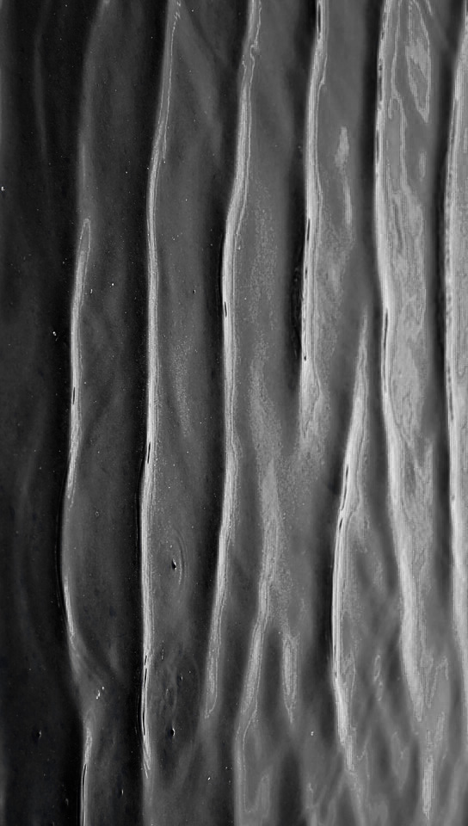

Slide 61
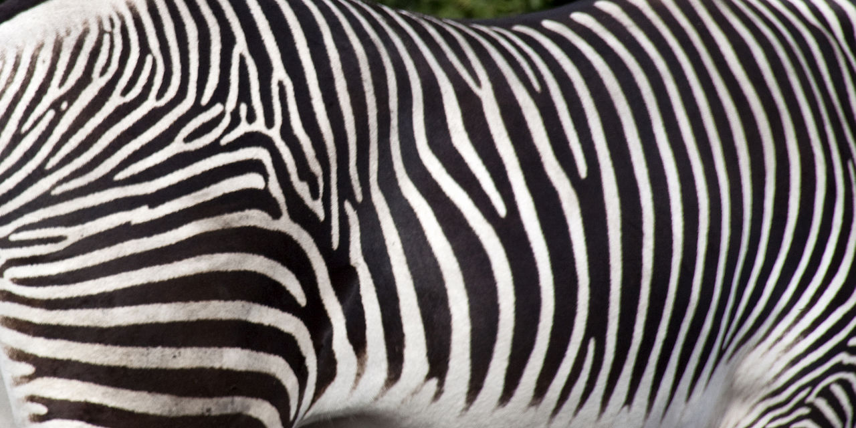

Slide 62
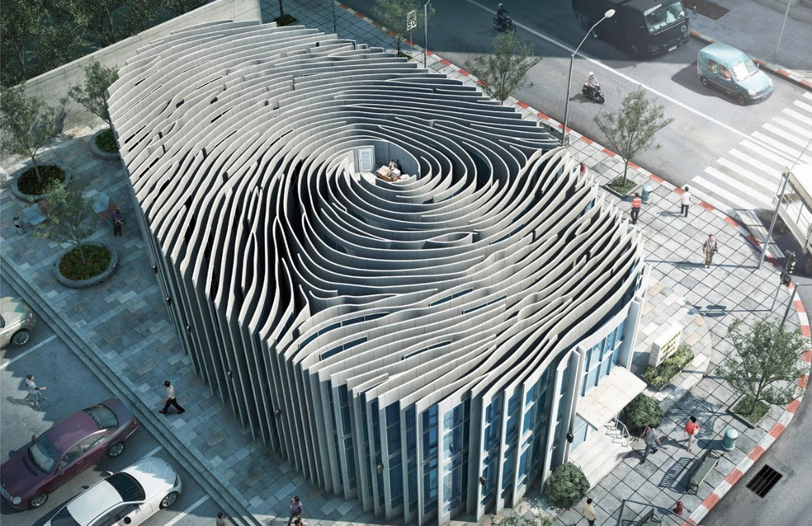

Slide 63
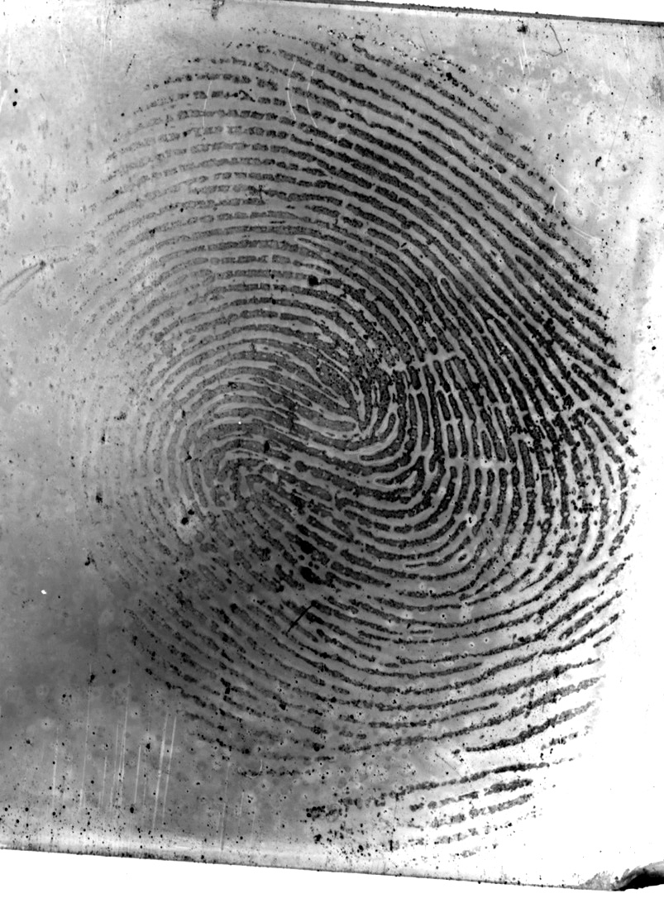

Slide 64
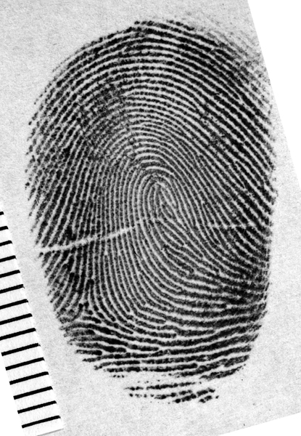

Slide 65
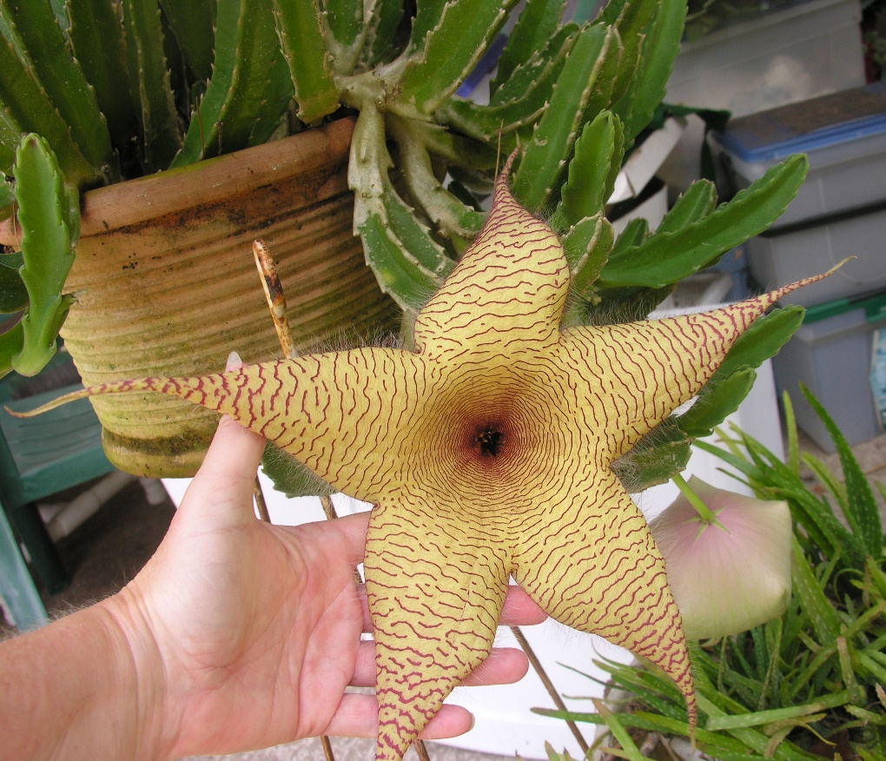

Slide 66
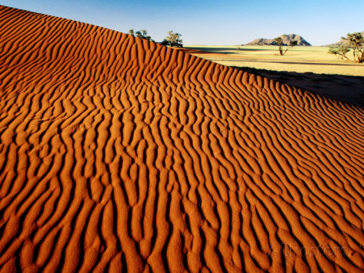

Slide 69
Inductive Reasoning and the Latent Print
Identification

Slide 70
Identification
The determination by an examiner that there is sufficient quality and quantity of detail in agreement to conclude that two friction ridge impressions originated from the same source.

Slide 71
Identification
The determination by an examiner that there is sufficient quality and quantity of detail in agreement to conclude that two friction ridge impressions originated from the same source.

Slide 72
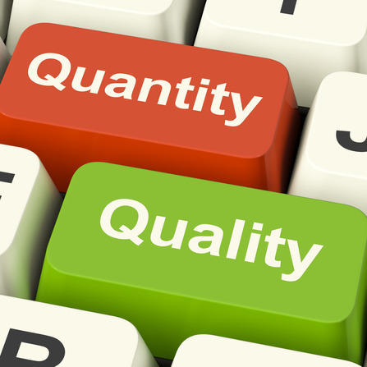
Identification
The determination by an examiner that there is sufficient quality and quantity of detail in agreement to conclude that two friction ridge impressions originated from the same source.

Slide 73
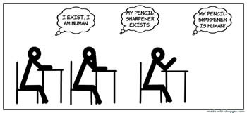
Identification
The determination by an examiner that there is sufficient quality and quantity of detail in agreement to conclude that two friction ridge impressions originated from the same source.
http://www.differencebetween.info/difference-between-inductive-reasoning-and-deductive-reasoning

Slide 75
llusions
http://www.optics4kids.org/home/content/illusions/
Double Loop Podcast
https://soundcloud.com/double-loop-podcast

Slide 77
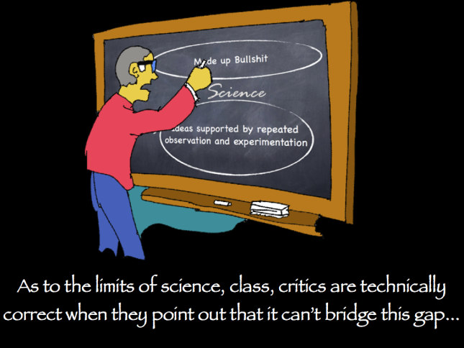

Slide 78
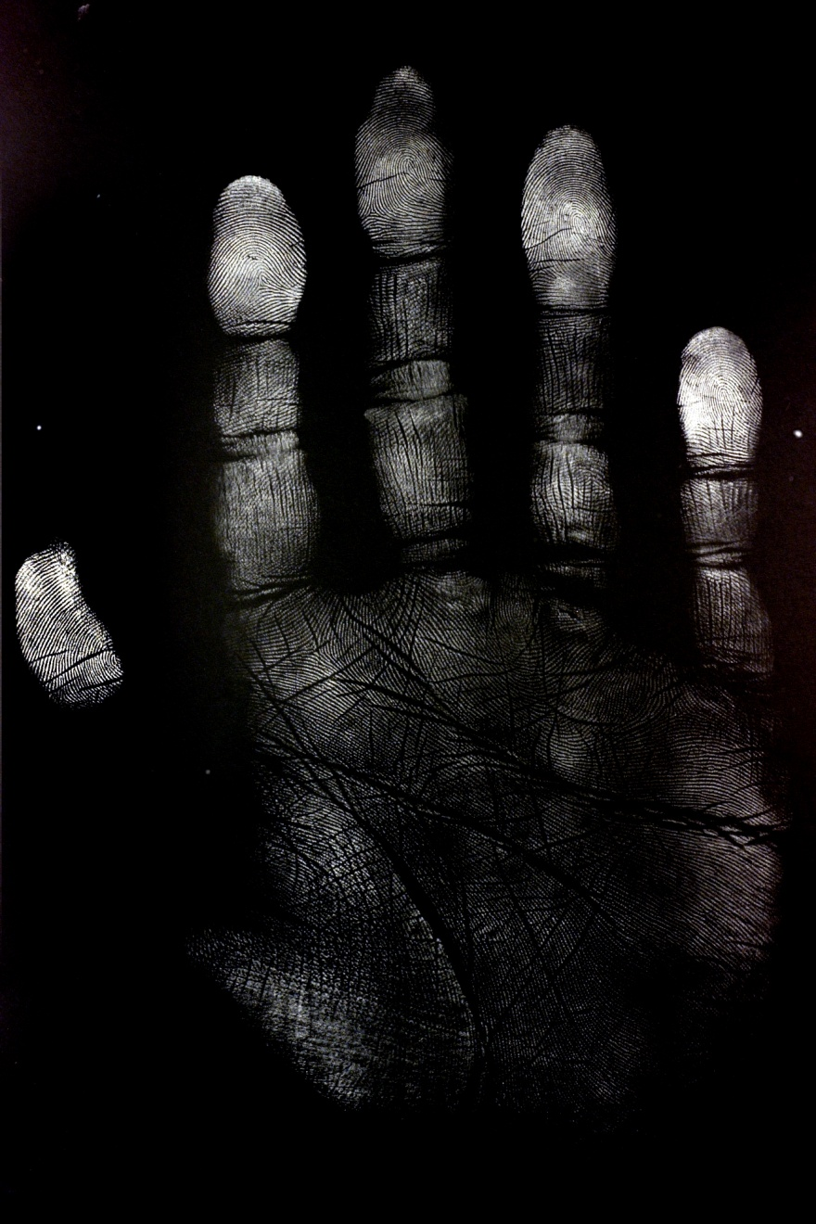
QUESTIONS?

Slide 79
THANK YOU !
QUESTIONS?

