Slide 1
Firearms in the Class Room
Matt Kurimsky
Syracuse University
Forensic Firearms Instructor

Slide 2
Contact Info
Matt Kurimsky
Syracuse University Forensic and National Security Sciences Institute- Firearms Instructor
Onondaga County Center for Forensic Science, Firearms Unit –Firearms Examiner
mtkurims@syr.edu

Slide 3
Overview
Legal Issues
Equipment Needed
Supply Resources

Slide 5
Know Your Laws
Understand that there are both Federal and Local Laws prohibiting firearms on school property.
Exceptions include: Sworn Law Enforcement Officers (LEOs) and citizens with written authorization from the superintendent or chief authority for that school.

Slide 6
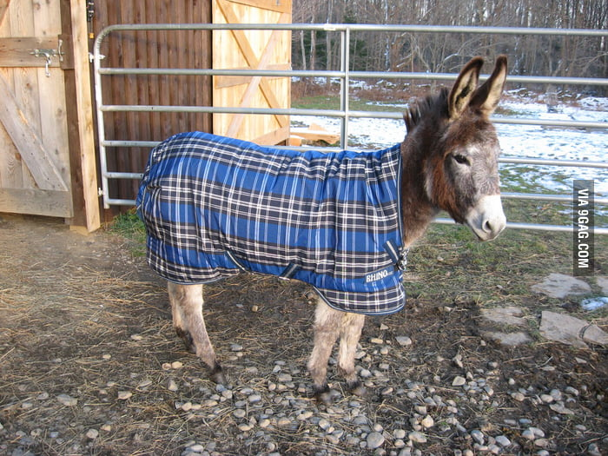
CYA
Verbal authorization is not sufficient to protect your self. Most schools have weapon policies that are far more restrictive than what is dictated by law. Even if you have no weapons or live ammunition, I strongly suggest you get written authorization for firearm related materials you intend to bring on campus!

Slide 7
General Rules Regarding Firearms
Note in NYS we are in the midst of new regulations that are being challenged in court. All information is subject to change.

Slide 8
Safe Act Info

Slide 9
Fed Regs

Slide 10
Short Version
No felons
No convictions for Domestic Violence
No involuntary mental health commitments
ITAR Regs

Slide 11
A few words of caution
This is a topic that requires student maturity.
Keep a tab on sensitive items.
Cartridge cases are not banned but you do not want them showing up in the parking lot to suggest your school may have been the scene of a shots fired incident.

Slide 12
Consider ID Marks/Loss Prevention

Slide 13
Fired Component ID

Slide 14
Beware of BS
Keep in mind that certain professions are often assumed to be knowledgeable with firearms, this may not be a safe assumption.

Slide 15
Vet Your Sources!!!!!

Slide 16
Recent Proof

Slide 17
SWAT Standoff

Slide 18
Sources
Peer reviewed journals
AFTE, IAI, JFS

Slide 19
How to Teach Firearms….Without Firearms

Slide 20
alternative

Slide 21
What do you need ?
Stereo scopes (low power dissecting type)
Calipers (dial type is best)
Reloading Balance
Bunsen burners or hand torch and probes
Diphenylamine Reagent
Bullet Maps?

Slide 22
Bullet Maps
Offered by major bullet manufactures
Hornady, Sierra, Nosler
Call customer service ask for a few samples (If you ask for 4-5 paper maps they should send them free of charge)
The maps help students link actual diameter to the caliber class

Slide 23
Caliper and Scales
Scales must be able to use grains
Digital calipers are either cheap or high quality, never both. Go dial!

Slide 24
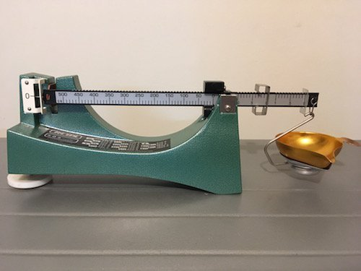
Scales/balances
Beam and digital-both work

Slide 25
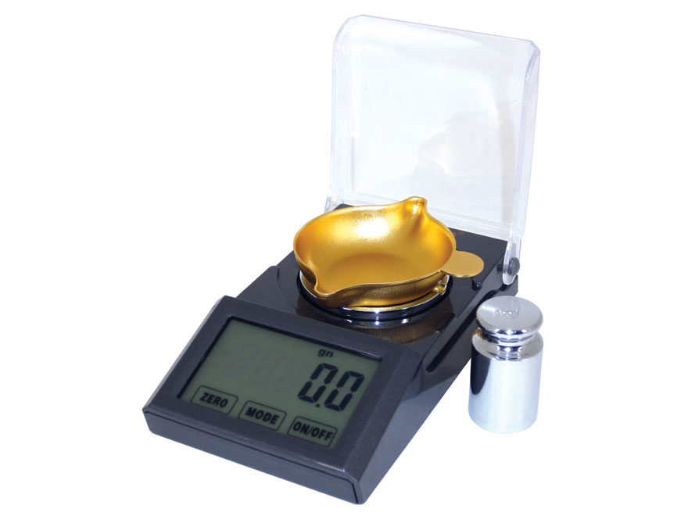
Scales/Balances
Digital-make sure it reads in grains and can be plugged in. Cheap ones are often battery only

Slide 26
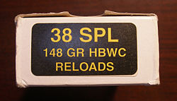
Grains
1lb = 7000 grains
Used for powder and projectiles

Slide 27
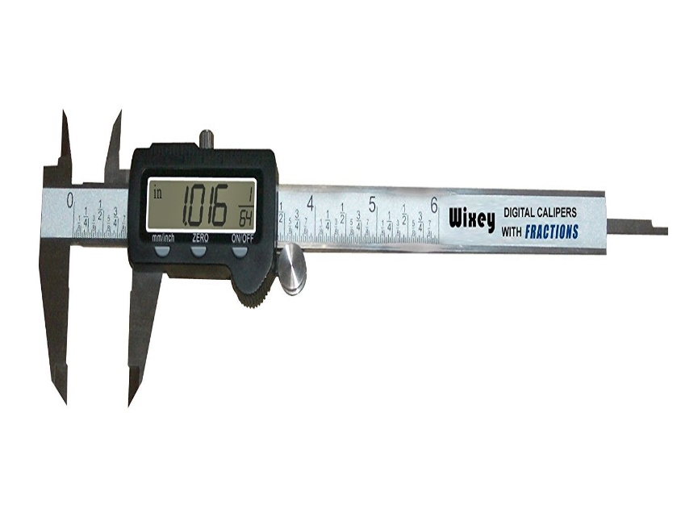
Calipers
Digital or analog

Slide 28
Calipers

Slide 29
Caliper USE

Slide 30
Supply Resources
Midway USA
Brownells
Cabelas
Local Gunshops (those that carry reloading supplies)
Larger orders best source is Rocky Mountain Reloading!

Slide 31
Supplies- plan ahead
Political and social events have had unprecedented impacts on firearm and ammunition availability. Plan far ahead to ensure you have adequate supplies.
Months not weeks.
FCCs can be obtained cheaply or for no cost at all
Bullets are typically ordered in boxes of 100 with an average cost of about $20 per box

Slide 33
Ammo/component availability

Slide 34
A suggestion…..
Let family and friends know your teaching firearms. You would be surprised at the number of donations people have made to support these types of programs. Consider reaching out to your local LE agency. See me during a break for suggestions on how to do this.

Slide 35
Agreement
This workshop is designed to give you the tools, but I am asking that all attendees that will teach forensic firearms understand the critical need and agree to cover basic firearms safety at the start of the firearms unit.

Slide 36
DEA Agent Demo

Slide 37
Safety Considerations
Don’t try this at home
Youtube and other outlets have some really neat videos, many of which are very unsafe

Slide 38
Safety

Slide 39
Safety

Slide 40
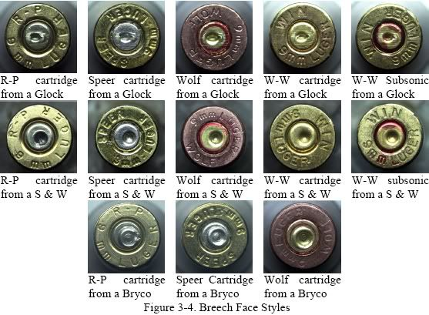
Firearms Lab Exercises
Class Char. –cartridge cases

Slide 41
What's needed
Stereomicroscope (dissecting type)
Fired cartridge cases from at least 4 different types of firearms
Suggestions include: Glock pistols, S&W Shield Pistols, Hi-Point pistols, rimfire rifles
If you don’t know where to get these locally, drop me a line and I will arrange to get you samples
Cartridge Reference (optional but recommended)
First step in forensic ID process for FCCs and bullets

Slide 42
Reference Suggestion

Slide 43
Bullet Class Char/Caliber Determination

Slide 44
Bullet Lab-what’s needed
Calipers
Balance
Stereomicroscope
Bullet maps
Fine tipped sharpie markers

Slide 45
Bullet class Char.

Slide 46
Bullet Class Char.
Rifling type
Number of Limps/Gimps
Direction of Twist
Widths of the Limps/Gimps
Caliber

Slide 47
Bullet Class Char.

Slide 48
What’s Caliber?
Nominal vs Specific
Nominal: base diameter of the bullet
Specific: all the critical measurements that go into making a cartridge

Slide 49
Nominal Vs Specific

Slide 51
Remember the exception
At the base or the widest point

Slide 53
Powder ID
What’s needed
Reference powder samples or Profiles in Propellants Book
Stereomicroscope
Bunsen burner and probe
Optional- Diphenylamine Test
Typically done during shooting reconstruction/GSR testing

Slide 54
Gunpowder-1lb cans

Slide 55
Make sure you Get Smokeless

Slide 56
Or

Slide 57
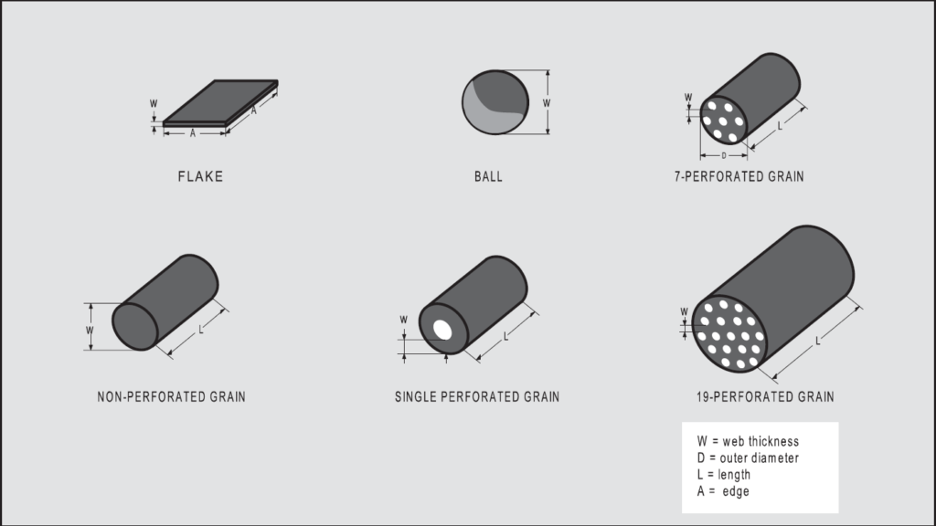
Powder ID
Morphological exam

Slide 58
Powder ID

Slide 59
Powder ID
Preservation of Evidence Sample with a standard microscope slide and coverslip

Slide 60
Hot Probe-only 1 grain of powder needed

Slide 61
Hot Probe
Only 1 grain of suspected gunpowder needed
Keep the stock powder away from the test area
Positive result is vaporization

Slide 62
Shooting Reconstruction

Slide 63
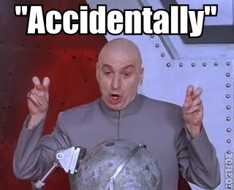
Shooting Reconstruction
Done when its self defense or

Slide 64
What’s needed
Target/Victim
Density and Diameter
Intended to determine the muzzle to target distance
Can provide you with digital copies of known/unknown, send a flash drive

Slide 65
Shotgun Reconstruction

Slide 66
Final Note
Can’t find materials, send me an email and let me know how I can help
Consider making a field trip and we will make up samples for you
Thank you for your interest in safely teaching forensic firearms

